Slide 1
Performance and Productivity Evaluation of Hybrid-Threading HLS versus HDLs
Gongyu Wang
Ph.D. candidate, ECE,
University of Florida
Dr. Herman Lam
Dr. Alan George
Professors of ECE,
University of Florida
Glen Edwards
Convey Computer (Now Micron)
09/16/2015

Slide 2

Agenda
Introduction
  Reconfigurable computing
  Motivation and approach
Overview of Convey Hybrid-Threading (HT)
Design flow comparison: HT versus HDL
Reference kernels
  Sobel, Breadth-first search, Smith-Waterman
Results
  Performance, resource utilization, and productivity
Conclusions

Slide 3
Reconfigurable Computing (RC)
What is RC?
  Computer architecture combining flexibility of software with high performance of hardware—field-programmable gate arrays (FPGAs)
  Relatively new computing technology with growing popularity
    Limited but growing list of available devices, tools, systems, and apps
Technical advantages
  Great performance for certain applications with need for:
    Customizable parallelism (width, depth), data precision (size, format),
    operations and units (type, quantity), memory structure, etc.
  More power/energy-efficient than fixed processors (CPU, GPU)
Technical challenges
  Programming complexity with adaptive hardware
    Low-level design entry languages with lengthy compilation
  Validation of hardware design is very time consuming

Slide 4

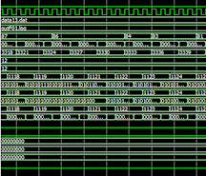
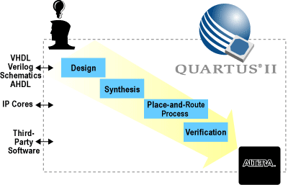
A Closer Look: Challenges with RC
Low-level hardware description languages
(HDLs) limit design productivity
  Steep learning curve
    Requires specifying hardware at register-transfer level (RTL)
    Have to handle data-dependencies and state control
Lengthy simulation/compilation of HDL code
  Need to simulate at RTL level (bit as element)
  Need for comprehensive test benches –
  complex & require significant design time
HDL design validation time consuming
  Need for hardware compilation―synthesis,
  place, & route―taking hours to days
FPGA

Slide 5

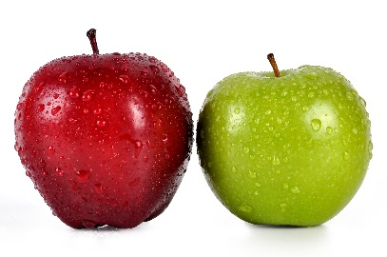

Motivation and Approach
Motivation
  High-level synthesis (HLS) languages and tools improve productivity for RC development
    E.g., Altera OpenCL, Xilinx Vivado, etc.
  But at what cost in terms of performance and resource?
  New HLS―Hybrid-threading (HT) needs evaluation
Approach: Comparative analysis of HT versus HDL
  Using RC-amenable kernels selected from multiple computing domains
  Design flow comparison
    HT versus HDL
  Kernel results
    Performance, resource utilization, design productivity
  Fairness considerations
    Developer expertise, optimization level, algorithm implementation
Notes:
Developer expertise: assuming both HDL and HT developers are already familiar with the tools – enough to carry the design tasks from start to finish.
Optimization level: try to find HDL versions that are fully optimized (according to literature) and then compile them for the target platform using the same settings when it makes sense. Optimize the HT version as much as we can.
Algorithm implementation: try to implement the same algorithms to fulfill the purpose of both HDL and HT, meaning that it is not a good idea to try to do exactly what the HDL is doing when using HT. Should try to use HT in a way that makes sense to software programmers. Such is the purpose and actually strength of HLS.

Slide 6
HT Infrastructure
HIF Software part
  Load FPGA image
  Allocate interface
  Dispatch co-processor
HT unit
  Hardware part of HIF
  Replicated by infrastructure
  Contains modules
HT module
  Private/shared/global variables
  Messaging I/F with HIF & other modules
  Execution pipelines
    Run HT instructions
    Perform thread control
HT instruction
  Basic element of execution
  A set of operations to run within single clock cycle

Slide 7
Hybrid-threading HLS (cont.)
HT programming language
  HT description code: Declare module, its private/shared/global variables, messaging interfaces, etc.
  HT instruction code: Define behavior of each module
#define EX_HTID_W 7
typedef ht_uint48 MemAddr_t;
dsnInfo.AddModule(name=addOne, htIdW=EX_HTID_W);
addOne.AddInst(name=EX_LD);
addOne.AddInst(name=EX_ST);
addOne.AddInst(name=EX_RTN);
addOne.AddHostMsg(dir=in, name=OP1_ADDR)
.AddDst(var=op1Addr);
addOne.AddPrivate()
.AddVar(type=uint32_t, name=vecIdx)
.AddVar(type=uint64_t, name=result);
addOne.AddShared().AddVar(type=MemAddr_t, name=op1Addr);
addOne.AddEntry(func=addOne, inst=EX_LD)
.AddParam(type=uint32_t, name=vecIdx);
addOne.AddReturn(func=addOne)
.AddParam(type=uint64_t, name=result);
addOne.AddReadMem().AddDst(var=op1);
addOne.AddWriteMem();
AddOne
#include "Ht.h"
#include "PersAddOne.h"
#define BUSY_RETRY(b) {if (b) {HtRetry(); break;}}
void CPersAddOne::PersAddOne() {
if (PR_htValid) {
switch (PR_htInst) {
case EX_LD: BUSY_RETRY(ReadMemBusy());
ReadMem_op1((MemAddr_t)(S_op1Addr+
(P_vecIdx*8)));
ReadMemPause(EX_ST); break;
case EX_ST: BUSY_RETRY(WriteMemBusy());
WriteMem((MemAddr_t)(S_op1Addr+
(P_vecIdx * 8)), (P_op1 + 1));
WriteMemPause(EX_RTN); break;
case EX_RTN:
BUSY_RETRY(SendReturnBusy_addOne());
SendReturn_addOne(); break;
default: assert(0);
}}}
HT instruction code
HT description code

Slide 8

Design Flow Comparison: HT vs. HDL
HT’s design is based on high-level language (C/C++-like)
HT’s SystemC-based simulation much faster than HDL simulation
  No need to write interface code between host and hardware
  SystemC simulation was shown to run faster than HDL ones
HT provides commonly used design patterns: e.g., memory partitioning

Slide 9

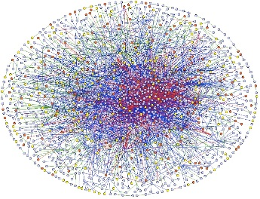

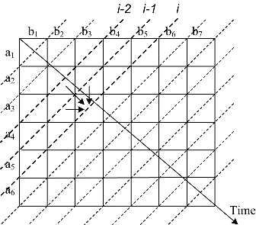
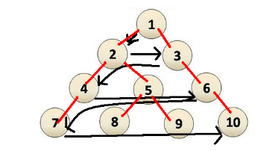
Reference Computing Kernels
Sobel edge detector, Breadth-first search (BFS), and Smith-Waterman Sequence Alignment (SW)
  Multiple RC-amenable computing domain: image processing, graph processing, and bioinformatics
Rationale for kernels
  Why multiple domain?
    Many HLS tools had domain-specific roots
    Performance in one domain does NOT speak for other domains
  Why those three kernels?
    Cover three common computation/memory-access patterns
    Sobel: Streaming
    BFS: Memory-bounded
    SW: Computation-bounded

Slide 10
Sobel Edge Detector
Algorithm
  2D convolution with G_{x} and G_{y} filters (i.e., Sobel filters)
HT design
  Smart buffer as an instance of HT’s stencil buffer
  Streaming interfaces to external memory provided
HDL design
  3x3 access window constructed of registers
  2 FIFOs to buffer input pixels
G_{x}
G_{y}
-1 | 0 | 1
-2 | 0 | 2
-1 | 0 | 1
-1 | -2 | -1
0 | 0 | 0
1 | 2 | 1

Slide 11
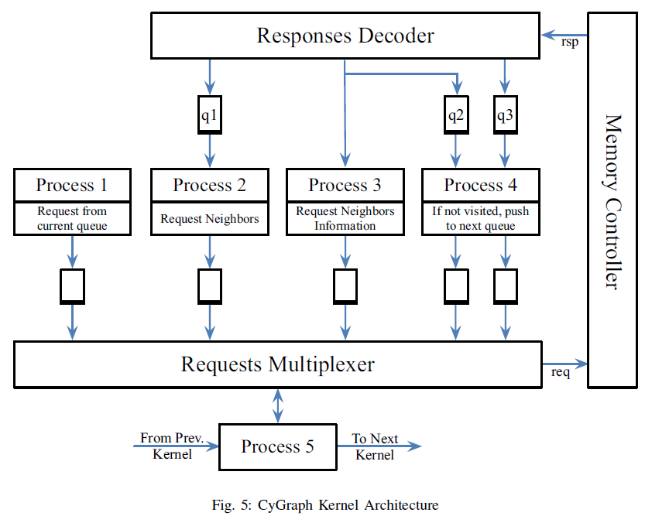
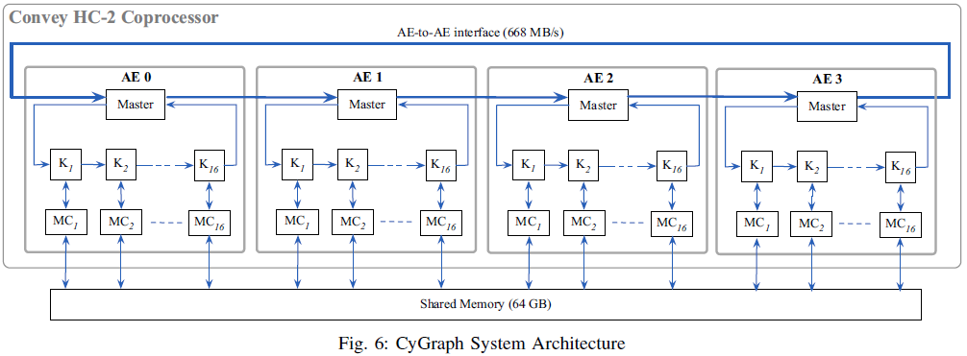
BFS with HDL
CyGraph* on Convey HC-2ex
  Best performance so far*
Design
* Attia, Osama G., et al. "CyGraph: A Reconfigurable Architecture for Parallel Breadth-First Search." Parallel & Distributed Processing Symposium Workshops (IPDPSW), 2014 IEEE International. IEEE, 2014.

Slide 12
BFS with HT
Similar design as CyGraph w/ HT
  Same input/output data format
  Make separate HT module for
  process 4 (Q₁, Q₂, …)
  Use atomics for sync. across HT units
K
Q
Convey HC-2ex
AE0
AE3
Master₁
Master₁₆
Master₁
Master₁₆
atomics
atomics
atomics
atomics
K₁
K₁₆
K₁
K₁₆
Q₁
Q₁₆
Q₁
Q₁₆
MC₁
MC₁₆
MC₁
MC₁₆
Coprocessor Memory (16GB)

Slide 13

Smith-Waterman with HDL
Optimized Verilog code from Convey
  Recompiled after removing detailed area
  constraints for PEs
  Fewer PEs but more
  realistic scenario for
  RC designers
  Fairer comparison
Complex control
logics supporting
480-long query
  4 tiles with each tile
  capable of handling
  120-long query
Graphic courtesy of Convey Computer, source: http://www.conveycomputer.com/files/1113/5085/5467/ConveySmithWaterman6202011.pdf
PE: Processing elements

Slide 14
Smith-Waterman with HT
HT design capable of processing arbitrarily long queries unlike reference HDL design
  Due to ease of programming complex control logics using high-level language
16 HT units
  Each holds 64 PEs
  1024 PEs in total
  Query-database
  module aligns 8-long
  segments of query
  and database seq.

Slide 15

Comparison Study Setup
Target platform: Convey HC-2ex
  Two Xeon X5670 processors (12 cores) on host side
  Four Xilinx Virtex-6 LX760 FPGAs on coprocessor
  64GB host memory and 16GB coprocessor memory
  Xilinx ISE version 14.7 and HT version 1.3 were used
Read-world input data for kernels
  Sobel’s input images are of resolution 640x480, 1280x720, 1920x1080
  BFS’s inputs are random graphs with 2^23 vertices and Nx2^23 edges, where N equals 8, 16, 32, and 64
  SW’s inputs
    Database: Swiss-Prot protein database with 195,014,757 residues in 547,599 sequences
    Queries: P07327, P01008, P03435, and Q9UKN1, featuring various lengths that are shorter and longer than 480

Slide 16
Results
HT can achieve >80% performance of optimized HDL for all three kernels in a fraction of the dev. time
There is non-negligible resource overhead but may be tolerable given the productivity gain

Slide 17

Conclusions
Reconfigurable computing
  Increasing popularity in high-performance computing apps
  Facing design productivity challenges
  High-level synthesis could help improve productivity but
  needs evaluation in tradeoff of performance & resource
HT―new promising HLS―needs evaluation
  Familiar design entry and flexible infrastructure
  Qualitative evaluation of HT’s design flow identifies productivity boost in comparison to HDL
  Quantitative evaluation of performance, resource, and productivity using Three distinctive kernels
  Notable Result: >80% performance of optimized HDL achieved with HT in a fraction of design time
Future work
  Detailed analysis of resource can reveal how much overhead each component of HT infrastructure incurs
  Explore new capabilities provided by HT version 1.5 and beyond
    E.g., Unit-wise messaging, module replication, etc.

Slide 18

Acknowledgements
This work was supported in part by the I/UCRC Program of the National Science Foundation under Grant Nos. EEC-0642422 and IIP-1161022.
Industry partner: Convey Computer

Slide 19

Questions

