Slide 1
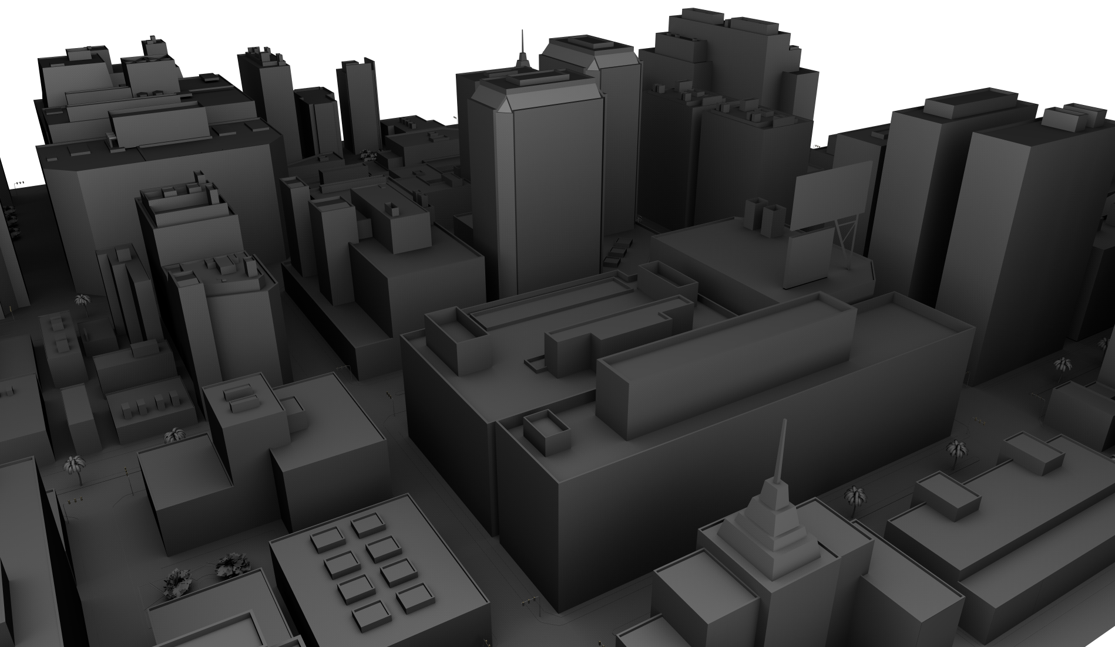
Effective Parallelization Strategies for Scalable, High
Performance Radio Frequency Ray Tracing
Christiaan Gribble & Jefferson Amstutz Applied Technology Operation SURVICE Engineering Company
IEEE High Performance Extreme Computing 17 September 2015

Slide 2
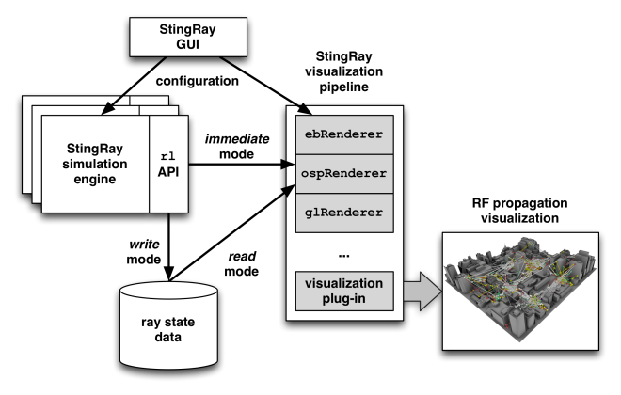
Agenda
Introduction
RFRT : radio frequency ray tracing
StingRay : architecture & core components
2
C. Gribble & J. Amstutz, Effective Parallelization … Radio Frequency Ray Tracing

Slide 3
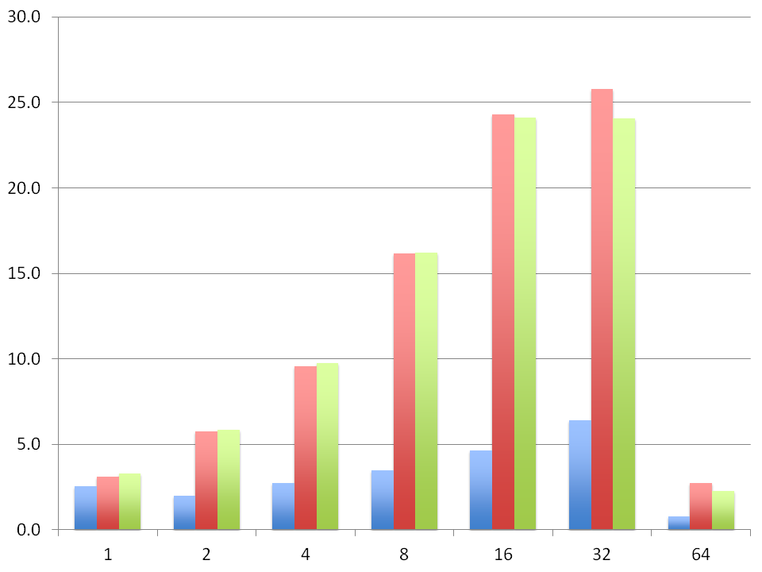
Agenda
Introduction
RFRT : radio frequency ray tracing
StingRay : architecture & core components
Parallel RF simulation
OpenMP parallelization strategies
Results & conclusions
3
C. Gribble & J. Amstutz, Effective Parallelization … Radio Frequency Ray Tracing

Slide 4
Agenda
Introduction
RFRT : radio frequency ray tracing
StingRay : architecture & core components
Parallel RF simulation
OpenMP parallelization strategies
Results & conclusions
Wrap-up
4
C. Gribble & J. Amstutz, Effective Parallelization … Radio Frequency Ray Tracing

Slide 5
Introduction

Slide 6
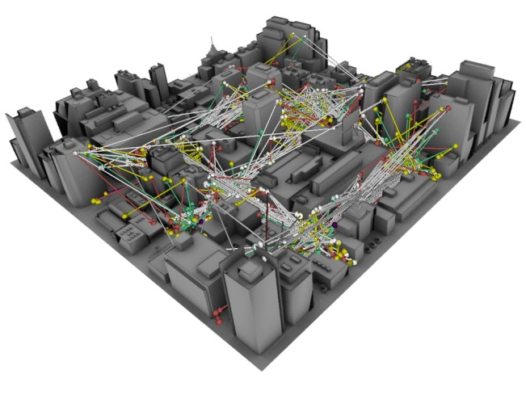
Radio frequency simulation
Radio frequency (RF) propagation
Transmission of radio waves
Behavior affected by various phenomena
6
C. Gribble & J. Amstutz, Effective Parallelization … Radio Frequency Ray Tracing

Slide 7
Radio frequency simulation
Radio frequency (RF) propagation
Transmission of radio waves
Behavior affected by various phenomena
Possible methodology
Empirical models, FEM, 2N-ray models, …
Monte Carlo path tracing
7
C. Gribble & J. Amstutz, Effective Parallelization … Radio Frequency Ray Tracing

Slide 8
RFRT – radio frequency ray tracing
Ray representation
EM wave, same direction of travel
Direction perpendicular to wavefront
8
C. Gribble & J. Amstutz, Effective Parallelization … Radio Frequency Ray Tracing

Slide 9
RFRT – radio frequency ray tracing
Ray representation
EM wave, same direction of travel
Direction perpendicular to wavefront
Ray behavior
Graphics : reflection, refraction
RF simulation : +diffraction, +interference
9
C. Gribble & J. Amstutz, Effective Parallelization … Radio Frequency Ray Tracing

Slide 10
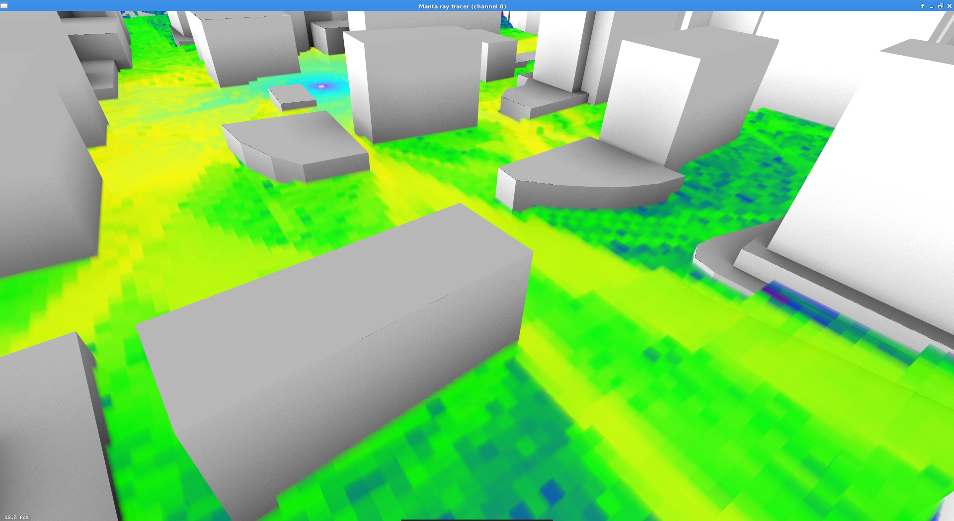
Transmitter
Interference
Line of Sight
Reflection
Diffraction

Slide 11
RFRT – diffraction
Wedge diffraction
without diffraction
with diffraction
scene
object
scene
object
11
C. Gribble & J. Amstutz, Effective Parallelization … Radio Frequency Ray Tracing

Slide 12
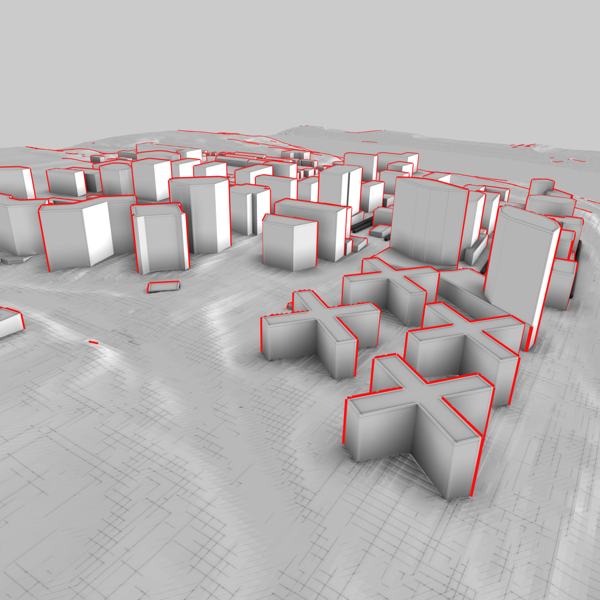
RFRT – diffraction
Wedge diffraction
Diffraction edge proxy geometry
without diffraction
with diffraction
scene
object
scene
object
12
C. Gribble & J. Amstutz, Effective Parallelization … Radio Frequency Ray Tracing

Slide 13
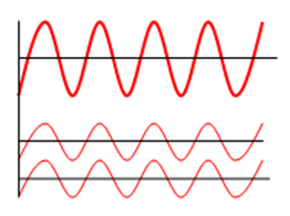
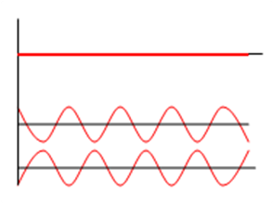
RFRT – interference
Constructive v. destructive
constructive
destructive
[image source: Google images]
13
C. Gribble & J. Amstutz, Effective Parallelization … Radio Frequency Ray Tracing

Slide 14
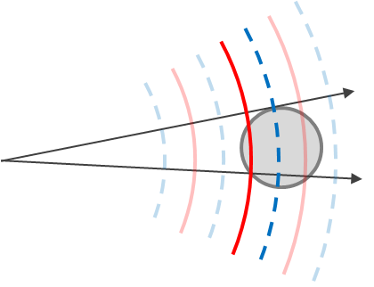
RFRT – interference
Constructive v. destructive
Ray/sensor interaction
constructive
destructive
[image source: Google images]
14
C. Gribble & J. Amstutz, Effective Parallelization … Radio Frequency Ray Tracing

Slide 15
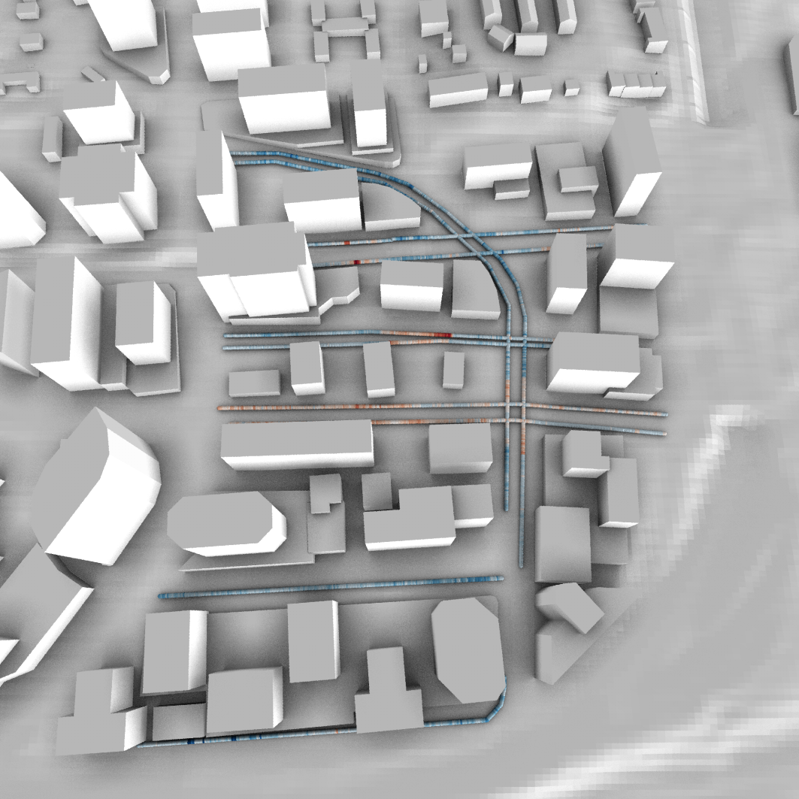
RFRT – validation
RFRT
15
C. Gribble & J. Amstutz, Effective Parallelization … Radio Frequency Ray Tracing

Slide 16
Under estimation
Over estimation
Transmitter

Slide 17
StingRay

Slide 18
StingRay – combined RF sim/viz
Loosely-coupled components
Simulation : Embree
Visualization : OpenGL, OSPRay, …
GUI : Qt5
18
C. Gribble & J. Amstutz, Effective Parallelization … Radio Frequency Ray Tracing

Slide 19
StingRay – combined RF sim/viz
Loosely-coupled components
Simulation : Embree
Visualization : OpenGL, OSPRay, …
GUI : Qt5
Open source project
BSD 3-clause license
Cross-platform support
http://code.survice.com
19
C. Gribble & J. Amstutz, Effective Parallelization … Radio Frequency Ray Tracing

Slide 20
StingRay – simulation engine
Ray-based RF wave propagation
Dominant RF propagation phenomena
Full simulation : Monte Carlo path tracing
20
C. Gribble & J. Amstutz, Effective Parallelization … Radio Frequency Ray Tracing

Slide 21
StingRay – simulation engine
Ray-based RF wave propagation
Dominant RF propagation phenomena
Full simulation : Monte Carlo path tracing
C++ library with straightforward API
Asynchronous multithreaded ray logging
Embree : intersection engine
21
C. Gribble & J. Amstutz, Effective Parallelization … Radio Frequency Ray Tracing

Slide 22
StingRay – visualization pipeline
Loosely-coupled visualization plug-ins
Producer/consumer API
Frame-oriented I/O
22
C. Gribble & J. Amstutz, Effective Parallelization … Radio Frequency Ray Tracing

Slide 23
StingRay – visualization pipeline
Loosely-coupled visualization plug-ins
Producer/consumer API
Frame-oriented I/O
Interactive exploration of results
Online queries of underlying data
OpenGL, OSPRay, …
23
C. Gribble & J. Amstutz, Effective Parallelization … Radio Frequency Ray Tracing

Slide 24
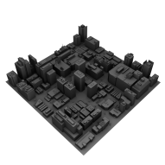
StingRay – visualization capabilities
Scene geometry
Diffraction edges
Ray glyphs
24
C. Gribble & J. Amstutz, Effective Parallelization … Radio Frequency Ray Tracing

Slide 25
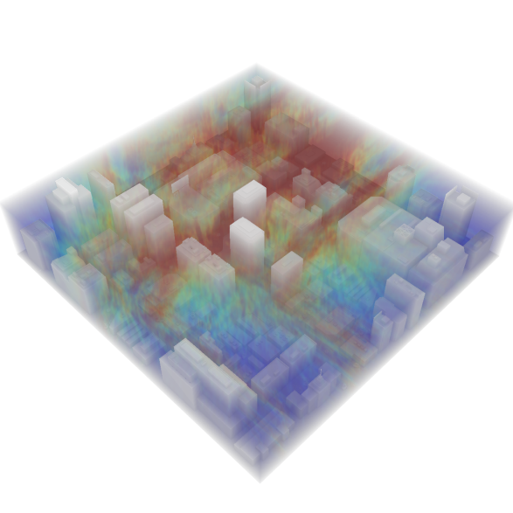
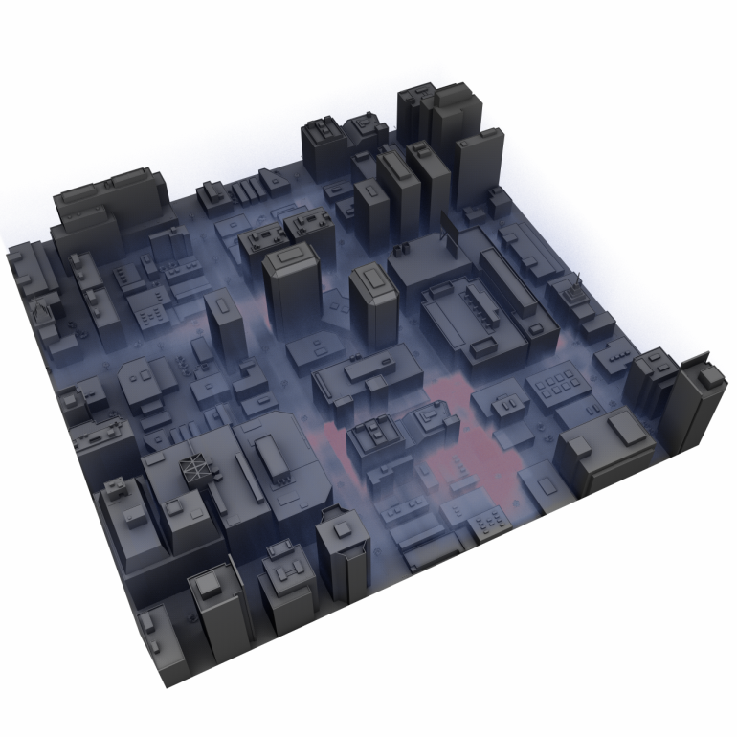
StingRay – visualization capabilities
Scene geometry
Diffraction edges
Ray glyphs
Scalar volume data
Traditional volume rendering
Participating media
25
C. Gribble & J. Amstutz, Effective Parallelization … Radio Frequency Ray Tracing

Slide 26
StingRay – examples
26
C. Gribble & J. Amstutz, Effective Parallelization … Radio Frequency Ray Tracing

Slide 27
StingRay – examples
27
C. Gribble & J. Amstutz, Effective Parallelization … Radio Frequency Ray Tracing

Slide 28
Parallelization

Slide 29
Motivation
Ray coherence
Visibility rays : coherent
Secondary rays : incoherent
visibility
secondary
29
C. Gribble & J. Amstutz, Effective Parallelization … Radio Frequency Ray Tracing

Slide 30
Motivation
Ray coherence
Visibility rays : coherent
Secondary rays : incoherent
Vector processing
Coherent rays
Low-level operations
visibility
secondary
30
C. Gribble & J. Amstutz, Effective Parallelization … Radio Frequency Ray Tracing

Slide 31
Motivation
Ray coherence
Visibility rays : coherent
Secondary rays : incoherent
Vector processing
Coherent rays
Low-level operations
visibility
RFRT is inherently incoherent
secondary
31
C. Gribble & J. Amstutz, Effective Parallelization … Radio Frequency Ray Tracing

Slide 32
RF simulation – core loop
while (running)
{
// Generate path originating from current transmitter
Transceiver* tr = transceivers[txrx%ntxrx];
Path path(tr->samplePrimaryRay(), tr->getPower());
// Trace path to completion
while (!path.traceNextRay(scene))
;
// Record state, advance to next transceiver
…
} // End while
// Simulation has been stopped, finish in-flight paths
// and terminate
…
No path-level parallelism
32
C. Gribble & J. Amstutz, Effective Parallelization … Radio Frequency Ray Tracing

Slide 33
RF simulation – core loop
while (running)
{
// Generate path originating from current transmitter
Transceiver* tr = transceivers[txrx%ntxrx];
Path path(tr->samplePrimaryRay(), tr->getPower());
// Trace path to completion
while (!path.traceNextRay(scene))
;
// Record state, advance to next transceiver
…
} // End while
// Simulation has been stopped, finish in-flight paths
// and terminate
…
No path-level parallelism
Performance baseline
33
C. Gribble & J. Amstutz, Effective Parallelization … Radio Frequency Ray Tracing

Slide 34
RF simulation – core loop
while (running)
{
// Generate path originating from current transmitter
Transceiver* tr = transceivers[txrx%ntxrx];
Path path(tr->samplePrimaryRay(), tr->getPower());
// Trace path to completion
while (!path.traceNextRay(scene))
;
// Record state, advance to next transceiver
…
} // End while
// Simulation has been stopped, finish in-flight paths
// and terminate
…
No path-level parallelism
Performance baseline
About 3.7 million rays/second
34
C. Gribble & J. Amstutz, Effective Parallelization … Radio Frequency Ray Tracing

Slide 35
RF simulation – OpenMP v1
while (running)
{
#pragma omp parallel for num_threads(nthreads)
for (auto i = 0; i < npaths; ++i)
{
…
} // End for
} // End while
// Simulation has been stopped, finish in-flight paths
// and terminate
…
Path-level parallelism
Maintain pool of live paths
Distribute paths across threads
35
C. Gribble & J. Amstutz, Effective Parallelization … Radio Frequency Ray Tracing

Slide 36
RF simulation – OpenMP v1
while (running)
{
#pragma omp parallel for num_threads(nthreads)
for (auto i = 0; i < npaths; ++i)
{
…
} // End for
} // End while
// Simulation has been stopped, finish in-flight paths
// and terminate
…
Path-level parallelism
Maintain pool of live paths
Distribute paths across threads
OpenMP constructs
omp parallel for
36
C. Gribble & J. Amstutz, Effective Parallelization … Radio Frequency Ray Tracing

Slide 37
RF simulation – OpenMP v1
while (running)
{
#pragma omp parallel for num_threads(nthreads)
for (auto i = 0; i < npaths; ++i)
{
…
} // End for
} // End while
// Simulation has been stopped, finish in-flight paths
// and terminate
…
Path-level parallelism
Maintain pool of live paths
Distribute paths across threads
OpenMP constructs
omp parallel for
Simple… But is it effective?
37
C. Gribble & J. Amstutz, Effective Parallelization … Radio Frequency Ray Tracing

Slide 38
Results – OpenMP v1
38
C. Gribble & J. Amstutz, Effective Parallelization … Radio Frequency Ray Tracing

Slide 39
RF simulation – OpenMP v1
while (running)
{
#pragma omp parallel for num_threads(nthreads)
for (auto i = 0; i < npaths; ++i)
{
…
} // End for
} // End while
// Simulation has been stopped, finish in-flight paths
// and terminate
…
Path-level parallelism
Maintain pool of live paths
Distribute paths across threads
OpenMP constructs
omp parallel for
Implicit barrier : unnecessary synchronization
39
C. Gribble & J. Amstutz, Effective Parallelization … Radio Frequency Ray Tracing

Slide 40
RF simulation – OpenMP v2
#pragma omp parallel num_threads(nthreads)
{
while (running)
{
#pragma omp for nowait
for (auto i = 0; i < npaths; ++i)
{
…
} // End for
} // End while
} // End omp parallel
// Simulation has been stopped, finish in-flight paths
// and terminate
…
Path-level parallelism
Distribute core loop
Cooperate to complete paths
40
C. Gribble & J. Amstutz, Effective Parallelization … Radio Frequency Ray Tracing

Slide 41
RF simulation – OpenMP v2
#pragma omp parallel num_threads(nthreads)
{
while (running)
{
#pragma omp for nowait
for (auto i = 0; i < npaths; ++i)
{
…
} // End for
} // End while
} // End omp parallel
// Simulation has been stopped, finish in-flight paths
// and terminate
…
Path-level parallelism
Distribute core loop
Cooperate to complete paths
OpenMP constructs
omp parallel
omp for nowait
41
C. Gribble & J. Amstutz, Effective Parallelization … Radio Frequency Ray Tracing

Slide 42
RF simulation – OpenMP v2
#pragma omp parallel num_threads(nthreads)
{
while (running)
{
#pragma omp for nowait
for (auto i = 0; i < npaths; ++i)
{
…
} // End for
} // End while
} // End omp parallel
// Simulation has been stopped, finish in-flight paths
// and terminate
…
Path-level parallelism
Distribute core loop
Cooperate to complete paths
OpenMP constructs
omp parallel
omp for nowait
Relatively simple… But does it alleviate synchronization?
42
C. Gribble & J. Amstutz, Effective Parallelization … Radio Frequency Ray Tracing

Slide 43
Results – OpenMP v2
43
C. Gribble & J. Amstutz, Effective Parallelization … Radio Frequency Ray Tracing

Slide 44
RF simulation – OpenMP v2
#pragma omp parallel num_threads(nthreads)
{
while (running)
{
#pragma omp for nowait
for (auto i = 0; i < npaths; ++i)
{
…
} // End for
} // End while
} // End omp parallel
// Simulation has been stopped, finish in-flight paths
// and terminate
…
Path-level parallelism
Distribute core loop
Cooperate to complete paths
OpenMP constructs
omp parallel
omp for nowait
for nowait : threads proceed independently
44
C. Gribble & J. Amstutz, Effective Parallelization … Radio Frequency Ray Tracing

Slide 45
RF simulation – OpenMP v3
#pragma omp parallel num_threads(nthreads)
{
#pragma omp single
{
for (auto i = 0; i < npaths; ++i)
{
#pragma omp task
{
Path& path = livePaths[i];
while (running)
{ … } // End while
// Simulation has been stopped, finish in-flight
// paths and terminate
…
} // End omp task
} // End for
} // End omp single
} // End omp parallel
Path-level parallelism
Maintain pool of live paths
Distribute work across threads
45
C. Gribble & J. Amstutz, Effective Parallelization … Radio Frequency Ray Tracing

Slide 46
RF simulation – OpenMP v3
#pragma omp parallel num_threads(nthreads)
{
#pragma omp single
{
for (auto i = 0; i < npaths; ++i)
{
#pragma omp task
{
Path& path = livePaths[i];
while (running)
{ … } // End while
// Simulation has been stopped, finish in-flight
// paths and terminate
…
} // End omp task
} // End for
} // End omp single
} // End omp parallel
Path-level parallelism
Maintain pool of live paths
Distribute work across threads
OpenMP constructs
omp parallel
omp single
omp task
46
C. Gribble & J. Amstutz, Effective Parallelization … Radio Frequency Ray Tracing

Slide 47
RF simulation – OpenMP v3
#pragma omp parallel num_threads(nthreads)
{
#pragma omp single
{
for (auto i = 0; i < npaths; ++i)
{
#pragma omp task
{
Path& path = livePaths[i];
while (running)
{ … } // End while
// Simulation has been stopped, finish in-flight
// paths and terminate
…
} // End omp task
} // End for
} // End omp single
} // End omp parallel
Path-level parallelism
Maintain pool of live paths
Distribute work across threads
OpenMP constructs
omp parallel
omp single
omp task
Complex… Is tasking actually necessary?
47
C. Gribble & J. Amstutz, Effective Parallelization … Radio Frequency Ray Tracing

Slide 48
Results – OpenMP v3
48
C. Gribble & J. Amstutz, Effective Parallelization … Radio Frequency Ray Tracing

Slide 49
RF simulation – OpenMP v3
#pragma omp parallel num_threads(nthreads)
{
#pragma omp single
{
for (auto i = 0; i < npaths; ++i)
{
#pragma omp task
{
Path& path = livePaths[i];
while (running)
{ … } // End while
// Simulation has been stopped, finish in-flight
// paths and terminate
…
} // End omp task
} // End for
} // End omp single
} // End omp parallel
Path-level parallelism
Maintain pool of live paths
Distribute work across threads
OpenMP constructs
omp parallel
omp single
omp task
omp single : higher overhead
49
C. Gribble & J. Amstutz, Effective Parallelization … Radio Frequency Ray Tracing

Slide 50
Conclusions
Parallelization strategies
v1 : omp parallel for
v2 : omp parallel + omp for nowait
v3 : omp task
50
C. Gribble & J. Amstutz, Effective Parallelization … Radio Frequency Ray Tracing

Slide 51
Conclusions
Parallelization strategies
v1 : omp parallel for
v2 : omp parallel + omp for nowait
v3 : omp task
Path-level parallelism : effective
51
C. Gribble & J. Amstutz, Effective Parallelization … Radio Frequency Ray Tracing

Slide 52
Conclusions
Parallelization strategies
v1 : omp parallel for
v2 : omp parallel + omp for nowait
v3 : omp task
Path-level parallelism : effective
Vectorization : open problem
52
C. Gribble & J. Amstutz, Effective Parallelization … Radio Frequency Ray Tracing

Slide 53
Wrap-up

Slide 54
Take-home messages
RF simulation : critical to planning, analyzing, & optimizing communication networks
54
C. Gribble & J. Amstutz, Effective Parallelization … Radio Frequency Ray Tracing

Slide 55
Take-home messages
RF simulation
RF ray tracing : high performance alternative to traditional RF simulation methods
55
C. Gribble & J. Amstutz, Effective Parallelization … Radio Frequency Ray Tracing

Slide 56
Take-home messages
RF simulation
RF ray tracing
StingRay : enables a combined simulation/visualization approach
56
C. Gribble & J. Amstutz, Effective Parallelization … Radio Frequency Ray Tracing

Slide 57
Take-home messages
RF simulation
RF ray tracing
StingRay
Parallelization with OpenMP : careful attention to path-level parallelism enables scalable, high performance RFRT
57
C. Gribble & J. Amstutz, Effective Parallelization … Radio Frequency Ray Tracing

Slide 58
Future work
Vectorization + incoherent rays
58
C. Gribble & J. Amstutz, Effective Parallelization … Radio Frequency Ray Tracing

Slide 59
Future work
Vectorization + incoherent rays
Intel Xeon Phi & GPUs
59
C. Gribble & J. Amstutz, Effective Parallelization … Radio Frequency Ray Tracing

Slide 60
Future work
Vectorization + incoherent rays
Intel Xeon Phi & GPUs
Bi-directional path tracing
60
C. Gribble & J. Amstutz, Effective Parallelization … Radio Frequency Ray Tracing

Slide 61
Acknowledgements
Intel Corporation
University of Utah
US Army Research Laboratory
NYU Polytechnic
61
C. Gribble & J. Amstutz, Effective Parallelization … Radio Frequency Ray Tracing

Slide 62
Contact information
Address
Applied Technology Operation
SURVICE Engineering Company
4694 Millennium Drive, Suite 500
Belcamp, MD 21017
E-mail
christiaan.gribble@survice.com
Web
http://www.survice.com/
62
C. Gribble & J. Amstutz, Effective Parallelization … Radio Frequency Ray Tracing

Slide 65
Simulation engine

Slide 66
StingRay – specular reflection
incident RF ray
reflected RF ray
scene object
66
C. Gribble & J. Amstutz, Effective Parallelization … Radio Frequency Ray Tracing

Slide 67
StingRay – wedge diffraction
diffraction edge proxy geometry
incident RF ray
scene object
diffracted RF ray
67
C. Gribble & J. Amstutz, Effective Parallelization … Radio Frequency Ray Tracing

Slide 68
StingRay – interference
receiver sphere
receiver sphere
receiver sphere
(constructive)
receiver sphere
(destructive)
receiver sphere
incoming RF ray at t₀
incoming RF ray at t₁
68
C. Gribble & J. Amstutz, Effective Parallelization … Radio Frequency Ray Tracing

Slide 69
StingRay – core components
scene
geometry
edge
geometry
ray
logger
simulation
controller
69
C. Gribble & J. Amstutz, Effective Parallelization … Radio Frequency Ray Tracing

Slide 70
StingRay – core components
scene
geometry
edge
geometry
ray
logger
simulation
controller
Defines objects & materials in physical environment
70
C. Gribble & J. Amstutz, Effective Parallelization … Radio Frequency Ray Tracing

Slide 71
StingRay – core components
scene
geometry
edge
geometry
ray
logger
simulation
controller
Defines objects & materials in physical environment
Defines objects & materials in physical environment
Captures & generates diffraction events
71
C. Gribble & J. Amstutz, Effective Parallelization … Radio Frequency Ray Tracing

Slide 72
StingRay – core components
scene
geometry
edge
geometry
ray
logger
simulation
controller
Defines objects & materials in physical environment
Captures & generates diffraction events
Collects completed paths & RF propagation state
Defines objects & materials in physical environment
Captures & generates diffraction events
72
C. Gribble & J. Amstutz, Effective Parallelization … Radio Frequency Ray Tracing

Slide 73
StingRay – core components
scene
geometry
edge
geometry
ray
logger
simulation
controller
Defines objects & materials in physical environment
Captures & generates diffraction events
Collects completed paths & RF propagation state
Governs execution & interfaces with client programs
Defines objects & materials in physical environment
Captures & generates diffraction events
Collects completed paths & RF propagation state
73
C. Gribble & J. Amstutz, Effective Parallelization … Radio Frequency Ray Tracing

Slide 74
Visualization pipeline

Slide 75
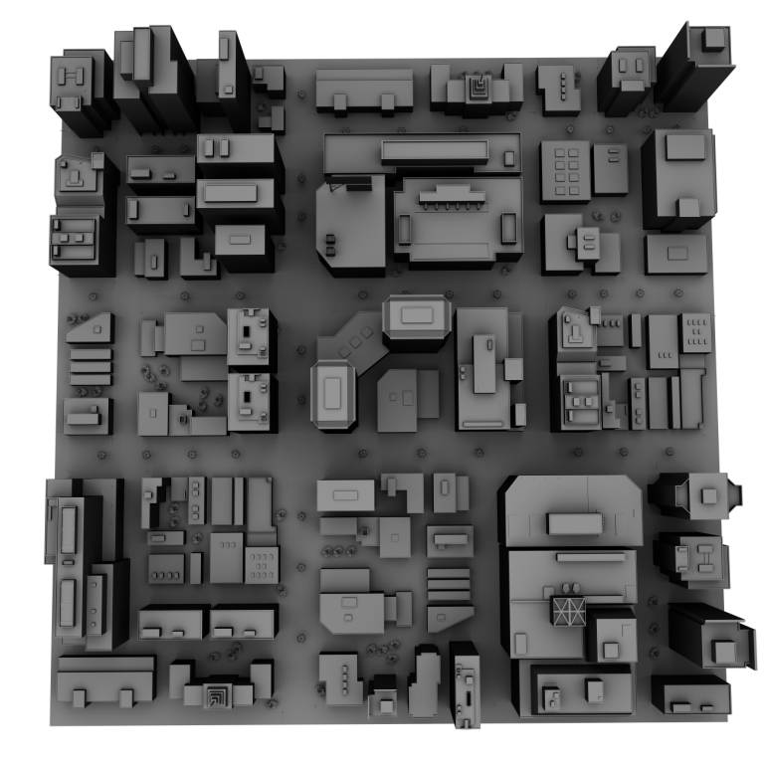
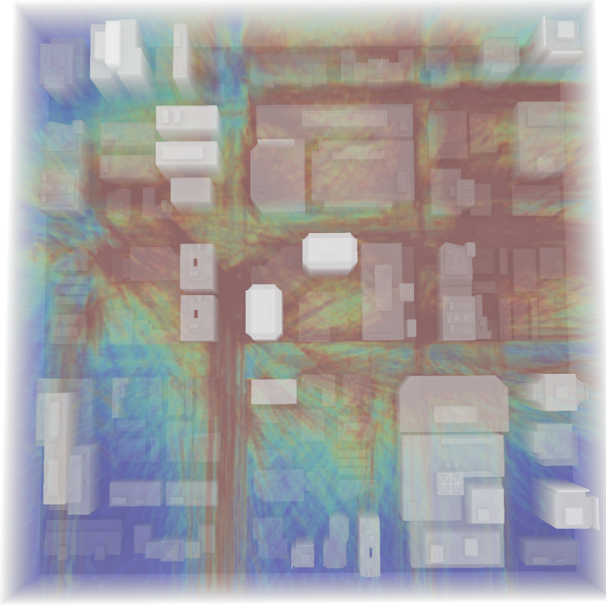
StingRay – examples
75
C. Gribble & J. Amstutz, Effective Parallelization … Radio Frequency Ray Tracing

Slide 78
Parallelization

Slide 79
Results – Intel Xeon Phi
79
C. Gribble & J. Amstutz, Effective Parallelization … Radio Frequency Ray Tracing

Slide 80
Live demonstration

