Slide 1
Using Copper Water Loop Heat Pipes to Efficiently Cool CPUs and GPUs
Stephen Fried
President
Passive Thermal Technology, Inc.

Slide 2
Overview
Unique LHP Technology Features
Thermal Conductivity – the highest in the industry. Makes efficient heat transfer possible.
Passive Cooling Cycle – eliminates the need for fans, blowers in the first stage of many cooling applications.
Work in high heat flux situations – makes possible economic cooling of devices up to 1,000 Watts/cm².
Rejection Distance – makes it possible to efficiently move rejected heat significant distances passively.
Small size of evaporators, condensers and piping make it ideal for Data Center Racks and Blades and Avionics.
Work in both zero G and High G environments making them ideal for aerospace and space applications.
Enables Year Round “Free Cooling” in climates as hot as Atlanta, GA.

Slide 3
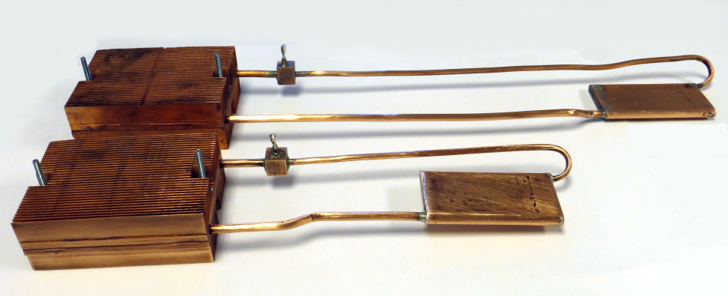
Air Cooled Copper Water LHP
Air Cooled Condenser
Vapor Line
Liquid Return Line
Evaporator

Slide 4
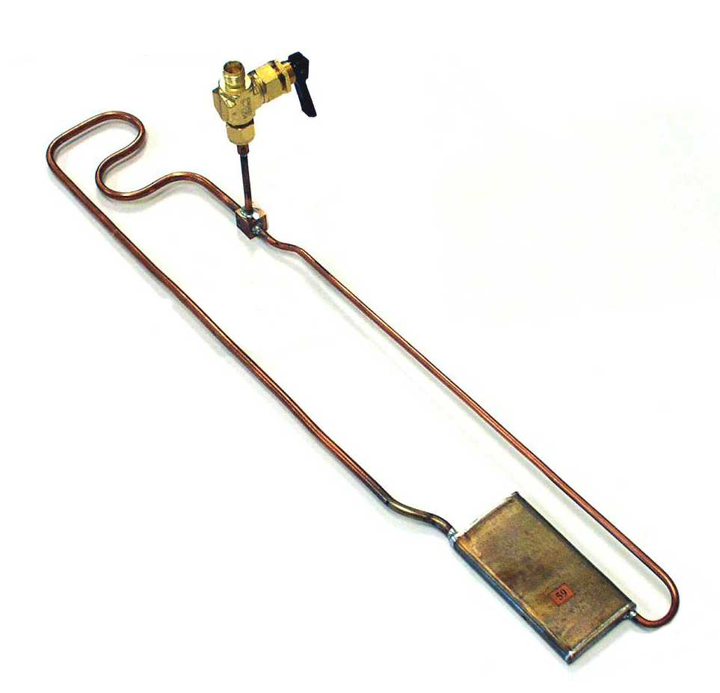
Copper Water LHP
Filler Tube Isolation Valve
Condenser Tubing
Vapor Line
Liquid Return Line
Evaporator

Slide 5
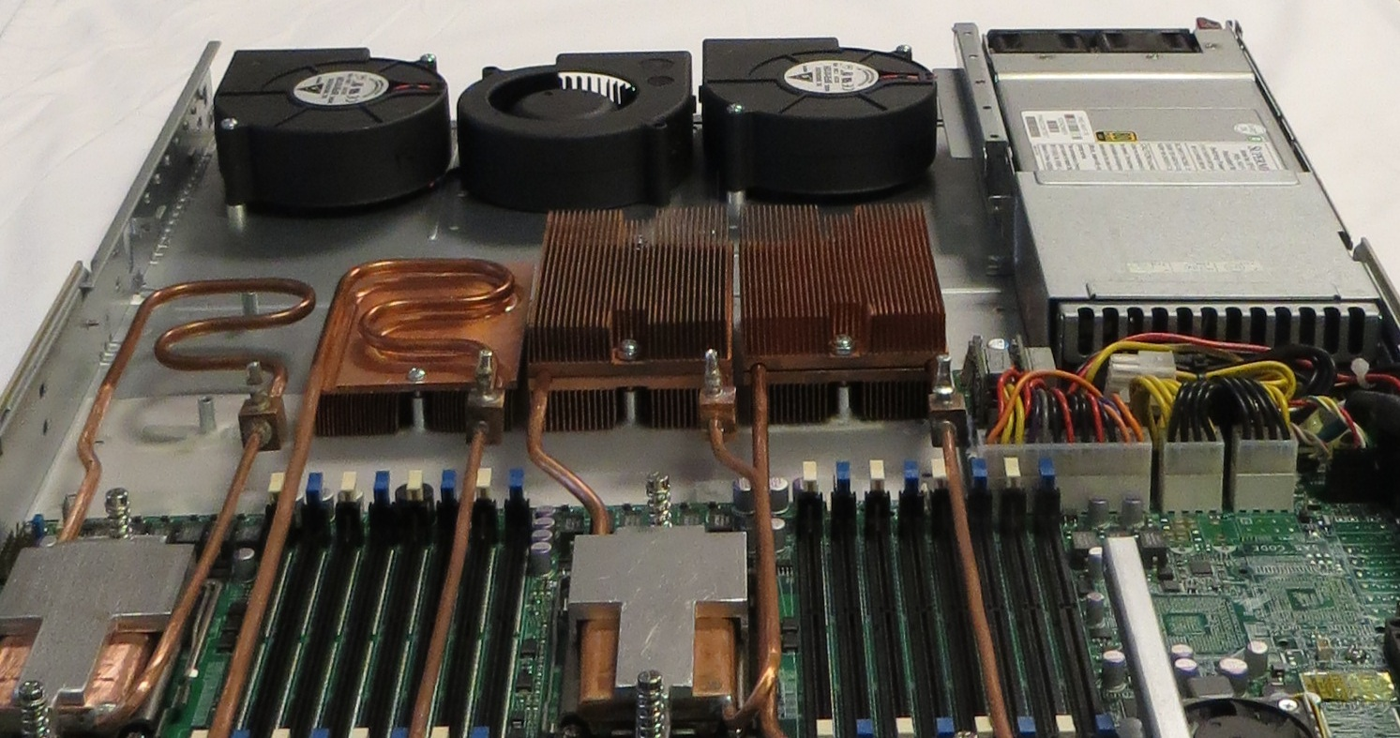
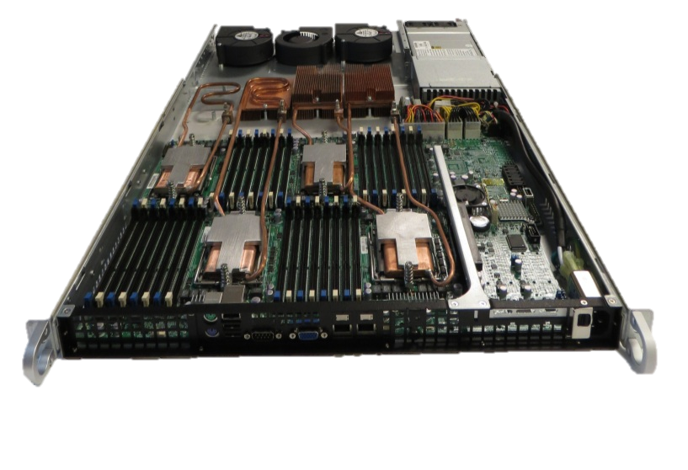
LHP Air Cooled 1U Chassis

Slide 6
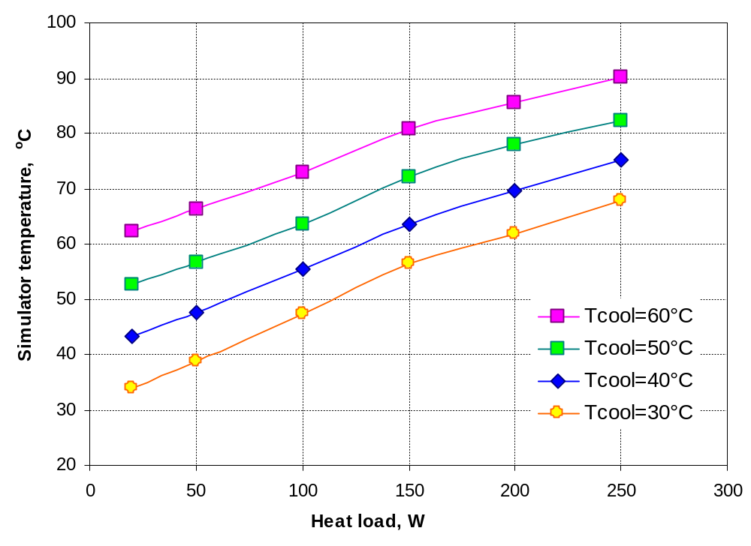
Water Cooled Cu H₂O LHP
Performance vs Water Cooling Temperature
Notes:
6

Slide 7
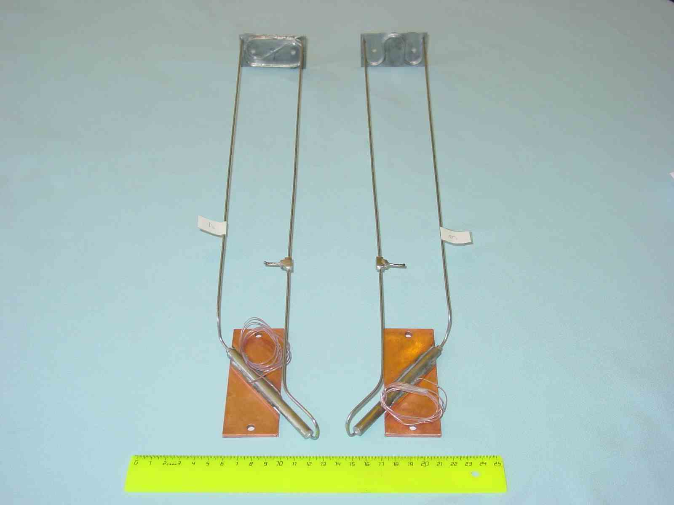
Ammonia LHP
Condenser
Vapor Line
Liquid Return Line
Evaporator

Slide 8
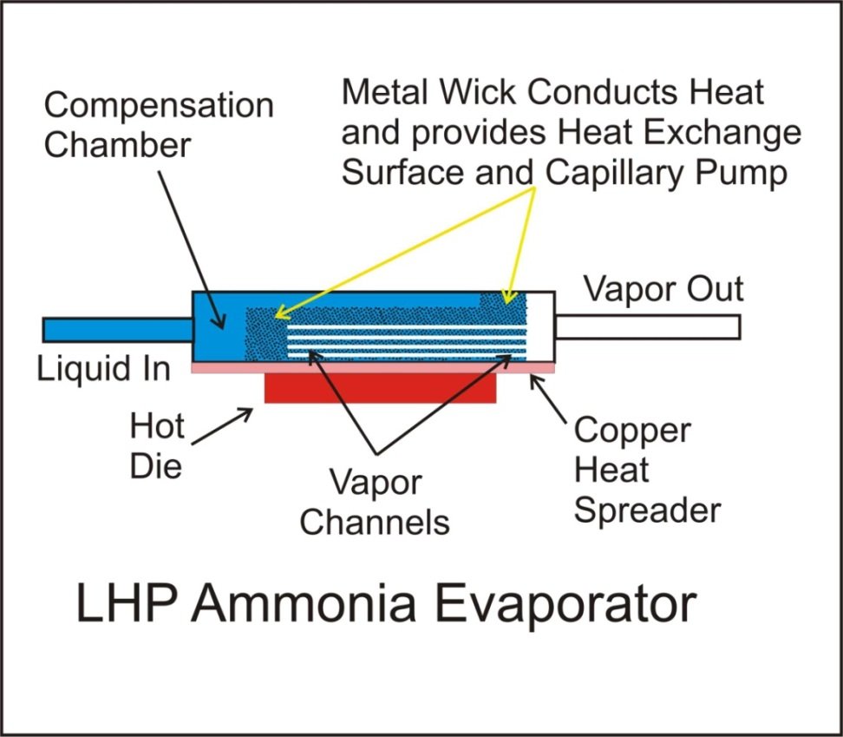
Ammonia Evaporator Design
Ammonia evaporator provides excellent heat exchange at low temperatures and works well with most CPUs running around 60 C.
Pressure inside LHP runs between 10 and 20 atmospheres, requiring cylindrical geometry.
Latent heat of vaporization is 1369 Joules/gram. Flow rate of .1 gram/sec rejects 137 Watts.

Slide 9
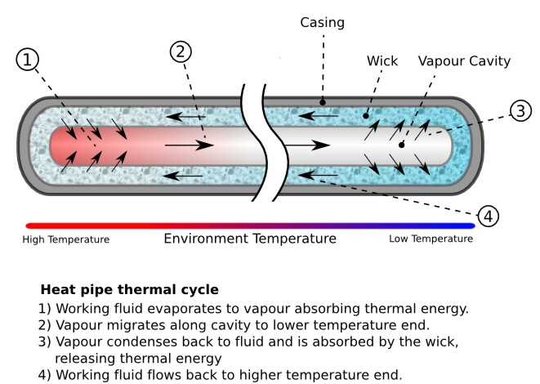
Heat Pipe Essentials
The pumping mechanism is a capillary wick that lines the walls of the pipe but is still sensitive to gravity.
When the distance between the condenser and evaporator grows large or the speed of the working fluid exceeds a critical value, the pressure required to overcome friction in the wick shuts down the heat pipe. Copper/water heat pipes made of ¼" tubing can at most transmit 40 Watts 4 inches.

Slide 10
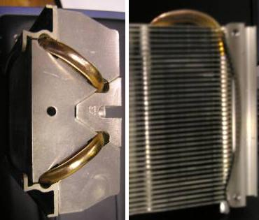
Heat Pipe Essentials
Because of their limitations, standard heat pipes typically get used in situations where a small amount of heat needs to be carried a small distance.
The most common use in computers is in copper finned heat sinks. A pair of heat pipes can be used to distribute up to 80 Watts in a heat sink made of thin copper cooling fins. The alternative is a heat sink whose fins are much heavier, which tends to choke the cooling flow between fins.

Slide 11
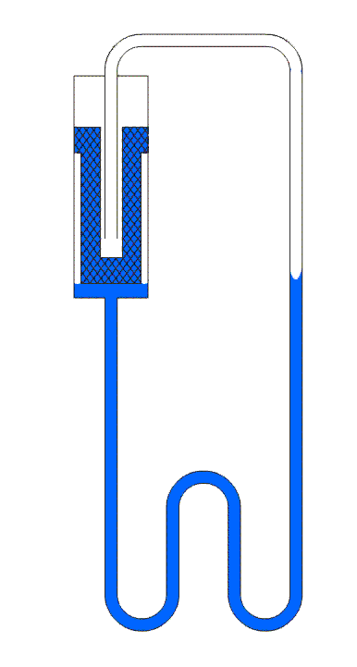
LHP Operation
Outer Wall
Escape Channels
Wick
Vapor Line
Liquid Return Line
Before heat is applied, to the evaporator outer wall, the wick is filled with liquid along with most of the condenser piping.
Notes:
11

Slide 12
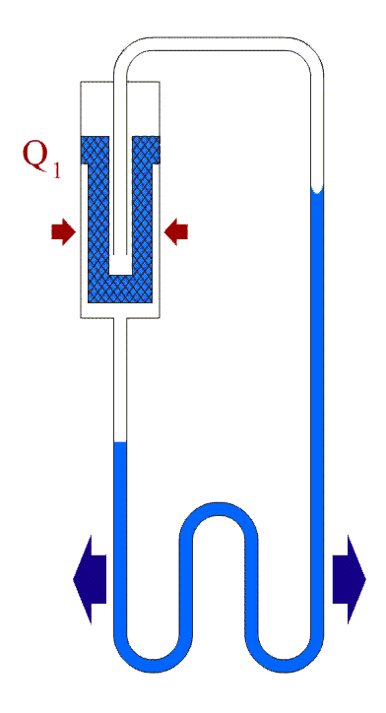
LHP Operation
Compensation Chamber
Heat
Wick
Vapor Line
Condenser
Liquid Return Line
After heat is applied, the wick is still filled with liquid.
Vapor escaping from the wick forces the liquid down through the condenser and around towards the compensation chamber.
Notes:
12

Slide 13
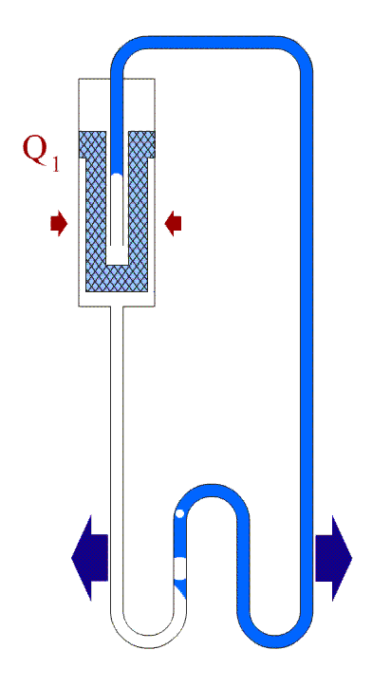
LHP Operation
After more heat is applied, the evaporator wick is drying out.
Escaping vapor has now pushed returning liquid up to evaporator.
The condenser is now filling with vapor, removing heat from the LHP.
Notes:
13

Slide 14
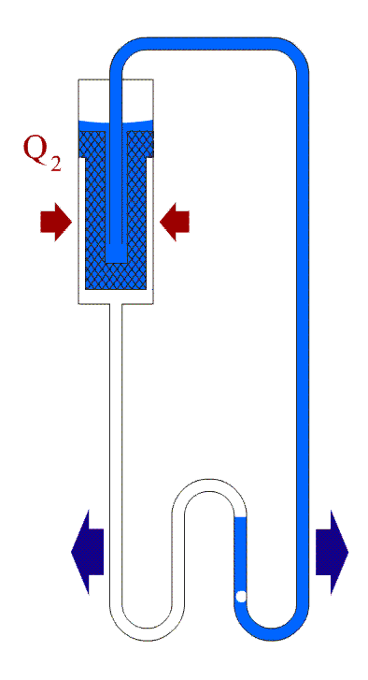
LHP Operation
Liquid starts to fill the compensation chamber as
more heat is applied.
The area in the condenser available for condensation increases.
Notes:
14

Slide 15
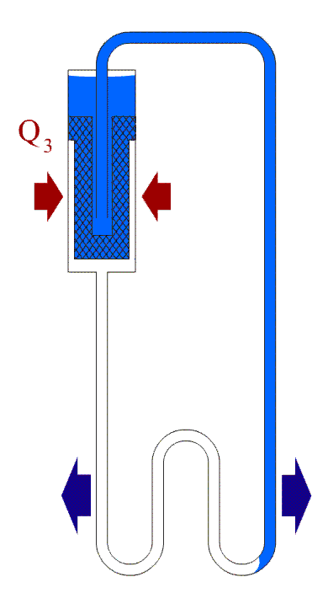
LHP Operation
The compensation chamber continues to fill with liquid.
More area is now available in the condenser, improving its performance.
Notes:
15

Slide 16
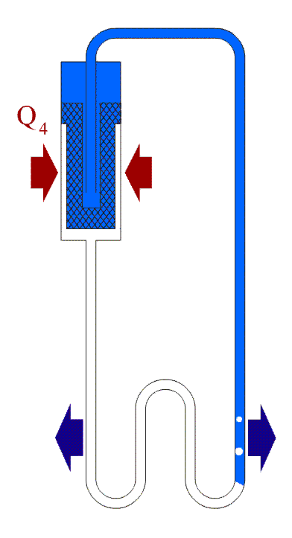
LHP Operation
The compensation chamber is now full.
The condenser has maximum area for vapor condensation.
This increase in condenser performance results in a phenomenon called auto-regulation, in which the temperature of the device remains constant as the heat load increases.
Notes:
16

Slide 17
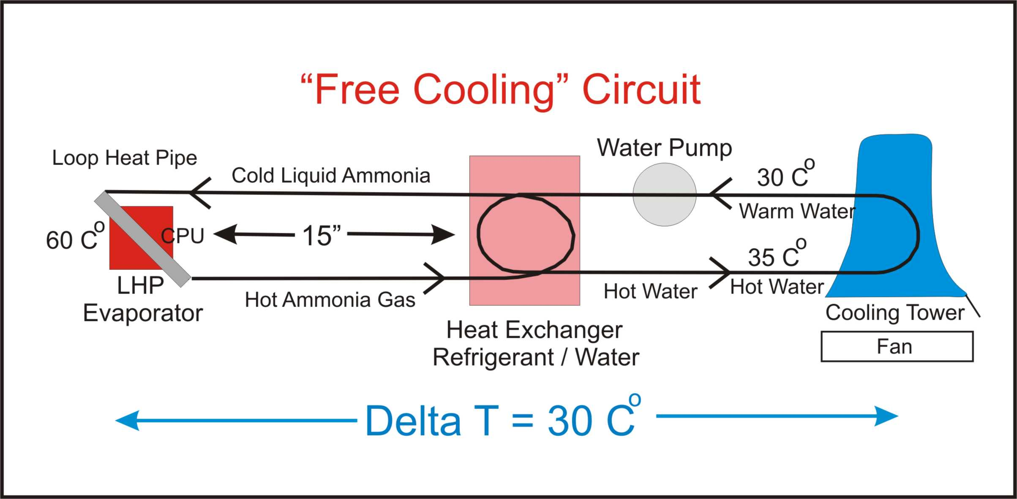
The Green Market Driver
Loop Heat Pipe “Free Cooling” halves the energy required to run data centers! The thermal conductivity of the LHP circuit is what makes this possible!
Notes:
17

Slide 18
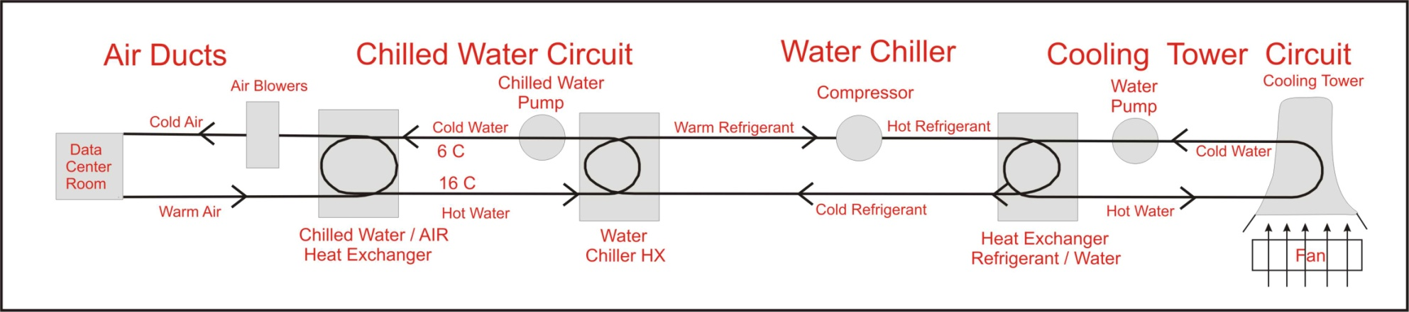

Count the motors
1 MW IT load can be cooled with a pair of 25HP motors in a single cooling tower.
35KW << 1,000KW!
Notes:
18

Slide 19
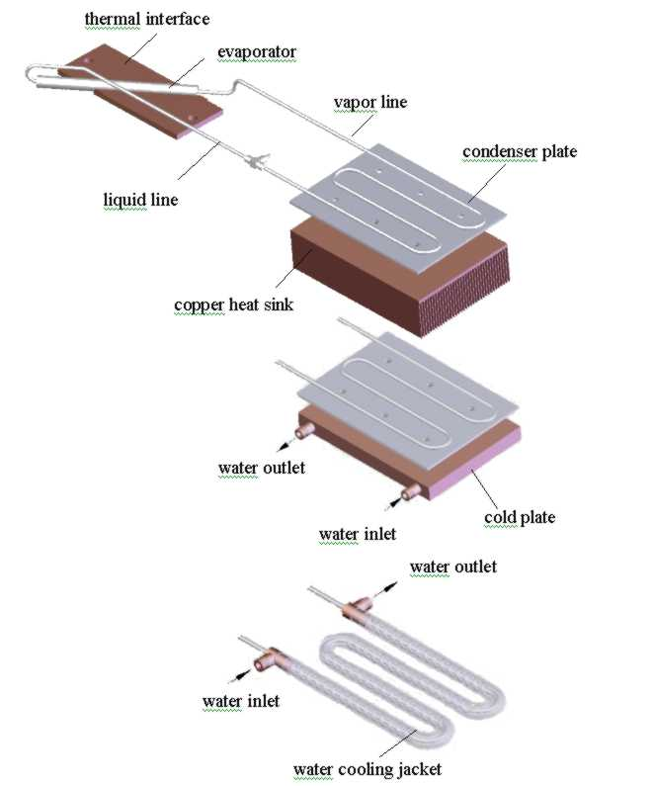
1U Chassis LHP Condenser Designs
  Air Cooled Finned Heat Exchanger
  Water Cold Plate Cooled Condenser
  Forced Water Convection results in lowest thermal resistance of any passive heat transfer device ever invented
Notes:
19

Slide 20
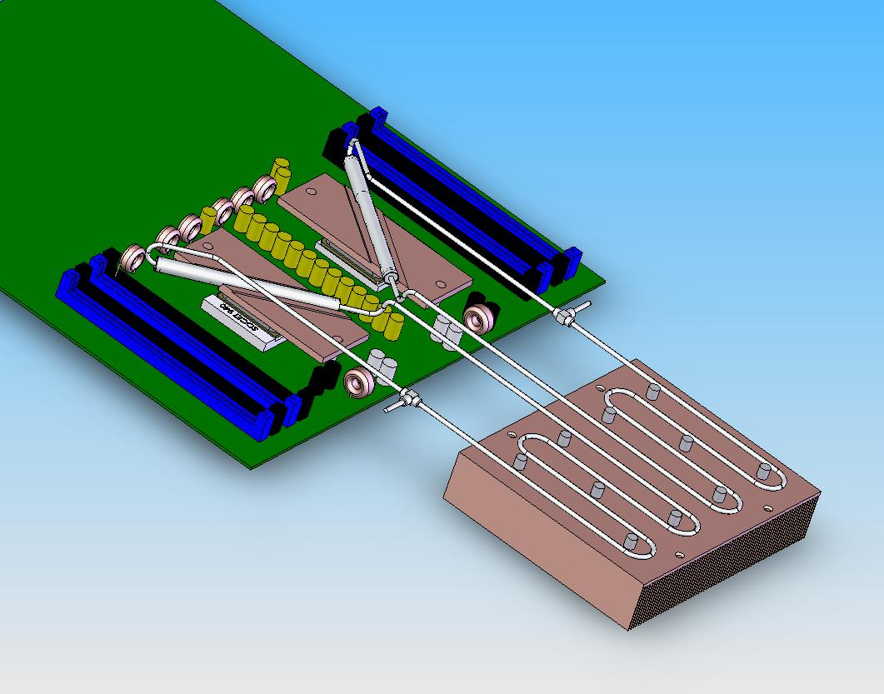
Air Cooled LHP’s Using
Large Finned Heat Exchanger
Design employs a large air cooled condenser. The finned heat sink was too large to fit on top of a CPU in 1U chassis. This heat sink made it possible to replace the four 1U fans used to cool a pair of Opterons with a single quiet blower.
A Rear mounted blower is already used to to eliminate chassis recirculation. Using the rear mounted blower to cool a pair of Opterons eliminates four to eight high speed fans!
Notes:
20

Slide 21
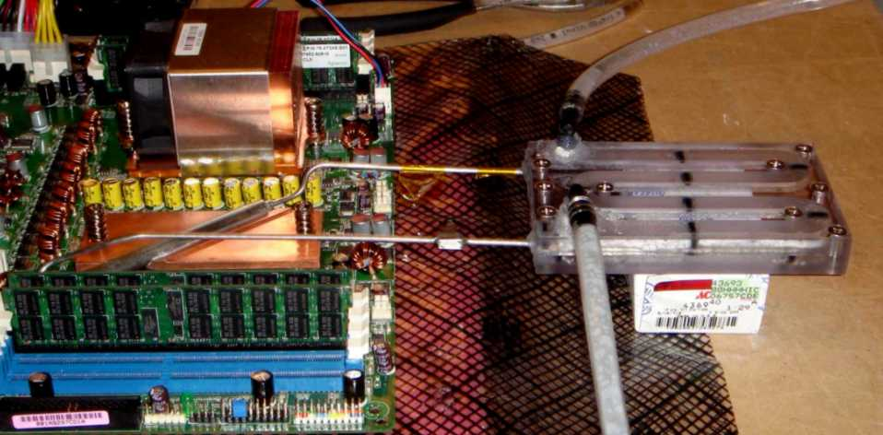
1U Forced Convection
Water Cooled LHP
Notes:
21

Slide 22
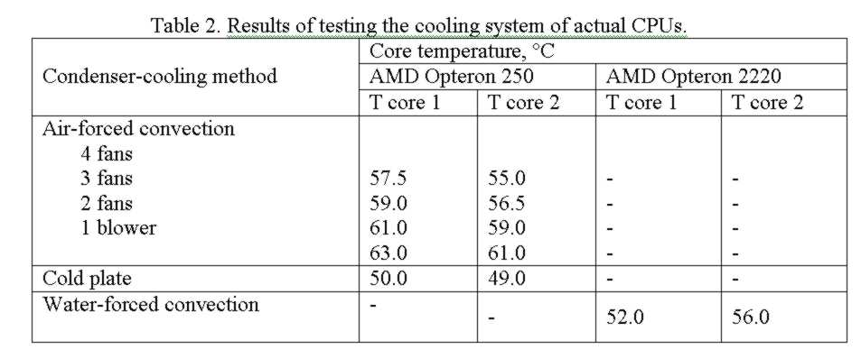
LHP Performance Cooling Dual Opterons
Notes:
22

Slide 23
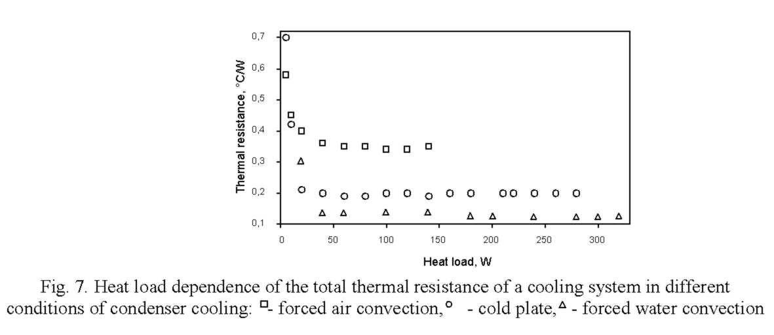
Ammonia LHP Thermal Resistance Summary
For forced air cooling the minimum value of R_{Σ} was achieved when the heat loads varied between 50 and 130 W and was equal to 0.33 °C/W, while for forced water cooling the overall system thermal resistance decreased to just 0.13 °C/W over heat loads that went from 50 to 320 W. The difference is 61%. A heat rejection on the “cold” plate gives an intermediate value of thermal resistance at a level of 0.2 °C/W.
Notes:
23

Slide 24
The Green Market Driver
Loop Heat Pipe “Free Cooling” halves the energy required to run data centers! The low thermal resistance of the LHP circuit is what makes this possible!
Notes:
24

Slide 25
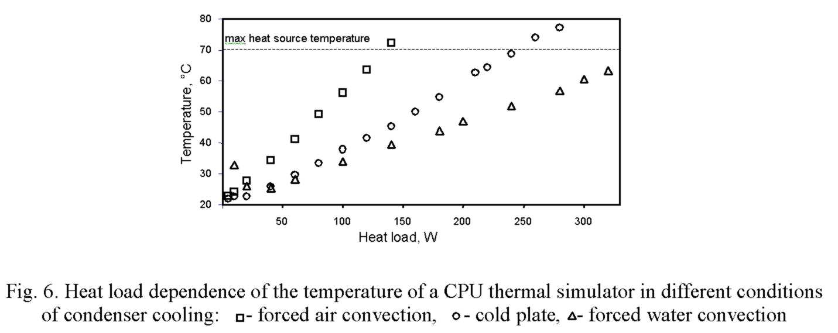
Ammonia LHP Performance Summary
The Opteron CPU’s prescribed maximum operating temperature of 70 °C is called out in Figure 6. The contact temperatures were measured at different heat loads employing the same evaporator and different LHP condenser designs. These results demonstrate convincingly that that in many LHP cooling systems the overall performance turns out to be condenser limited.
Notes:
25

Slide 26
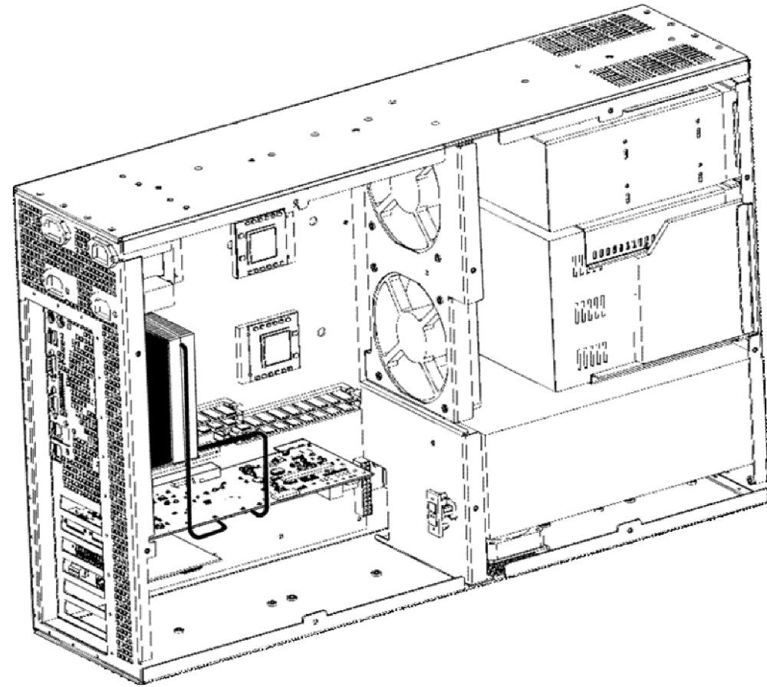
Air Cooled GPU Cu H₂O LHP
Cooling Concept
Notes:
26

Slide 27
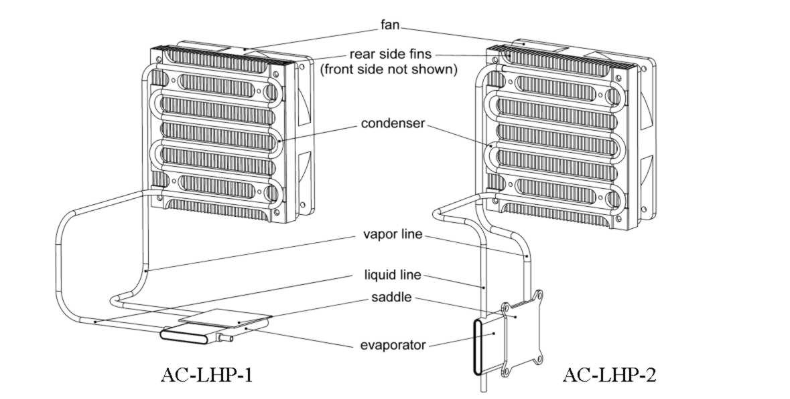
Air Cooled Cu H₂O LHP
Designs in Development
Notes:
27

Slide 28
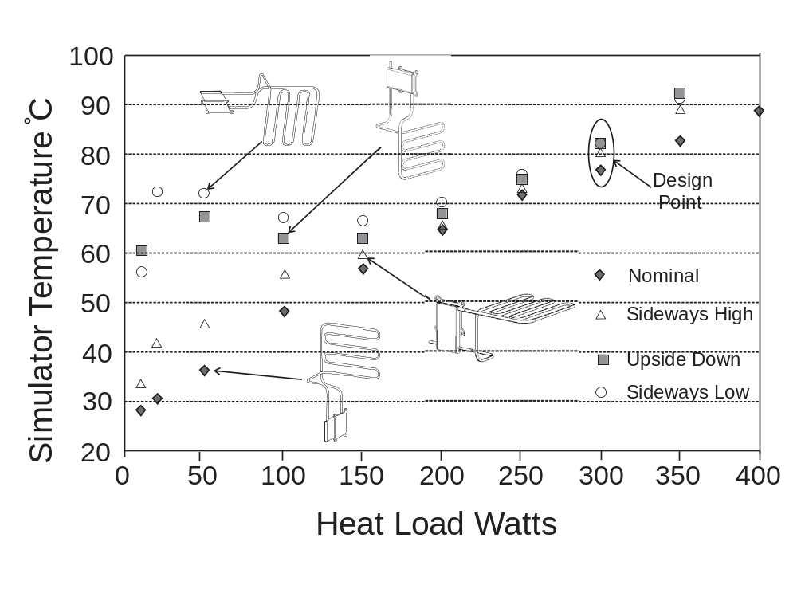
Air Cooled Cu H₂O LHP
Performance vs Orientation
Notes:
28

Slide 29
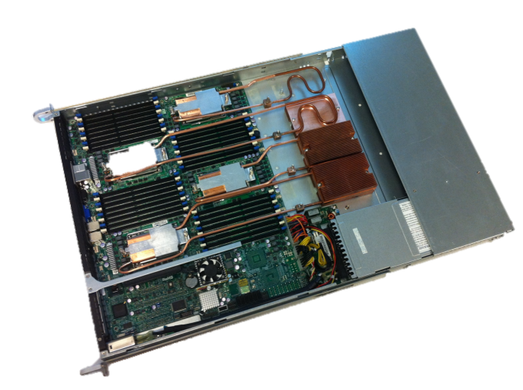
Q & A

