Slide 1
General Purpose Computing on Graphics Processing Units: Optimization Strategy
Henry Au
Space and Naval Warfare Center Pacific
henry.au@navy.mil
09/12/12
Distribution Statement

Slide 2
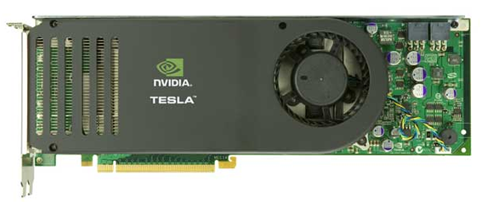
Outline
Background
NVIDIA’s CUDA
Decomposition & Porting
CUDA Optimizations
GPU Results
Conclusion

Slide 3
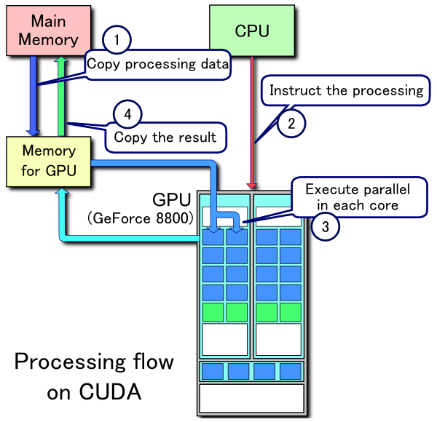
Background
Parallel Programming on GPUs
  General-Purpose Computation on Graphics Processing Units (GPGPU)
  Compute Unified Device Architecture (CUDA)
  Open Computing Language (OpenCLTM)

Slide 4
Background
GPUs vs. CPUs
  GPU and CPU cores not the same
  CPU core is faster and more robust but, fewer cores
  GPU not as robust nor fast, but handles repetitive tasks quickly
NVIDIA GeForce GTX 470
  448 cores
  Memory Bandwidth = 133.9 GB/sec
  544.32 GFLOPS DP
Intel Core i7-965
  4 cores
  Memory Bandwidth = 25.6 GB/sec
  69.23 GFLOPS DP

Slide 5
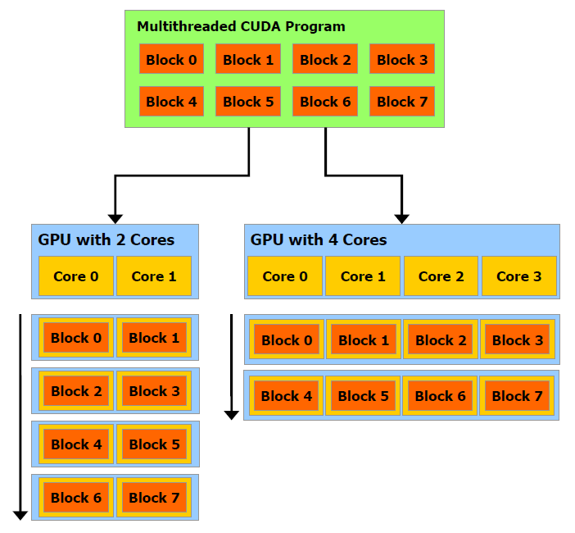
CUDA by NVIDIA
Compute Unified Device Architecture
  Low and High Level API available
  C for CUDA
  High latency memory transfers
  Limited Cache
  Scalable programming model
  Requires NVIDIA graphics cards

Slide 6
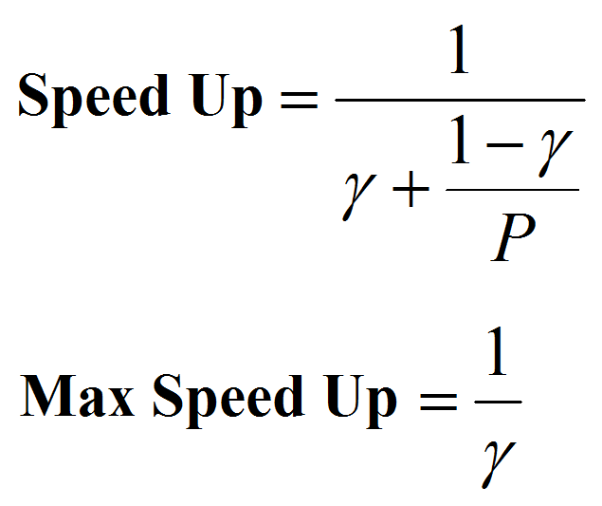
Decomposition and Porting
Amdhal’s and Gustafson’s Law
Estimate Speed Up
  P amount of parallel scaling achieved
  γ is the fraction of algorithm that is serial

Slide 7

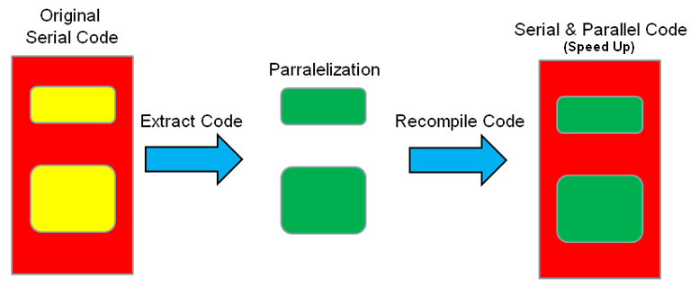
Decomposition and Porting
TAU Profile
  Determine call paths and consider subroutine calls
  Pay attention to large for loops or redundant computations
Visual Studio 2008
  Initialize Profile: TAU_PROFILE(“StartFor”, “Main”, TAU_USER);
  Place Timers:
    TAU_START(“FunctionName”)
    TAU_STOP(“FunctionName”)

Slide 8
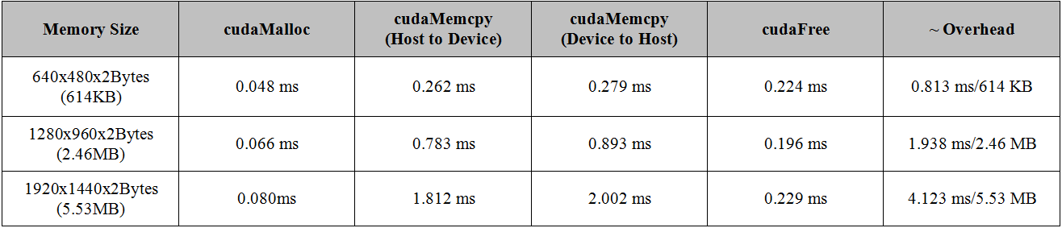
Decomposition and Porting
CUDA Overhead
  High latency associated with memory transfers
  Can be hidden with large amounts of mathematical computations
  Reduce Device to Host memory transfers
    Many small transfers vs. fewer but larger transfers
    Perform serial tasks using parallel processors

Slide 9
CUDA Optimizations
Thread and Block Occupancy
  Varies depending on graphics card
Page Locked Memory
  cudaHostAlloc()
  Limited resource and should not be overused
Streams
  A queue of GPU operations
  Such as GPU computation “kernels” and memory copies
Asynchronous Memory Calls
  Ensure non-blocking calls
  cudaMemcpyAsync() or kernel call

Slide 10
Thread Occupancy
Ensure enough threads are operating at the same time
  256 threads per block
  Max 1024 threads per block
  Monitor occupancy

Slide 11
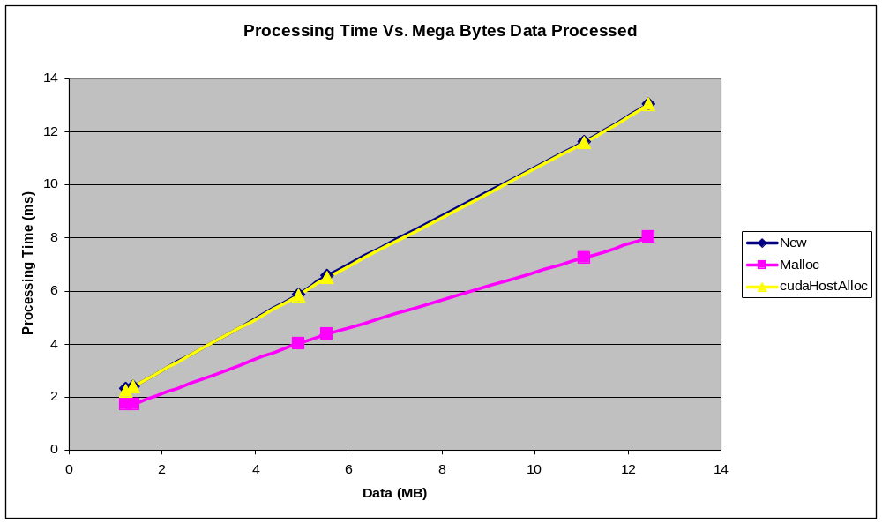
CUDA Optimizations
Page Locked Host Memory
  cudaHostAlloc() vs. malloc vs. new

Slide 12
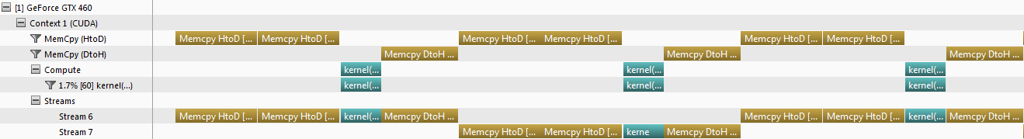
CUDA Optimizations
Stream Structure Non-Optimized
  Processing time: 49.5ms
cudaMemcpyAsync(dataA0, stream0, HostToDevice) cudaMemcpyAsync(dataB0, stream0, HostToDevice) kernel<<< blocks, threads, stream0>>>(result0, dataA0, dataB0) cudaMemcpyAsync(result0, stream0, DeviceToHost) cudaMemcpyAsync(dataA1, stream1, HostToDevice) cudaMemcpyAsync(dataB1, stream1, HostToDevice) kernel<<<blocks, threads, stream1>>>(result1, dataA1, dataB1) cudaMemcpyAsync(result1, stream1, DeviceToHost)

Slide 13
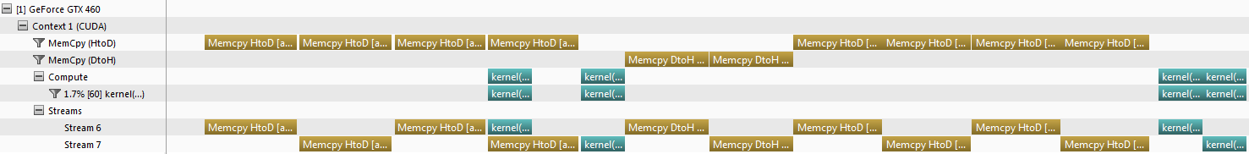
CUDA Optimizations
Stream Structure Optimized
  Processing time: 49.4ms
cudaMemcpyAsync(dataA0, stream0, HostToDevice) cudaMemcpyAsync(dataA1, stream1, HostToDevice) cudaMemcpyAsync(dataB0, stream0, HostToDevice) cudaMemcpyAsync(dataB1, stream1, HostToDevice) kernel<<< blocks, threads, stream0>>>(result0, dataA0, dataB0) kernel<<<blocks, threads, stream1>>>(result1, dataA1, dataB1) cudaMemcpyAsync(result0, stream0, DeviceToHost) cudaMemcpyAsync(result1, stream1, DeviceToHost)

Slide 14
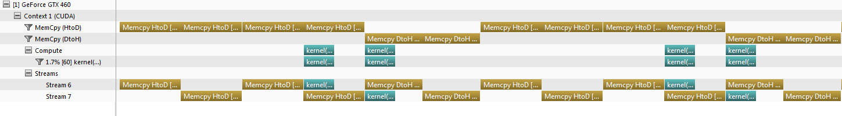
CUDA Optimizations
Stream Structure Optimized & Modified
  Processing time: 41.1ms
cudaMemcpyAsync(dataA0, stream0, HostToDevice) cudaMemcpyAsync(dataA1, stream1, HostToDevice) cudaMemcpyAsync(dataB0, stream0, HostToDevice) cudaMemcpyAsync(dataB1, stream1, HostToDevice) kernel<<< blocks, threads, stream0>>>(result0, dataA0, dataB0) cudaMemcpyAsync(result0, stream0, DeviceToHost) kernel<<<blocks, threads, stream1>>>(result1, dataA1, dataB1) cudaMemcpyAsync(result1, stream1, DeviceToHost)

Slide 15
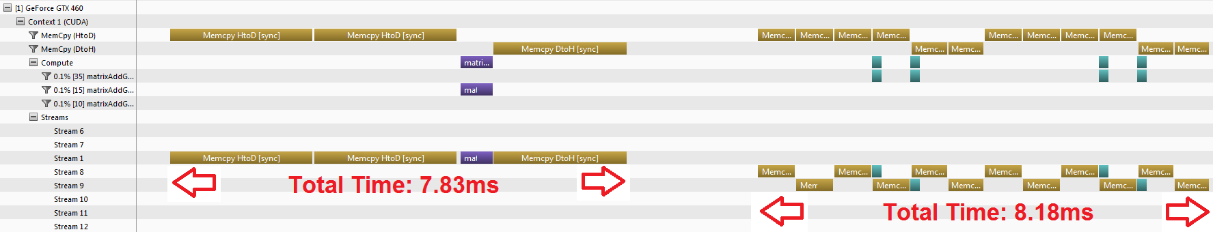
CUDA Optimizations
Stream Structure not always beneficial
  Overhead could result in performance reduction
  Profile to determine kernel execution vs. data transfer
    NVIDIA Visual Profiler
    cudaEventRecord()

Slide 16
GPU Results
Optimization Stages
  0: No Optimizations (65 FPS)
  1: Page Locking Memory (67 FPS)
  2: Asynchronous GPU calls (81 FPS)
  3: Non-optimized Streaming (82 FPS)
  4: Optimized Streaming (85 FPS)

Slide 17
GPU Results
ALF CPU vs. GPU Processing

Slide 18

Conclusion
Test various thread per block allocations
Use page locked memory for data transfers
  Asynchronous memory transfer and non-blocking calls
Ensure proper coordination of streams
  Data Parallelism and Task Parallelism

Slide 19
QUESTIONS?

Slide 20
References
Amdahl, G., "Validity of the single processor approach to achieving large scale computing capabilities." AFIPS Spring Joint Computer Conference, 1976.
CUDA C Best Practices Guide Ver 4.0, 5/2011.
Gustafson, J., "Reevaluating Amdahl's Law." Communications of the ACM, Vol. 31 Number 5, May 1988.
Jason Sanders, Edward Kandrot. CUDA By Example, An Introduction to General-Purpose GPU Programming. Addison-Wesley. Copyright NVIDIA Corporation 2011.
NVIDIA CUDA Programming Guide Ver 4.0, 5/6/2011.
Tau-User Guide. Department of Computer and Information Science, University of Oregon Advanced Computing Laboratory. 2011

