Slide 1
a near real-time, parallel and distributed adaptive object detection and retraining framework based on adaboost algorithm
Munther Abualkibash
University of Bridgeport, CT

Slide 2

Outline
Introduction
Contributions of the Research
AdaBoost Algorithm
Parallel and Distributed AdaBoost Algorithm
Extracting Optimized Subset
Implementing a Cascade Structure based on an Optimized Small Training Set
Retraining
Results
Conclusion

Slide 3

Introduction
Object detection is an important area of research in computer vision.
One of the most popular approaches for object detection is called Boosting.
Boosting has been applied to many different object detection implementations such as face, car, and airplane detection.

Slide 4
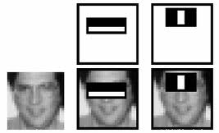
Introduction
One of the most significant contributions to object detection work is from Viola and Jones [1].
[1] P. Viola and M. Jones, "Robust real-time face detection," in Computer Vision, 2001. ICCV 2001. Proceedings. Eighth IEEE

Slide 5
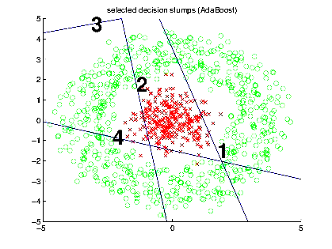
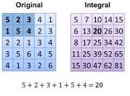
Introduction
Viola and Jones’ algorithm
  Based on a variation of boosting technique called AdaBoost.
  Employs a concept called integral image that greatly reduces the computations in the detection algorithm.
First image Ref: http://cs.adelaide.edu.au/~paulp/
Second image Ref: http://www.codeproject.com/Articles/441226/Haar-feature-Object-Detection-in-Csharp

Slide 6
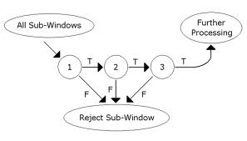
Introduction
  Viola and Jones algorithm uses a cascade of classifiers in an effective manner to obtain high real-time face detection accuracy.
Image Ref: http://www.rosariomgomez.me/nyfw2014-1-color-detection/

Slide 7

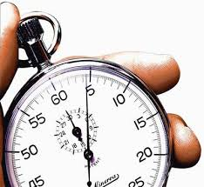
Research Problem and Scope Cont…
Viola and Jones’ algorithm uses a large dataset for training AdaBoost to detect objects.
This improves detection accuracy; however, the training execution time can be high.

Slide 8

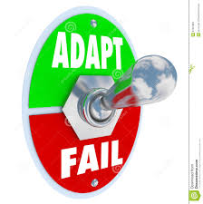

Introduction
If the system fails to detect a valid object, there should be a methodology by which the system can be updated by retraining instantly.
There is a need for a system that can be retrained in near real-time so that the detection rate can be enhanced.
Building an entire framework to allow for an easy update in case of misclassified data is highly needed.

Slide 9

Contributions of the Research
We build a generalized object detection framework such that the system can efficiently adapt to misclassified data and be retrained within a few minutes or less.

Slide 10
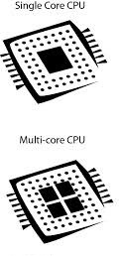
Contributions of the Research Cont…
We reduce the training execution time through two major contributions:
  A highly parallel and distributed AdaBoost algorithm that exploits the multiple cores in a CPU via light weight threads is developed.
    It further uses multiple machines to achieve high scalability, resulting in training execution time of a few minutes, rather than days.
  Development of a methodology to create a much smaller optimized training subset than is normally used, in order to reduce the training execution time further.
Image Ref: http://digitaldimensionoftechnology.com/2013/03/

Slide 11


Contributions of the Research Cont…
Finally, we incorporate our parallel and distributed AdaBoost algorithm along with the optimized training subset into a generalized object detection framework.
      This efficiently adapts and can be retrained when it encounters misclassified data.
    We demonstrate the usefulness of our adaptive framework by providing detailed testing on face and car detection.

Slide 12

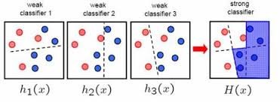
AdaBoost Algorithm
An important algorithm in machine learning and is being widely used in object detection.
Works by iteratively selecting the best among weak classifiers, and then combines several weak classifiers to obtain a strong classifier.
Image Ref: http://www.ieev.org/2010/03/adaboost-haar-features-face-detection.html

Slide 13
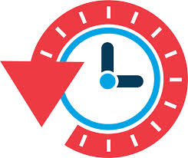
AdaBoost Algorithm Cont…
It has proven to be very effective, but:
  Its learning execution time can be quite long depending upon the application.
  e.g., in face detection, the learning time can be several days.

Slide 14
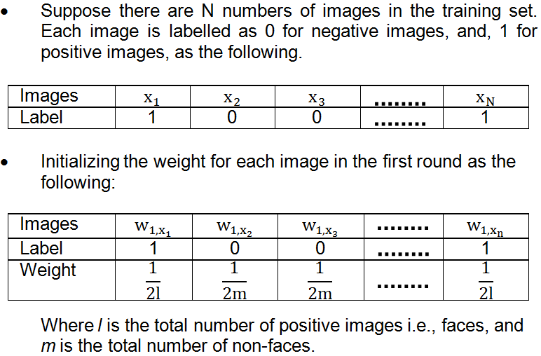
AdaBoost Algorithm Cont…
Pseudocode Ref: P. Viola and M. Jones, "Robust real-time face detection," in Computer Vision, 2001. ICCV 2001. Proceedings. Eighth IEEE

Slide 15
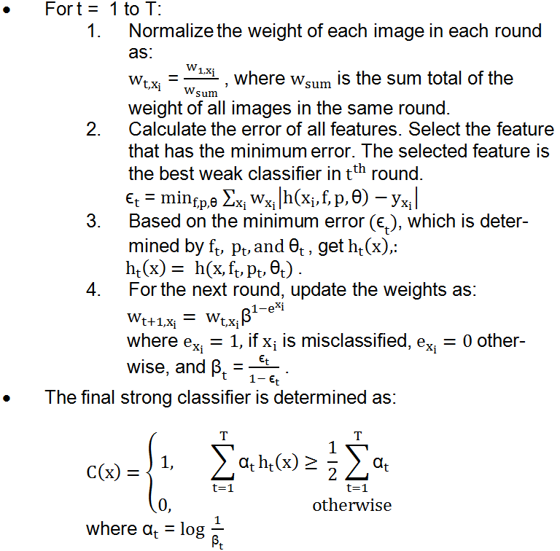
AdaBoost Algorithm Cont…
Pseudocode Ref: P. Viola and M. Jones, "Robust real-time face detection," in Computer Vision, 2001. ICCV 2001. Proceedings. Eighth IEEE

Slide 16
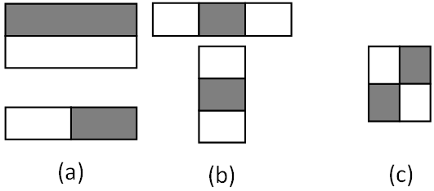
Haar Features
Five types of Haar features have been used in AdaBoost.
(a) Two Rectangle Horizontal and Vertical
(b) Three Rectangle Horizontal and Vertical
(c) Four Rectangle
Figure 2 Five rectangular features. Figure (a) shows two rectangle horizontal and vertical features, figure (b) shows three rectangle horizontal and vertical features, and figure (c) shows a four rectangle feature

Slide 17
Haar Features Cont…
For faces, we have used images of size 24x24 pixels.
Based on this size:
  2Rec H = 43,200 features
  2Rec V = 43,200 features
  3Rec H = 27,600 features
  3Rec V = 27,600 features
  4 Rec = 20,736 features
  Total = 162,336 features

Slide 18

Haar Features Cont…
For example: in 2Rec V, the smallest feature size is 1 x 2.
Then the size is increased until reaching the maximum size 24 x 24.
Total of 43,200 features

Slide 19

Haar Features Cont…
We have used 4,916 faces and 7,960 non-faces.
  Total of all images = 12,876
For each image there is 162,336 features.
There are 2,090,238,336 data points from the features in this training set.
As a result, a very large amount of data has to be used in AdaBoost.

Slide 20
Parallel and Distributed AdaBoost Algorithm
Our parallel approach speeds up the execution time by efficiently parallelizing the AdaBoost algorithm.
We run the main computational part of AdaBoost in parallel, using Task Parallel Library (TPL), which is a built-in library in the Microsoft .NET framework.
The advantage of using TPL is apparent in multi-core CPUs where the declared parallel workload is automatically distributed between the different CPU cores.
  This is done by creating light weight threads called tasks.
Notes:
Refernce: http://docs.huihoo.com/hpc-cluster/parallel-computing/

Slide 21
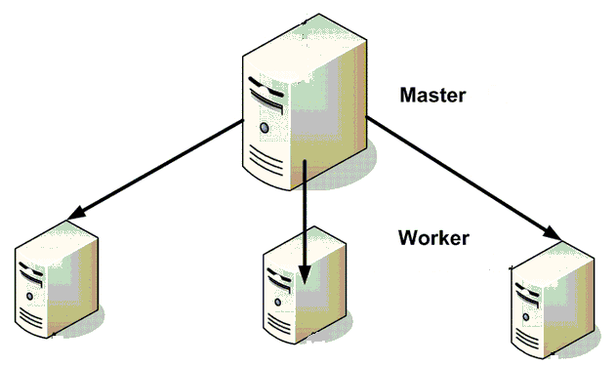
Parallel and Distributed AdaBoost Algorithm Cont…
To further improve the execution time of AdaBoost, we use web services to run parallel AdaBoost on multiple workstations in a distributed manner.
Notes:
Image Ref: http://www.codeproject.com/Articles/35671/Distributed-and-Parallel-Processing-using-WCF

Slide 22
Our implementation of the Parallel and Distributed AdaBoost Algorithm
We implement a four-way approach to get results in the shortest possible time compared to the sequential approach:
    Sequential algorithm
    Parallel on one machine
    Web services and parallel execution on one hierarchal level
    Web services and parallel execution on two hierarchal levels
    Web services and parallel execution on one hierarchal level and N slave nodes

Slide 23
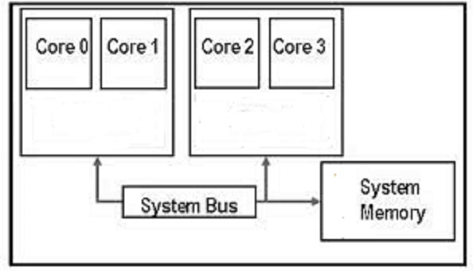
Parallel execution on a single machine
All features are grouped on the same machine based on type,
  Three rectangle horizontal.
  Three rectangle vertical.
  Two rectangle horizontal.
  Two rectangle vertical.
  Four rectangle.
Each group is uploaded to the system memory in parallel.
Once all of these have been loaded, AdaBoost rounds are started.

Slide 24
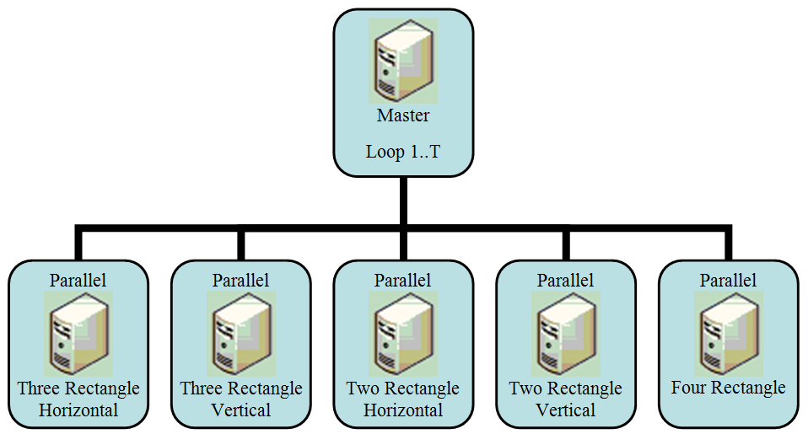
Web Services and Parallel execution on one hierarchal level
Each group of features is distributed to a separate PC.
Since five feature types are exist, five PCs are used for feature calculations.
  The master workstation coordinates the five PCs.
Figure 3 One hierarchal level for Web Services and Parallel AdaBoost, based on master and five slaves (Total of six PCs)

Slide 25
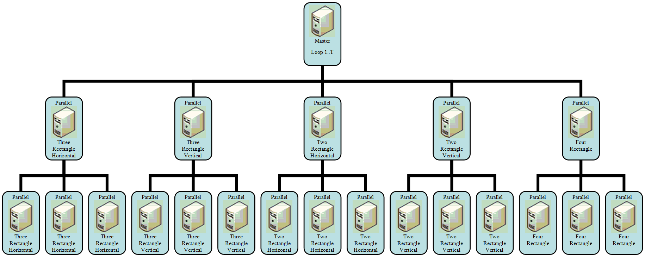
Web Services and Parallel execution on two hierarchal Levels
The previous technique divided the work based on feature type.
Now, we further distribute the calculations in a feature type to another set of machines in the next hierarchical level.
Figure 4 Two hierarchal level for Web Services and Parallel AdaBoost, based on master and five sub-master and 3 slaves for each sub-master (Total of twenty one PCs)

Slide 26
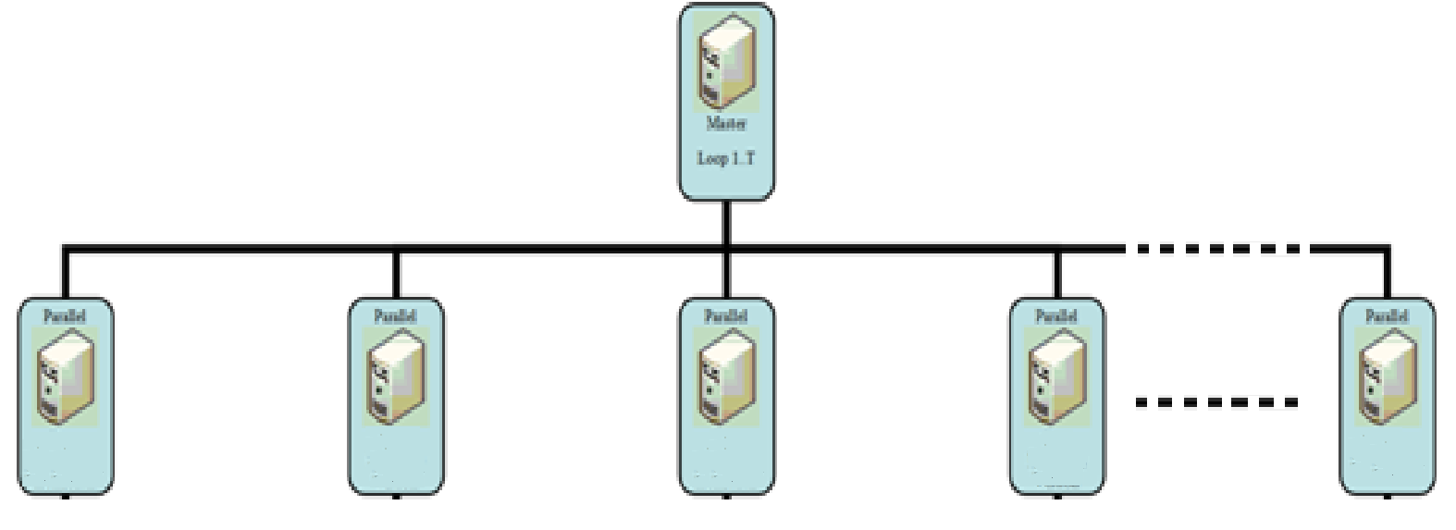
Web Services and parallel execution on one hierarchal level with N number of slave nodes
The previous techniques divided the work based on feature type.
Now, we further distribute the work to all slave nodes in balance, where each node will receive approximately the same number of features.
Figure 5 One hierarchal level for Web Services and Parallel AdaBoost, based on master and N slaves

Slide 27
Extracting Optimized Subset
In order to be able to retrain in a near real-time fashion, we find a small optimized subset for both faces and non-faces that is capable of achieving 100% detection rates
  Once the optimized subset is created, it is tested on the entire set.

Slide 28
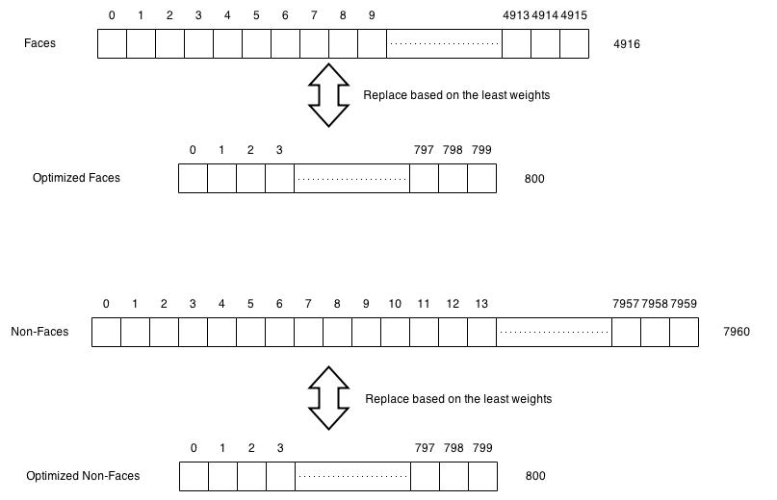
Extracting Optimized Subset Cont…
For faces, the full training set has 4,916 faces and 7,960 non-faces.
Figure 10 Replacing faces and non-faces to get an optimized subset

Slide 29
Extracting Optimized Subset Cont…
We start with a small set of faces and non-faces, and replace some of the images that have lowest weights based on the Parallel and Distributed AdaBoost algorithm.
Figure 10 Replacing faces and non-faces to get an optimized subset

Slide 30
Extracting Optimized Subset Cont…
After extensive testing on the faces training set:
  We have found that extracting 200 features from a subset of 800 faces and 800 non-faces is able to correctly classify all the images of the full set.
Figure 10 Replacing faces and non-faces to get an optimized subset

Slide 31
Extracting Optimized Subset Cont…
Which means:
  A classifier trained on 800 faces and 800 non-faces is able to perform 100% detection on the entire set of 12,876 faces and non-faces.
  A classifier trained on 60 cars and 60 non-cars is able to perform 100% detection on the entire set of 1,050 cars and non-cars.
Thus we utilize around 12% of the training set as the optimized subset that is capable of achieving high detection rates. This further reduces the retraining execution time.

Slide 32
Implementing a Cascade Structure based on an Optimized Small Training Set
We are building a framework that is able to retrain in near real time by using a parallel and distributed structure.
Classifiers in each stage are based on the optimized subset of the training set.
The optimized subset of the full training set is able to get a 100% positive detection rate on objects for each stage after testing the classifier of each stage on the whole training set.

Slide 33
Implementing a Cascade Structure based on an Optimized Small Training Set Cont…
The Cascade was built to have 21 stages, where:
  The first stage is based on 5 weak classifiers.
  The second stage has 10 weak classifiers.
  The third stage has 20 weak classifiers.
  Each subsequent stage has 10 more weak classifiers.
  Stage number twenty-one has 200 weak classifiers.

Slide 34
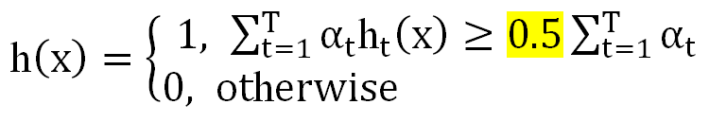
Implementing a Cascade Structure based on an Optimized Small Training Set Cont…
In the AdaBoost algorithm that has been used to build classifiers on each stage of the cascade,
  any sub window will be considered a positive object when the sum of alphas of all weak classifiers in the sub window are greater than or equal to 0.5 multiplied by the sum of alphas that were obtained during training classifiers;
  this result is the threshold that will determine positive objects from non-objects.

Slide 35
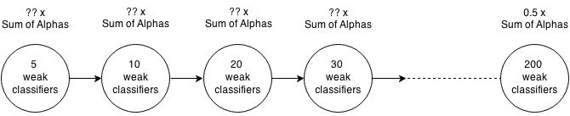
Implementing a Cascade Structure based on an Optimized Small Training Set Cont…
Using the few weak classifiers that were extracted based on the optimized training subset
  Will not achieve 100% detection rate for positive objects (e.g. faces) when the threshold is based on multiplying the sum of alphas by 0.5.
To solve this problem, the threshold needs to be based on multiplying sum of alphas by a number less than 0.5.

Slide 36
Implementing a Cascade Structure based on an Optimized Small Training Set Cont…
Our implementation of cascade structure started with multiplying the sum of alphas by 0.5, then:
  If the detection rate on the entire set is less than 99.9%, 0.01 was subtracted
  If it is greater than or equal to 99.9%, 0.01 was added

Slide 37
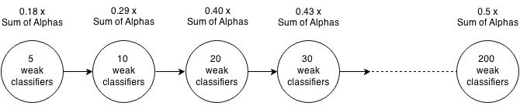
Implementing a Cascade Structure based on an Optimized Small Training Set Cont…
Our results found that, in the first stage, which has 5 weak classifiers, the new threshold obtained is based on multiplying the sum of alphas by 0.18.
And for the second stage, which has 10 weak classifiers, the new threshold obtained is based on multiplying sum of alphas by 0.29, etc.

Slide 38
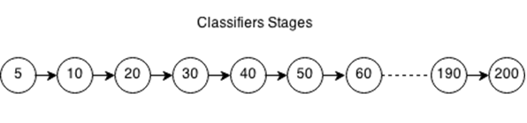
Retraining
After building a cascade of 21 stages where each one has a specific threshold to be used for detection purposes,
  it is time to make the framework able to be retrained using parallel and distributed AdaBoost.
To do that, another stage is added, which will be copied from the last stage.
Now the total number of stages is 22. The reason for creating the new stage is for fast retraining.
The new stage will retrain based on missed objects and false positives to help the classifier to detect difficult cases in a simple and easy way.
Figure 11 Twenty one stages

Slide 39
Retraining Cont…
The strategy used for retraining in the new stage to detect the missed objects and erase false positives is by:
  Adding specific missed objects as well as all false positives to the training set of the new stage.
To make the missed objects stronger and the false positives weaker,
  We added rectangles that overlap with the missed objects and false positives, to increase the chance of detecting the missed objects and to erase the false positives after finishing the retraining process.
Now, false negatives and positives and their overlapping rectangles will be added together in the new stage and will be given a high weight so more focus is given to them during retraining.

Slide 40
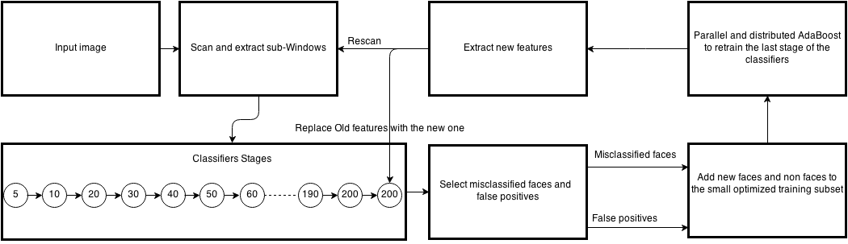
Retraining Cont…
Figure 12 Architecture for Retrainable System

Slide 41
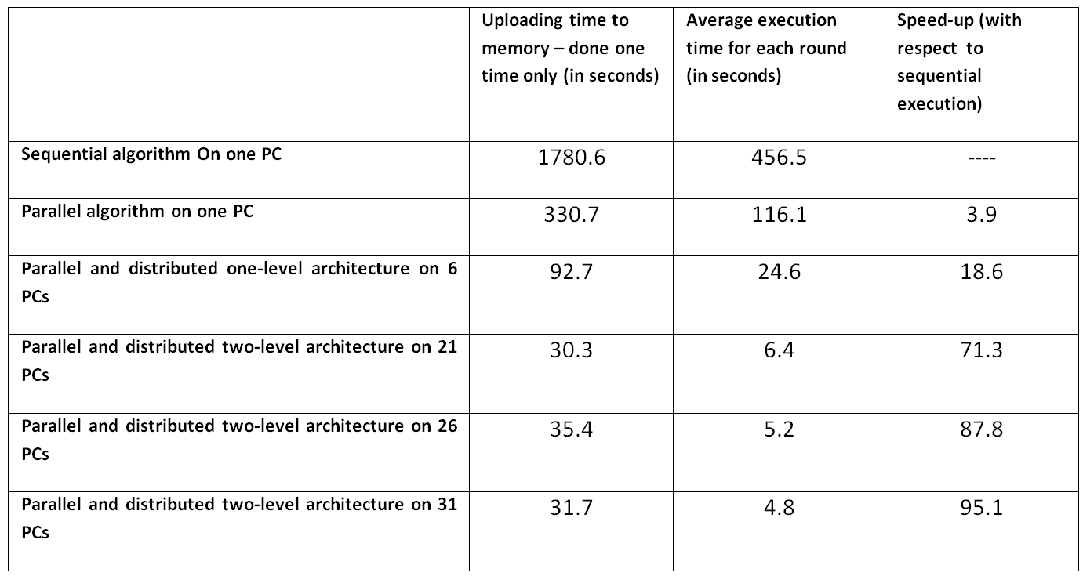
Web Services and parallel execution time for the first three approaches
Table 1 Comparison of the first four approaches used
By using 31 machines, an execution time of 4.8 seconds per feature is achieved.

Slide 42
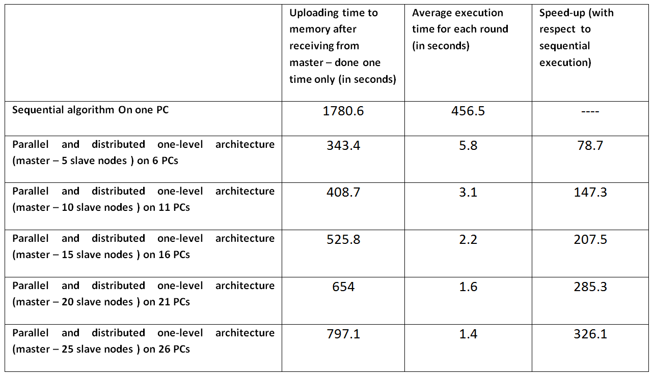
Web Services and parallel execution time for the last approach
Table 2 Comparison of the fifth approach with different number of nodes

Slide 43

Web Services and parallel execution time for the last approach Cont…
To be able to predict the speedup for any number of machines available, the following predictive equation was developed
  for calculating parallel execution time based on the number of nodes attached to master node.
where n is the number of nodes attached to a master node, and m is the total number of features.

Slide 44
Web Services and parallel execution time for the last approach Cont…
Figure 9 Real and predictive parallel execution time based on total number of slave nodes using master – N slave nodes approach

Slide 45
Results after retraining
The following are cases where cars and faces were not detected based on the existing trained classifier.
  For cars, the optimized training set size was around 60 cars and 60 non-cars.
  For faces, the optimized training set size was around 800 faces and 800 non-faces.
A short retraining will make the false positives weaker and the missed cars or faces stronger; then the previously missed car or face should be detected.

Slide 46
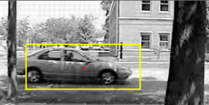
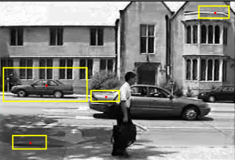
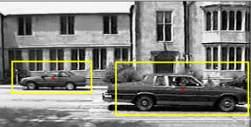
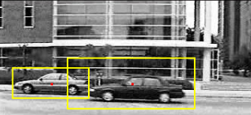
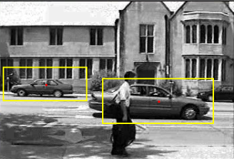
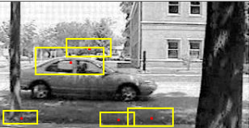
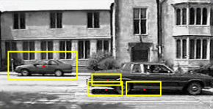
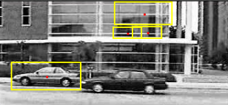
Results after retraining Cont…
Output | After re-training | Re-training time (seconds)
 |  | 22.4
 |  | 23.1
 |  | 22.4
 |  | 23.9

Slide 47
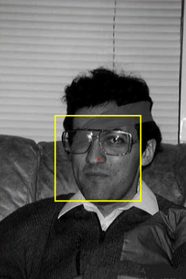
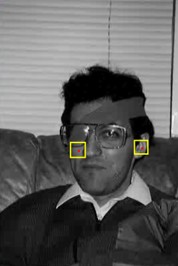
Results after retraining Cont…
Output | After re-training | Re-training time (seconds)
 |  | 384.2

Slide 48
Results after retraining Cont…
The following are cases where cars and faces were detected based on the existing trained classifier. However, there were also some false positives.
A short retraining will make these false positives weaker; then it should not be detected again as a car or a face.

Slide 49
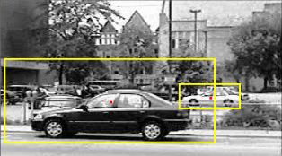
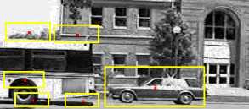
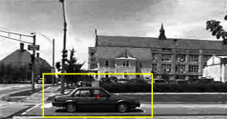
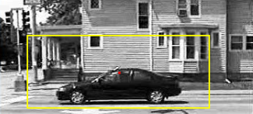
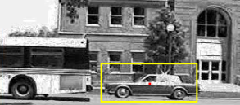
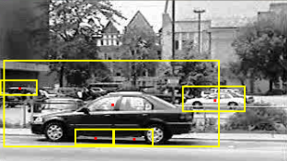
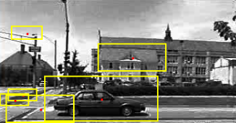
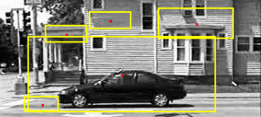
Results after retraining Cont…
Output | After re-training | Re-training time (seconds)
 |  | 19.2
 |  | 21.2
 |  | 28.5
 |  | 23.4

Slide 50
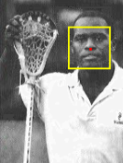


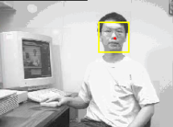

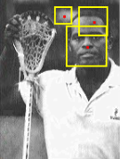
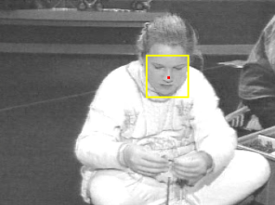

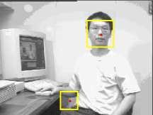
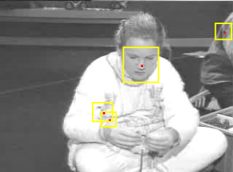
Results after retraining Cont…
Output | After re-training | Re-training time (seconds)
 |  | 187.6
 |  | 187.6
 |  | 192.6
 |  | 188.2
 |  | 190.3

Slide 51
Conclusion
This paper presents a generalized object detection framework such that:
  the system can efficiently adapt to misclassified data and be retrained within a few minutes or less.
We reduce this execution time through two major contributions:
  A highly parallel and distributed AdaBoost algorithm that exploits the multiple cores in a CPU and uses multiple machines.

Slide 52
Conclusion Cont…
    Development of a methodology to create a much smaller optimized training subset than is normally used, to reduce the training execution time further.
  Finally, we incorporate our parallel and distributed AdaBoost algorithm along with the optimized training subset into a generalized object detection framework
    that efficiently adapts to misclassified data and can be retrained within a few minutes or less.

Slide 53
Thank you

