Slide 1
Improving the Performance of Graph Analysis Through Partitioning with Sampling
Michael M. Wolf, Sandia National Laboratories
Benjamin A. Miller, MIT Lincoln Laboratory
IEEE HPEC 2015
September 16, 2015
=

Slide 2

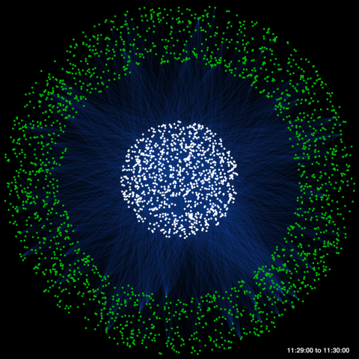

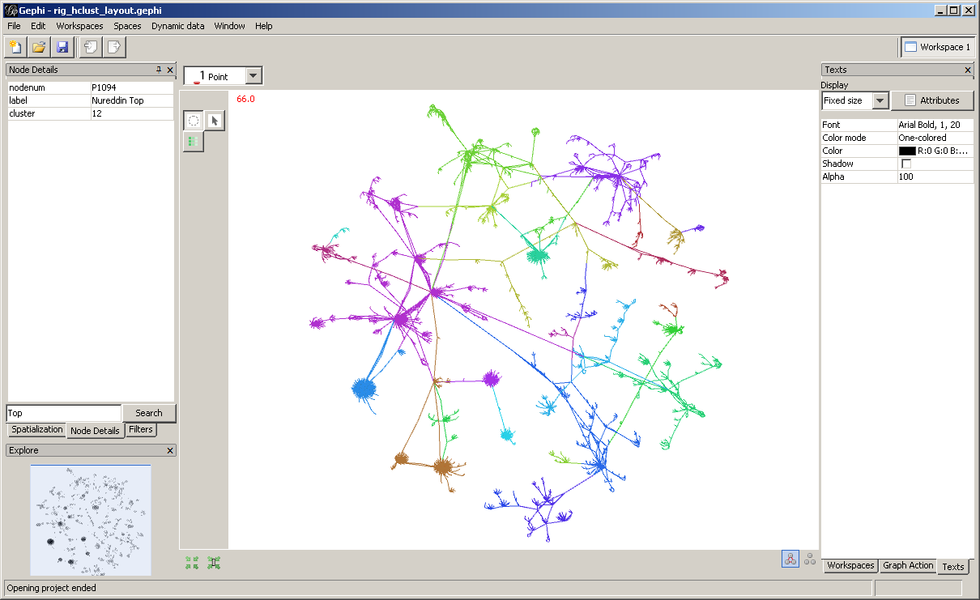
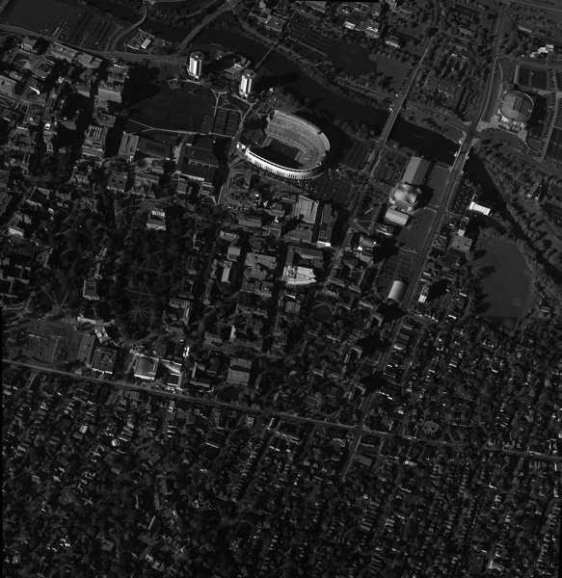

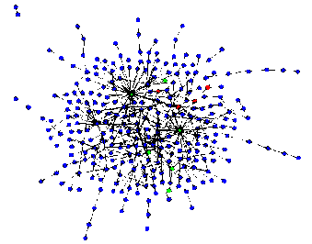
Motivating Graph Analytics Applications
ISR
Social
Cyber
Graphs represent entities and relationships detected through multiple sources
1,000s – 1,000,000s tracks and locations
GOAL: Identify anomalous patterns of life
Graphs represent relationships between individuals or documents
10,000s – 10,000,000s individual and interactions
GOAL: Identify hidden social networks
Graphs represent communication patterns of computers on a network
1,000,000s – 1,000,000,000s network events
GOAL: Detect cyber attacks or malicious software
Framework for detecting anomalies in massive datasets
Sparse matrix-vector (SpMV) product dominates runtime
M. Wolf and B. Miller, “Sparse Matrix Partitioning for Parallel Eigenanalysis of Large Static and Dynamic Graphs," in IEEE HPEC, 2014.
Notes:
Graphs analysis has proven to be useful in a number of different application areas. This reason for this is likely due to graph analytics proclivity for being able to identify patterns of coordination. The application of graph analytics grows harder as the patterns of coordination grow more subtle and the background graph grows larger and noisier.

Slide 3
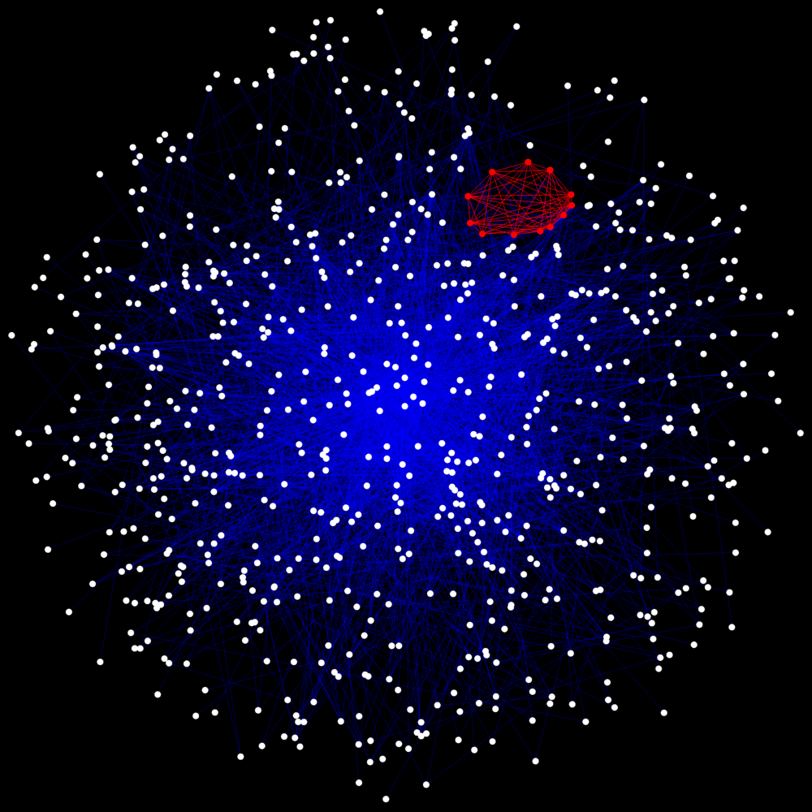
MITLL Statistical Detection Framework for Graphs
THRESHOLD
SIGNAL
‘+’
NOISE
NOISE
H₀
H₁
Graph Theory
Detection Theory
Develop fundamental graph
signal processing concepts
Signal Processing
for Graphs (SPG)
Demonstrate in simulation
Apply to real data
B.A. Miller, N.T. Bliss, P.J. Wolfe, and M.S. Beard, “Detection theory for graphs,” Lincoln Laboratory Journal, vol. 20, no. 1, pp. 10–30, 2013.
Notes:
The graph analytics I’ll discuss here are part of an effort at MIT-LL called Signal Processing for Graphs. This effort attempts to enable signal processing concepts to be applied to graph data

Slide 4
Computational Focus: Dimensionality Reduction
DIMENSIONALITY REDUCTION
Temporal Integration
Graph Model Construction
Residual Decomposition
Component Selection
Anomaly Detection
Identification
Eigensystem
Example: Modularity Matrix
Solve:
|e| – Number of edges in graph G(A)
k – degree vector
k_{i} = degree(v_{i}),
Dimensionality reduction dominates SPG computation
Eigen decomposition is key computational kernel
Parallel implementation required for very large graph problems
  Fit into memory, minimize runtime
Need fast parallel eigensolvers
M. Wolf and B. Miller, “Sparse Matrix Partitioning for Parallel Eigenanalysis of Large Static and Dynamic Graphs," in IEEE HPEC, 2014.
Notes:
Dimensionality reduction stages dominate the computation in the graph analytic processing chain. Eigen decomposition is a key computational kernel in this processing chain.

Slide 5
Outline
Motivation: Anomaly Detection in Very Large Graphs
Parallel Eigenanalysis Performance Challenges
Partitioning: Dynamic Graphs and Sampling
Impact of Graph Structure on Parallel SpMV Performance
Summary
Notes:
Outline

Slide 6
Partitioning Objective
Ideally we minimize total execution time of SpMV
Settle for easier objectives
  Balance computational work
  Minimize communication metric
    Total communication volume
    Number of messages
Can Partition matrices in different ways
  1D
  2D
Can model problem in different ways
  Graph
  Bipartite graph
  Hypergraph

Slide 7
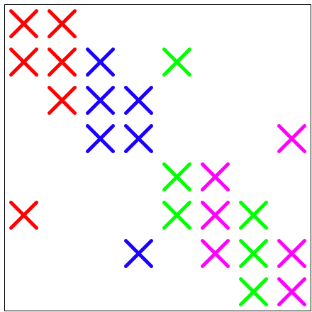
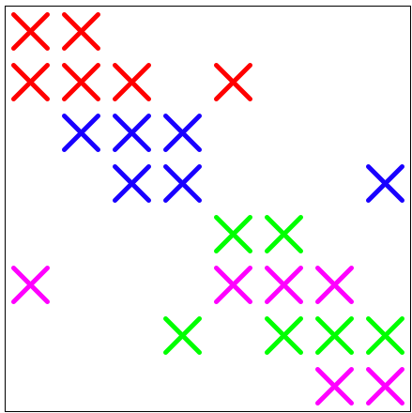
1D Partitioning
1D Column
1D Row
Each process assigned nonzeros for set of columns
Each process assigned nonzeros for set of rows

Slide 8
Weak Scaling
Runtime to Find 1st Eigenvector
4 billion vertices
R-MAT, 2¹⁸ vertices/core
Modularity Matrix
NERSC Hopper^
1D random
partitioning
Solved system for up to 4 billion vertex graph
^ This research used resources of the National Energy Research Scientific Computing Center, which is supported by the Office of Science of the U.S. Department of Energy under Contract No. DE-AC02-05CH11231.
M. Wolf and B. Miller, “Sparse Matrix Partitioning for Parallel Eigenanalysis of Large Static and Dynamic Graphs," in IEEE HPEC, 2014.
Notes:
Weak scaling on Hopper. Up to 4 billion vertex graph!
For a weak scaling study, the amount of memory per core is kept constant as we increase the number of cores.
The hope with a weak scaling study, the execution will remain constant as the number of cores are increased. For many sparse problems, this
may not be possible.

Slide 9
Strong Scaling: SpMV
R-Mat, 2²³ vertices
NERSC Hopper*
1D random
partitioning
Scalability limited and runtime increases for large numbers of cores
SpMV= Sparse matrix-vector multiplication
* This research used resources of the National Energy Research Scientific Computing Center, which is supported by the Office of Science of the U.S. Department of Energy under Contract No. DE-AC02-05CH11231.
M. Wolf and B. Miller, “Sparse Matrix Partitioning for Parallel Eigenanalysis of Large Static and Dynamic Graphs," in IEEE HPEC, 2014.
Notes:
Strong scaling result for SpMV kernel on LLGrid. Performance degrades as the number of cores is increased beyond a certain point (64).

Slide 10
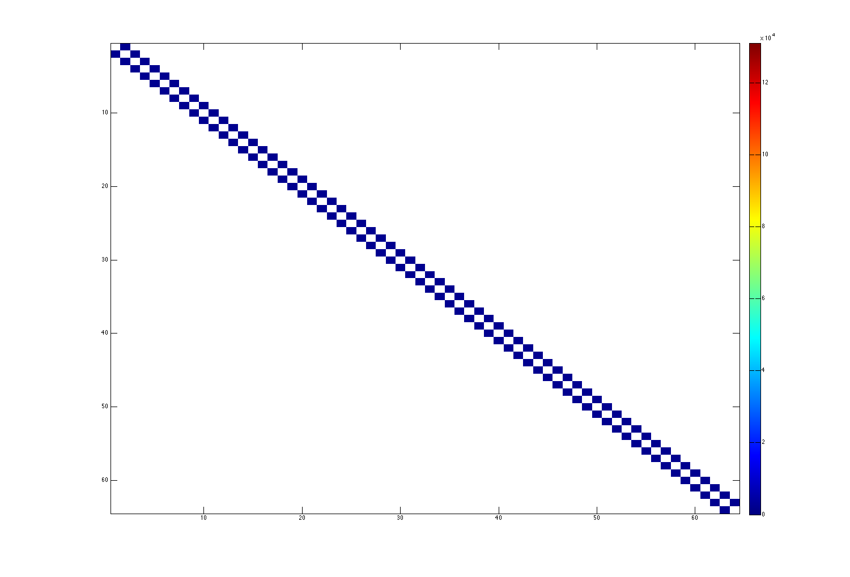
Communication Pattern: 1D Block Partitioning
2D Finite Difference Matrix (9 point)
Number of Rows: 2²³
Nonzeros/Row: 9
NNZ/process
min: 1.17E+06
max: 1.18E+06
avg: 1.18E+06
max/avg: 1.00
# Messages (Phase 1)
total: 126
max: 2
Volume (Phase 1)
total: 2.58E+05
max: 4.10E+03
source process
Nice properties:
Great load balance
Small number of messages
Low communication volume
P=64
destination process
M. Wolf and B. Miller, “Sparse Matrix Partitioning for Parallel Eigenanalysis of Large Static and Dynamic Graphs," in IEEE HPEC, 2014.
Notes:
Communication pattern for SpMV operation resulting from 1D Block Partitioning of 2D finite difference matrix.
These very regular matrices have very nice properties to obtain good parallel performance.

Slide 11
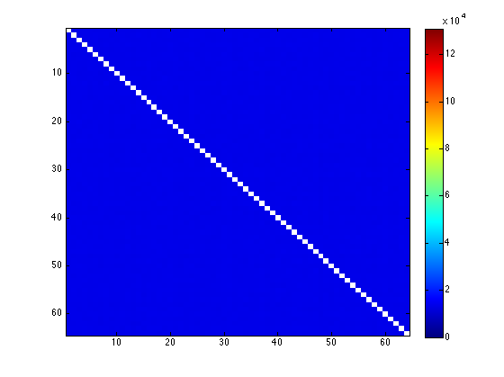
Communication Pattern: 1D Random Partitioning
R-Mat (0.5, 0.125, 0.125, 0.25)
Number of Rows: 2²³
Nonzeros/Row: 8
NNZ/process
min: 1.05E+06
max: 1.07E+06
avg: 1.06E+06
max/avg: 1.01
# Messages (Phase 1)
total: 4032
max: 63
Volume (Phase 1)
total: 5.48E+07
max: 8.62E+05
All-to-all communication
source process
Nice properties:
Great load balance
Challenges:
All-to-all communication
P=64
destination process
M. Wolf and B. Miller, “Sparse Matrix Partitioning for Parallel Eigenanalysis of Large Static and Dynamic Graphs," in IEEE HPEC, 2014.
Notes:
Communication pattern for SpMV operation resulting from 1D Random Partitioning of rmat matrix.
These power-law graph matrices have very challenging properties that makes obtaining good parallel performance difficult.
Important to note is the all-to-all communication. This can be prohibitively expensive for large numbers of processes.
Random partitioning (compared to block) “smooths” out the communication hot spots and improves the computational load balance.

Slide 12
2D Partitioning
2D Random Cartesian*
2D Cartesian Hypergraph**
=
=
(permuted)
(permuted)
2D Partitioning
  More flexibility: no particular part for entire row/column, more general sets of nonzeros
Use flexibility of 2D partitioning to bound number of messages
2D Random Cartesian*
  Block Cartesian with rows/columns randomly distributed
  Cyclic striping to minimize number of messages
2D Cartesian Hypergraph**
  Use hypergraph partitioning to minimize communication volume
  Con: more costly to partition than random
*Hendrickson, et al.; Bisseling; Yoo, et al.
**Boman, Devine, Rajamanickam, “Scalable Matrix Computations on Large Scale-Free Graphs Using 2D Partitioning, SC2013.
Notes:
1D partitioning tends not to not be scalable for these power law graph matrices.
Alternatively, we can try 2D partitioning, where entire rows/colums are no longer
assigned to a particular process. More flexibility
Several 2D methods have been developed: fine-grain hypergraph, Mondriaan, coarse-grain, etc.
Mondriaan (Vastenhouw and Bisseling) (2005)
Recursive bisection hypergraph partitioning
Each level: 1D row or column partitioning
Many other methods
An important class of 2D methods are the “2D Cartesian” type methods that
bound the number of messages communicated in the resulting SpMV operation.
Coarse-grain hypergraph partitioning also falls into this category.

Slide 13
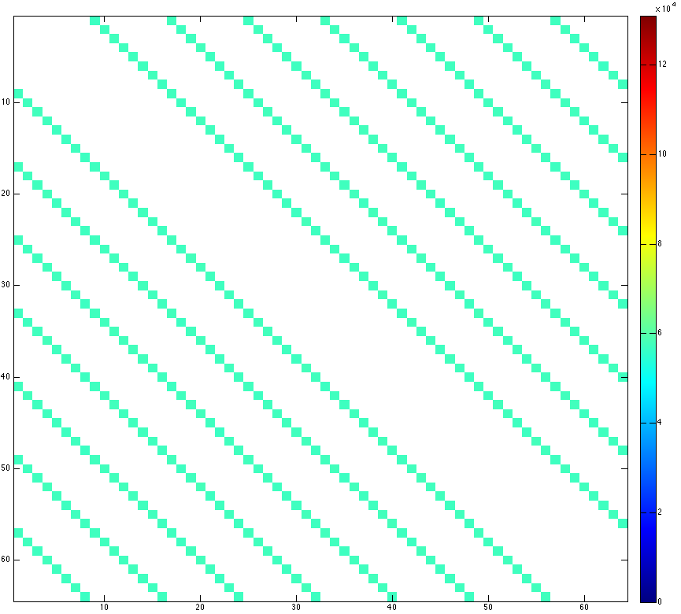
Communication Pattern: 2D Random Partitioning
Cartesian Blocks (2DR)
R-Mat (0.5, 0.125, 0.125, 0.25)
Number of Rows: 2²³
Nonzeros/Row: 8
NNZ/process
min: 1.04E+06
max: 1.05E+06
avg: 1.05E+06
max/avg: 1.01
# Messages (Phase 1)
total: 448
max: 7
Volume (Phase 1)
total: 2.57E+07
max: 4.03E+05
source process
Nice properties:
No all-to-all communication
Total volume lower than 1DR
P=64
destination process
1DR = 1D Random

Slide 14
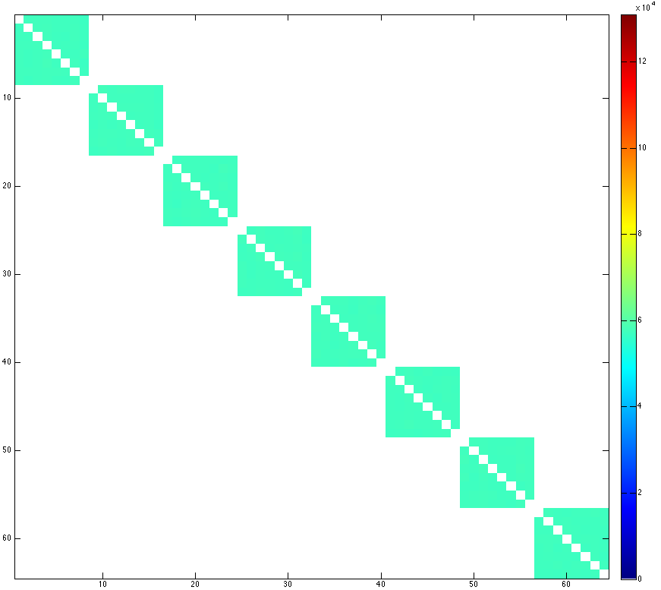
Communication Pattern: 2D Random Partitioning
Cartesian Blocks (2DR)
R-Mat (0.5, 0.125, 0.125, 0.25)
Number of Rows: 2²³
Nonzeros/Row: 8
NNZ/process
min: 1.04E+06
max: 1.05E+06
avg: 1.05E+06
max/avg: 1.01
# Messages (Phase 2)
total: 448
max: 7
Volume (Phase 2)
total: 2.57E+07
max: 4.03E+05
source process
Nice properties:
No all-to-all communication
Total volume lower than 1DR
P=64
destination process
1DR = 1D Random

Slide 15
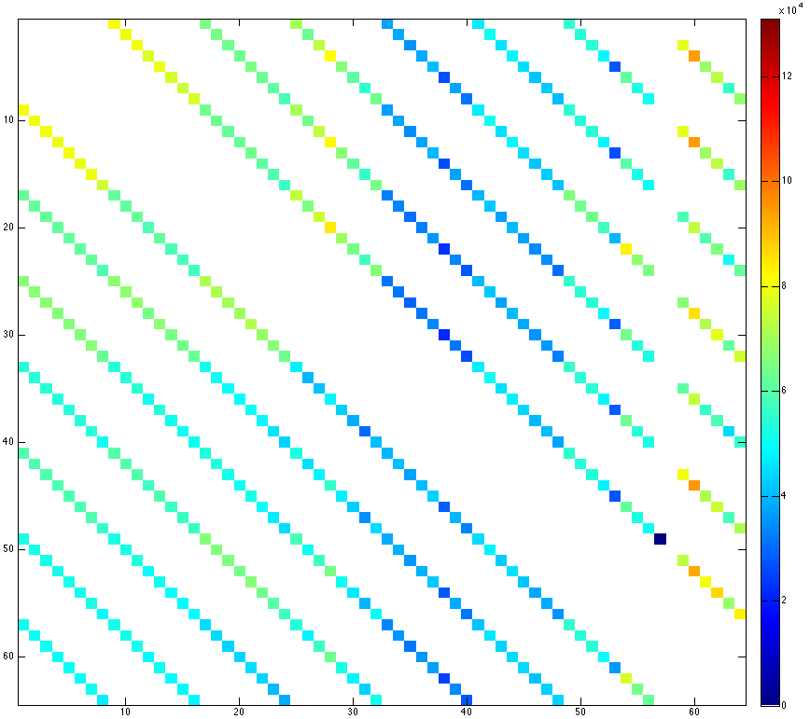
Communication Pattern: 2D Cartesian
Hypergraph Partitioning
R-Mat (0.5, 0.125, 0.125, 0.25)
Number of Rows: 2²³
Nonzeros/Row: 8
NNZ/process
min: 5.88E+05
max: 1.29E+06
avg: 1.05E+06
max/avg: 1.23
# Messages (Phase 1)
total: 448
max: 7
Volume (Phase 1)
total: 2.33E+07
max: 4.52E+05
source process
Nice properties:
No all-to-all communication
Total volume lower than 2DR
Challenges:
Imbalance worse than 2DR
P=64
destination process
2DR = 2D Random Cartesian
Notes:
Total volume actually slightly higher than 2D Random Cartesian blocks. However, for other problems it is often lower.

Slide 16
Improved Strong Scaling: SpMV
*
**
R-Mat, 2²³ vertices/rows
NERSC Hopper^
Zoltan PHG
hypergraph partitioner
2D methods show improved scalability
^ This research used resources of the National Energy Research Scientific Computing Center, which is supported by the Office of Science of the U.S. Department of Energy under Contract No. DE-AC02-05CH11231.
*Hendrickson, et al.; Bisseling; Yoo, et al.
**Boman, Devine, Rajamanickam, “Scalable Matrix Computations on Large Scale-Free Graphs Using 2D Partitioning, SC2013.
M. Wolf and B. Miller, “Sparse Matrix Partitioning for Parallel Eigenanalysis of Large Static and Dynamic Graphs," in IEEE HPEC, 2014.
Notes:
Strong scaling of SpMV operation isolated from eigensolver. Even a simple 2D distribution can improve scalability.

Slide 17
Improved Strong Scaling: Eigensolver
Runtime to Find 1st Eigenvector
R-Mat, 2²³ vertices
Modularity Matrix
NERSC Hopper*
2D methods show improved scalability
* This research used resources of the National Energy Research Scientific Computing Center, which is supported by the Office of Science of the U.S. Department of Energy under Contract No. DE-AC02-05CH11231.
M. Wolf and B. Miller, “Sparse Matrix Partitioning for Parallel Eigenanalysis of Large Static and Dynamic Graphs," in IEEE HPEC, 2014.
Notes:
Even a simple 2D distribution can improve scalability.

Slide 18
Challenge with Hypergraph Partitioning
NERSC Hopper
~40,000 SpMVs
R-Mat, 2²³ vertices
1024 cores
High partitioning cost of hypergraph methods must be amortized by computing many SpMV operations
Anomaly detection* requires at most 1000s of SpMV operations
*L1 norm method: computing 100 eigenvectors
M. Wolf and B. Miller, “Sparse Matrix Partitioning for Parallel Eigenanalysis of Large Static and Dynamic Graphs," in IEEE HPEC, 2014.
Notes:
Outline

Slide 19
Outline
Motivation: Anomaly Detection in Very Large Graphs
Parallel Eigenanalysis Performance Challenges
Partitioning: Dynamic Graphs and Sampling
Impact of Graph Structure on Parallel SpMV Performance
Summary
Notes:
Outline

Slide 20
Sampling and Partitioning for Web/SN Graphs
Graph Sampling and Partitioning
Sample E
Partition G’
Apply partition
to G
Input Graph,
G=(V, E)
G’=(V,E’)
G₁’=(V₁,E₁’)
G₂’=(V₂,E₂’)
G₁=(V₁,E₁)
G₂=(V₂,E₂)
|E’|≈α|E|
Sampling rate
Sampling + Partitioning:
  Produce smaller graph G’ by sampling edges in graph G (uniform random sampling), keep vertices same
  Partition G’ (2D Cartesian Hypergraph, Zoltan PHG)
  Apply partition to G
Idea: Partition sampled graph to reduce partitioning time

Slide 21
Partitioning + Sampling: Partitioning Time
2D Cartesian Hypergraph
hollywood-2009**:
Actor network
1.1 M vertices, 110 M edges
Edge sampling greatly reduces partitioning time (by up to 6x)
NERSC Hopper*
* This research used resources of the National Energy Research Scientific Computing Center, which is supported by the Office of Science of the U.S. Department of Energy under Contract No. DE-AC02-05CH11231.
**The University of Florida Sparse Matrix Collection

Slide 22
Partitioning + Sampling: SpMV Time
2D Cartesian Hypergraph
hollywood-2009**:
Actor network
1.1 M vertices, 110 M edges
NERSC Hopper*
Resulting SpMV time does not increase for modest sampling
* This research used resources of the National Energy Research Scientific Computing Center, which is supported by the Office of Science of the U.S. Department of Energy under Contract No. DE-AC02-05CH11231.
**The University of Florida Sparse Matrix Collection

Slide 23
Challenge with Hypergraph Partitioning Revisited
2DR = 2D Cartesian Random
2DH = 2D Cartesian Hypergraph (Zoltan PHG)
~100,000 SpMVs
~10,000 SpMVs
hollywood-2009
1024 cores
NERSC Hopper*
Sampling rate: 0.1
Sampling reduces overhead of hypergraph partitioning
(fewer SpMVs needed to amortize partitioning cost)
* This research used resources of the National Energy Research Scientific Computing Center, which is supported by the Office of Science of the U.S. Department of Energy under Contract No. DE-AC02-05CH11231.
Notes:
Outline

Slide 24
Outline
Motivation: Anomaly Detection in Very Large Graphs
Parallel Eigenanalysis Performance Challenges
Partitioning: Dynamic Graphs and Sampling
Impact of Graph Structure on Parallel SpMV Performance
Summary
Notes:
Outline

Slide 25
Experiments
Want to determine impact of both data and sampling method features on SpMV performance
Use three graph models (2²⁰ vertices, avg degree 32)
  Erdős–Rényi: neither community structure nor skewed degree distribution
  Chung–Lu: skewed degree distribution, no community structure
    Average degree distribution based on beta distribution
  Stochastic Blockmodel: community structure, no skewed degree distribution
    32 communities, internal connections 15 times more likely
Also three sampling strategies
  Uniformly sample edges
  Sample edges based on degree (edges connected to high-degree vertices are more likely to be sampled)
  Sample edges based on inverse degree (edges connected to high-degree vertices are less likely to be sampled)

Slide 26
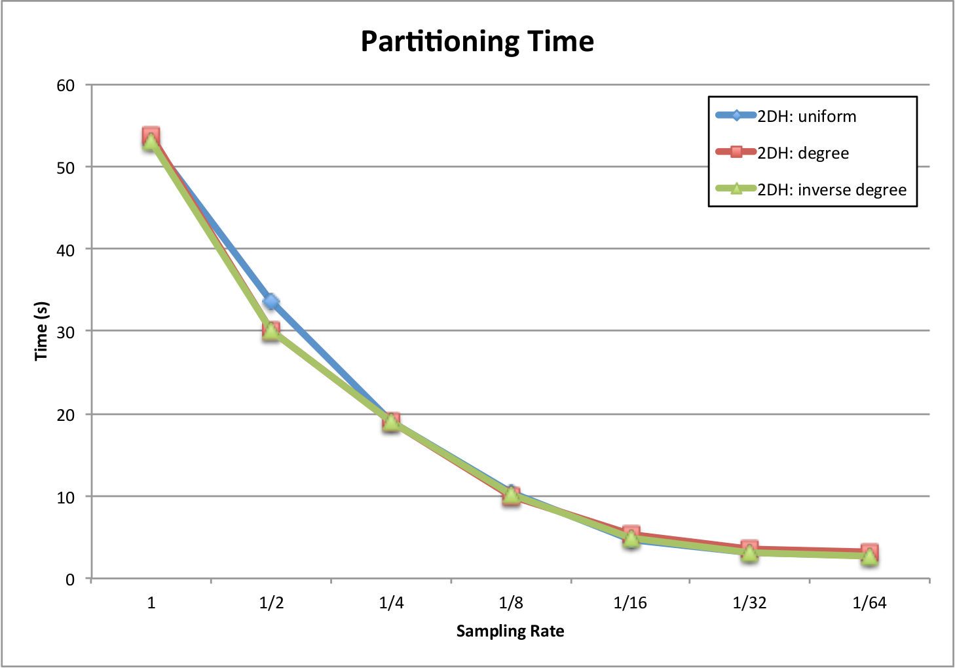
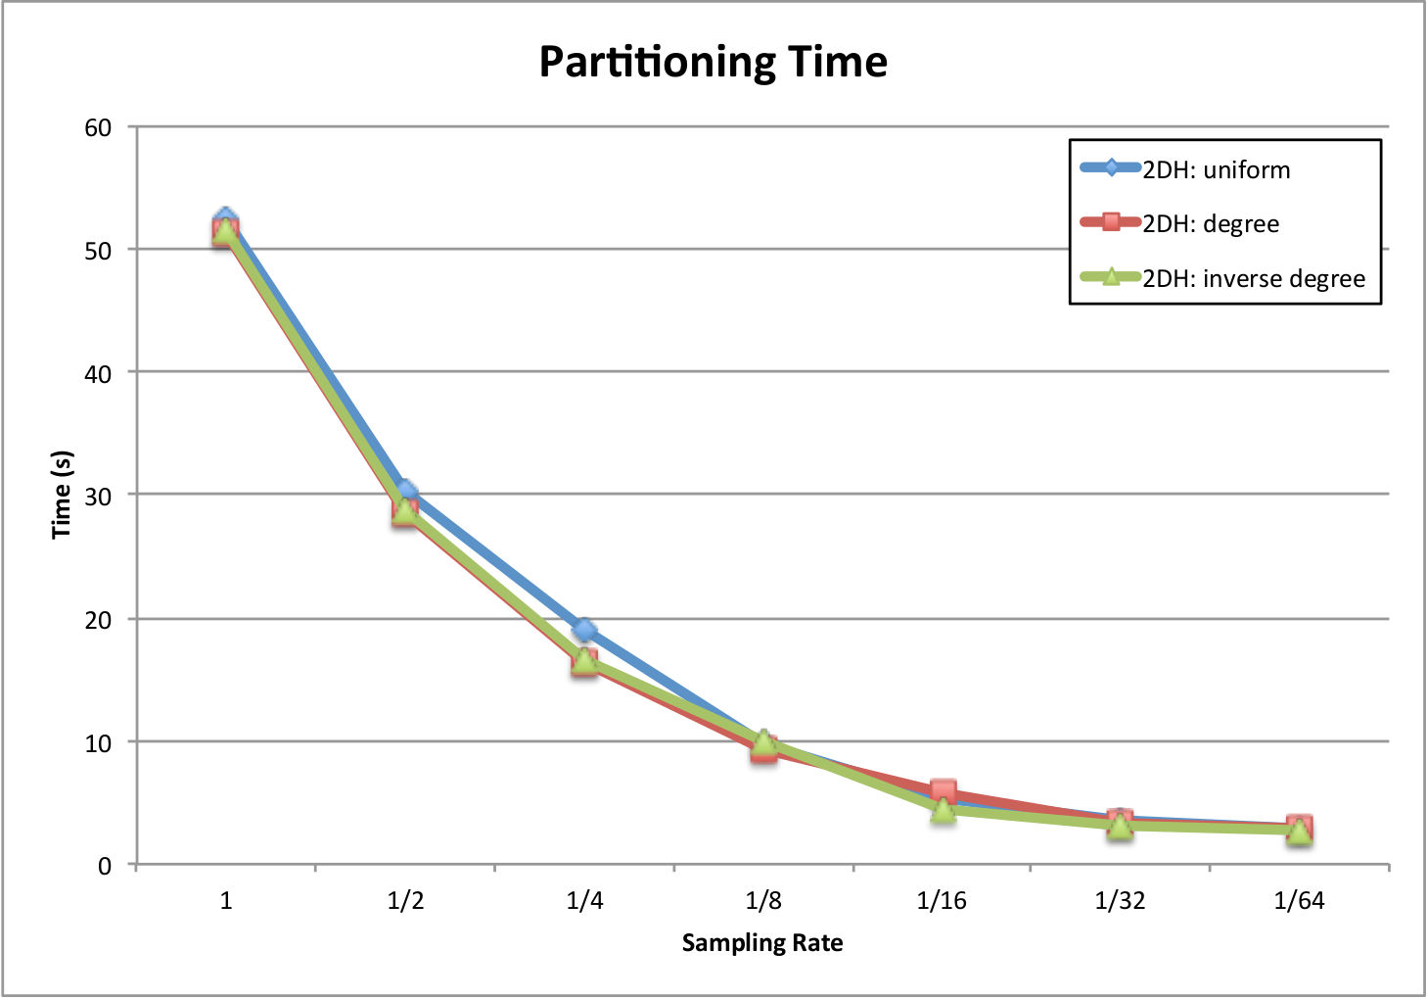
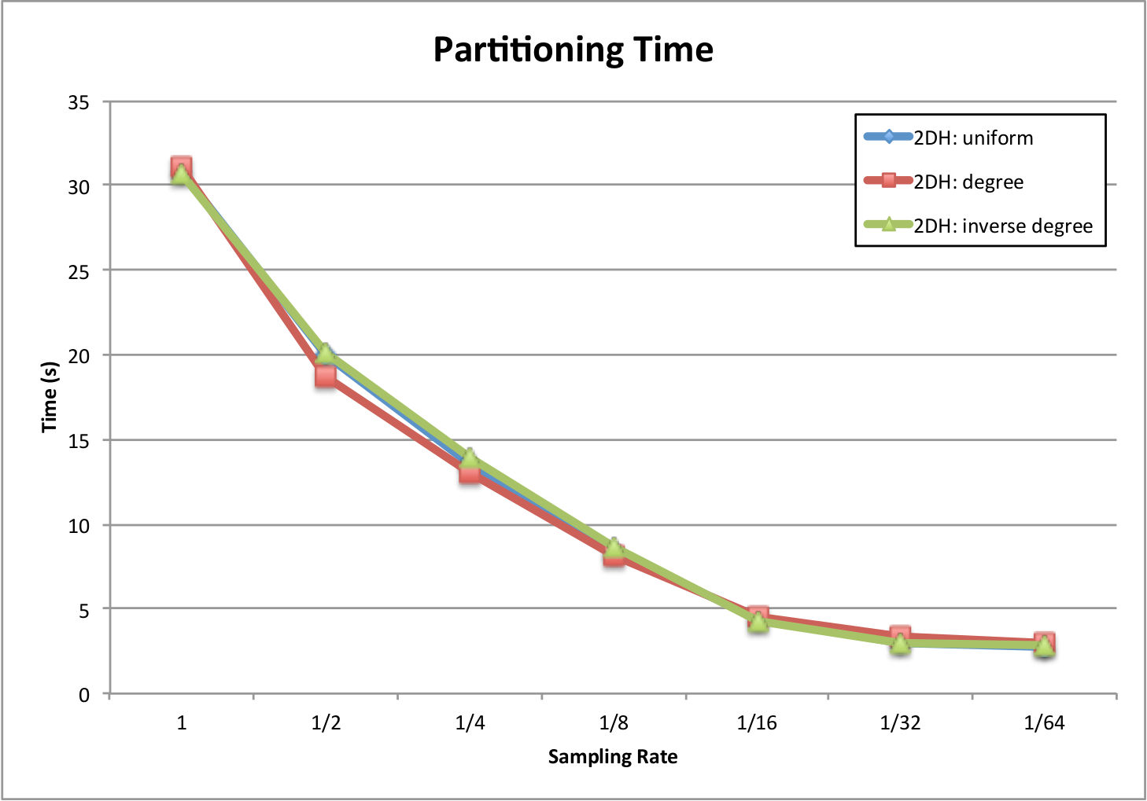
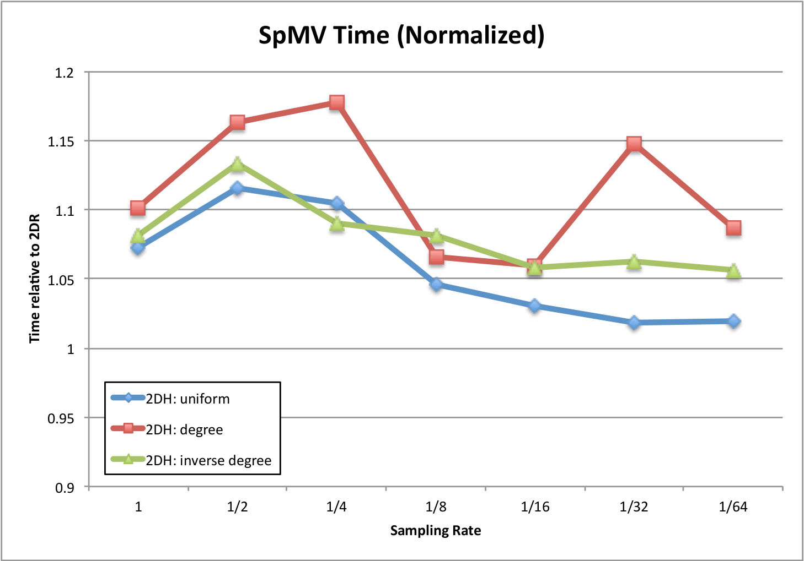
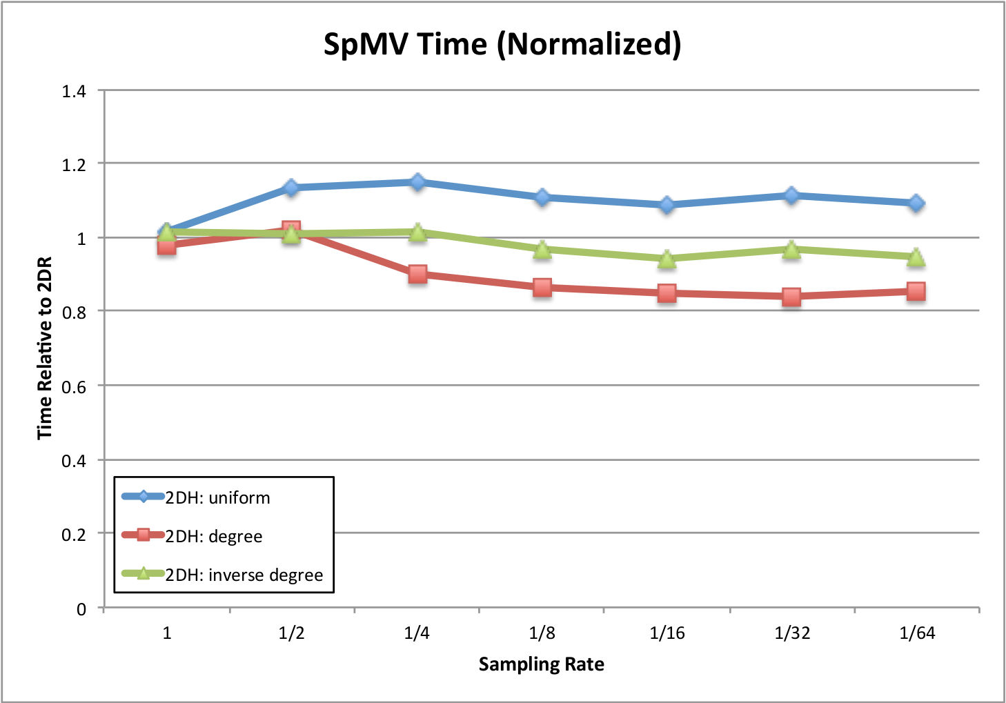
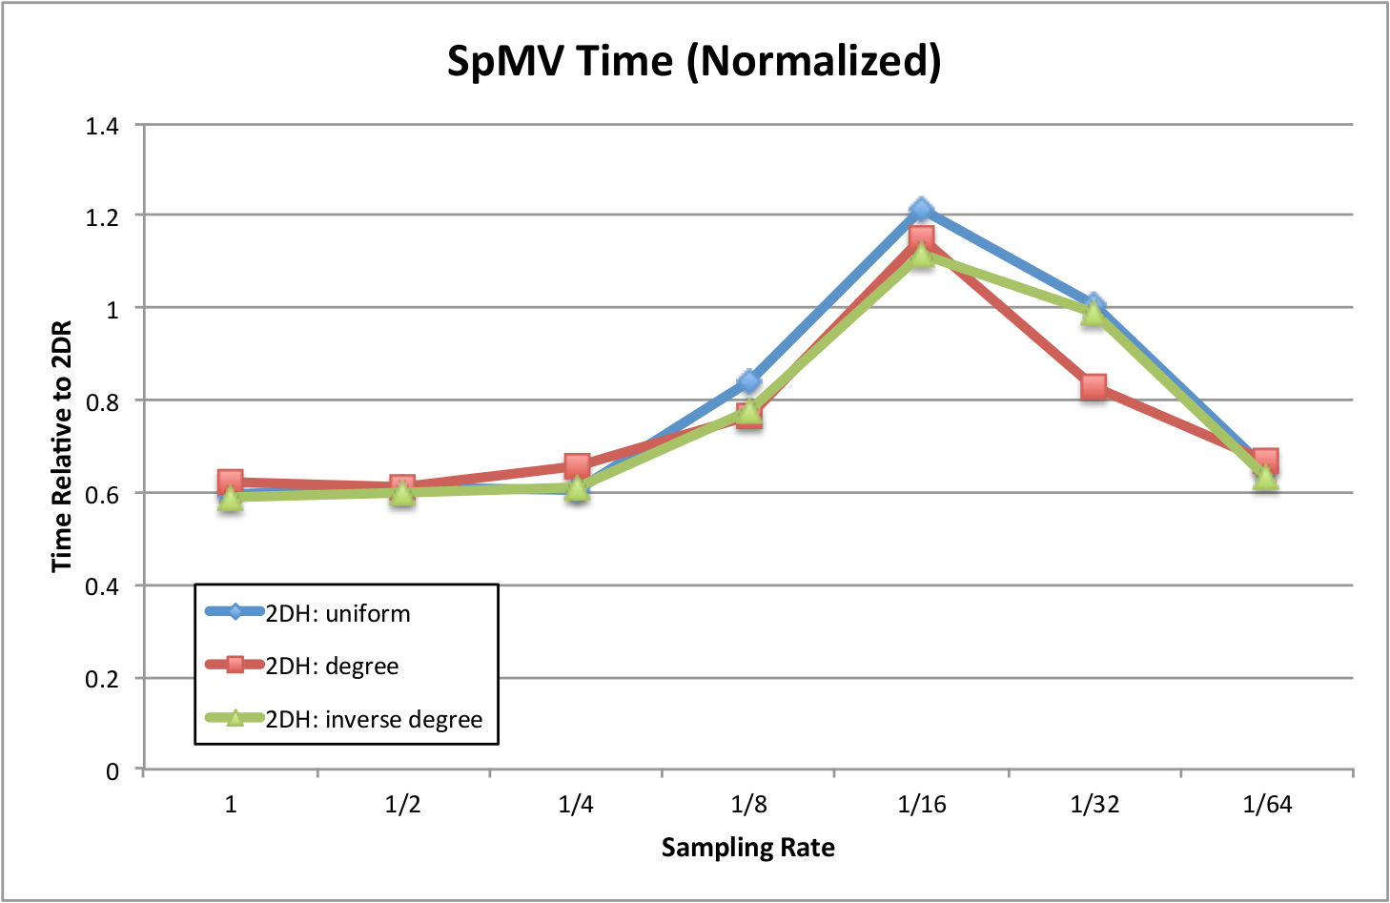
Results
Erdős–Rényi
Chung–Lu
Stochastic Blockmodel
NERSC Hopper*
* This research used resources of the National Energy Research Scientific Computing Center, which is supported by the Office of Science of the U.S. Department of Energy under Contract No. DE-AC02-05CH11231.

Slide 27
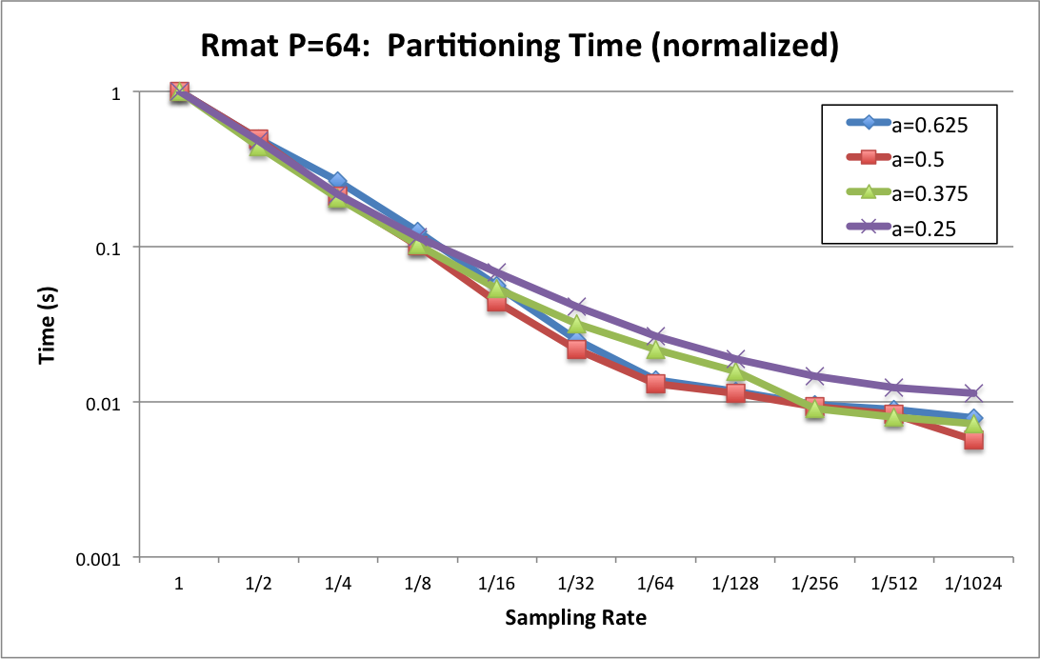
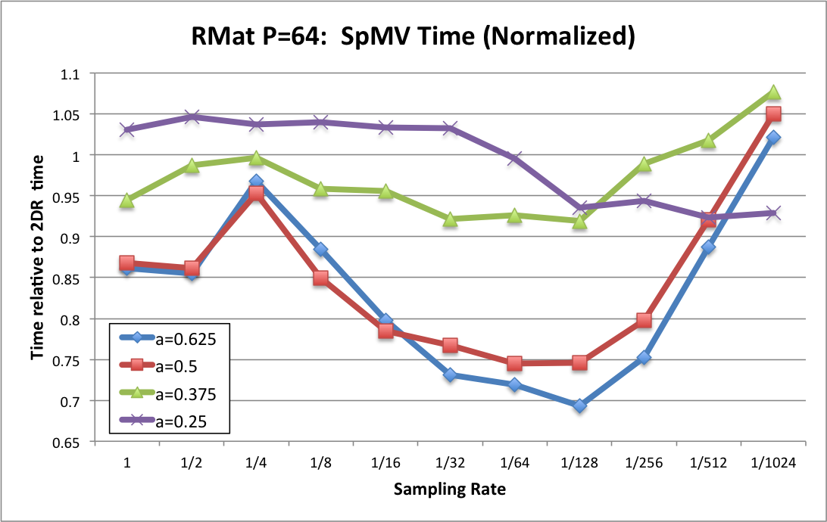
R-Mat Experiment
Partitioning Time
R-Mat graphs:
1 M vertices, 100 M edges
R-Mat parameters:
a
b=c=(0.75-a)/2
d=0.25
Number of processors: 64
NERSC Hopper
2D Cartesian Hypergraph
(Zoltan PHG)
R-Mat
a
b
Time relative to unsampled partitioning
c
d
SpMV Time
Sampling greatly reduces partitioning time (by up to 100x)
SpMV runtime is decreased (over 2D random) for graphs with more community-like structure
Time relative to 2D random time
NERSC Hopper*
* This research used resources of the National Energy Research Scientific Computing Center, which is supported by the Office of Science of the U.S. Department of Energy under Contract No. DE-AC02-05CH11231.

Slide 28
Discussion
As community structure increases, the benefit of hypergraph partitioning also increases
  Sampling affects SpMV performance in a non-monotonic way
  This will require further investigation
Chung-Lu Graphs benefit more from “degree” sampling than “inverse degree” sampling
  Suggests high-degree vertices are important for partitioning
SpMV of R-Mat graphs significantly improves at some sampling rates
  May be an artifact of the R-Mat process

Slide 29
Summary
Partitioning for extreme scale problems and architectures challenging
  Need high quality partitions
  Need fast partitioners
Possible approach: Sampling and partitioning
  Significant improvement of hypergraph partitioning performance for web/SN graphs
Question: what is the impact of graph structure on partitioning?
  Consistently reduces partitioning time
  May increase or decrease SpMV time
    Appears highly dependent on aspects of the graph structure
Future Work
  Larger problem set, larger problems
  More intelligent sampling techniques
  Experiments using real data with varying characteristics
Notes:
Summary.

