Slide 1
Lustre, Hadoop, Accumulo
Jeremy Kepner^{1,2,3}, William Arcand¹, David Bestor¹, Bill Bergeron¹, Chansup Byun¹, Lauren Edwards¹, Vijay Gadepally^{1,2}, Matthew Hubbell¹, Peter Michaleas¹, Julie Mullen¹, Andrew Prout¹, Antonio Rosa¹, Charles Yee¹, Albert Reuther¹
¹MIT Lincoln Laboratory, ²MIT Computer Science & AI Laboratory, ³MIT Mathematics Department
September 17, 2015
This material is based upon work supported by the National Science Foundation under Grant No. DMS-1312831. Any opinions, findings, and conclusions or recommendations expressed in this material are those of the author(s) and do not necessarily reflect the views of the National Science Foundation.
Notes:
1
1
Title Page

Slide 2
Outline
Introduction
  Volume, Velocity, Variety, Veracity
Big Data Storage APIs
  Lustre, Hadoop, Accumulo
Modeling Storage Performance
  Mix n’ Match Solutions
Summary
Notes:
Outline

Slide 3
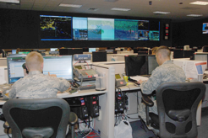

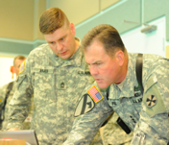




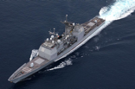
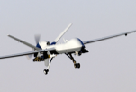






Common Big Data Challenge
Operators
Analysts
Commanders
Users
Rapidly increasing
- Data volume
- Data velocity
- Data variety
- Data veracity (security)
Data
Gap
Users
2000
2005
2010
2015 & Beyond
Data
<html>
OSINT
Weather
HUMINT
C2
Ground
Maritime
Air
Space
Cyber
Notes:
Increasing data volume, velocity, and variety has created a growing gap between data and users.
Image Sources:
Operators: http://en.wikipedia.org/wiki/Air_and_Space_Operations_Center
Analysts: © Comstock http://www.gettyimages.com/detail/photo/businessman-at-computer-royalty-free-image/78479774.
Commanders: US Forces Korea General News http://www.usfk.mil/usfk/%28A%28dL8DLge1ywEkAAAAYzg4NWY4MzMtM2I0OS00YWI5LTljYjctMWQ0NDM4MGUwYzVmgU4GPacw1yQ4-d8XCgyTu_0lbjQ1%29S%28aw5nfc45hpuvapn5pihn0o45%29%29/news.annual.command.post.exercise.winds.down.in.korea.printview.648
OSINT: Acrobat logo is © Adobe Systems Inc., © Twitter and Office 2011 logos are © Microsoft
Weather: © Rebecca van Ommen : http://www.gettyimages.com/detail/photo/paper-craft-weather-royalty-free-image/180478515
HUMINT: U.S. Dept of State http://www.rewardsforjustice.net/index.cfm?page=zulkifli&language=english
C2: http://www.disa.mil/Services/Command-and-Control/GCCS-J
Ground: Staff Sgt. William Tremblay/U.S. Army via Wired : http://www.wired.com/dangerroom/2010/09/afghan-biometric-dragnet-could-snag-millions/
Maritime: This file is a work of a sailor or employee of the U.S. Navy, taken or made as part of that person's official duties. As a work of the U.S. federal government, the image is in the public domain. http://en.wikipedia.org/wiki/File:USS_Lake_Champlain_%28CG-57%29.JPG
Air: This image or file is a work of a U.S. Air Force Airman or employee, taken or made as part of that person's official duties. As a work of the U.S. federal government, the image or file is in the public domain. http://en.wikipedia.org/wiki/File:MQ-9_Reaper_in_flight_%282007%29.jpg
Space: This file is in the public domain because it was solely created by NASA. NASA copyright policy states that "NASA material is not protected by copyright unless noted". http://en.wikipedia.org/wiki/File:CloudSat_-_Artist_Concept.jpg
Cyber: © derrrek : http://www.gettyimages.com/detail/illustration/abstract-backgrounds-royalty-free-illustration/185548379
This graphic was previously approved for public release as MS-77705

Slide 4
Common Big Data Architecture
Operators
Analysts
Commanders
Users
Web
Ingest & Enrichment
Databases
Ingest & Enrichment
Ingest
Analytics
Files
Scheduler
Computing
Data
<html>
OSINT
Weather
HUMINT
C2
Ground
Maritime
Air
Space
Cyber
Notes:
The Common Big Data Architecture shows the components that are common to many big data and supercomputing systems. The platform is designed to support standardized data access and dynamic composition of functionalities.
Image Sources:
Operators: http://en.wikipedia.org/wiki/Air_and_Space_Operations_Center
Analysts: © Comstock http://www.gettyimages.com/detail/photo/businessman-at-computer-royalty-free-image/78479774.
Commanders: US Forces Korea General News http://www.usfk.mil/usfk/%28A%28dL8DLge1ywEkAAAAYzg4NWY4MzMtM2I0OS00YWI5LTljYjctMWQ0NDM4MGUwYzVmgU4GPacw1yQ4-d8XCgyTu_0lbjQ1%29S%28aw5nfc45hpuvapn5pihn0o45%29%29/news.annual.command.post.exercise.winds.down.in.korea.printview.648
OSINT: Acrobat logo is © Adobe Systems Inc., © Twitter and Office 2011 logos are © Microsoft
Weather: © Rebecca van Ommen : http://www.gettyimages.com/detail/photo/paper-craft-weather-royalty-free-image/180478515
HUMINT: U.S. Dept of State http://www.rewardsforjustice.net/index.cfm?page=zulkifli&language=english
C2: http://www.disa.mil/Services/Command-and-Control/GCCS-J
Ground: Staff Sgt. William Tremblay/U.S. Army via Wired : http://www.wired.com/dangerroom/2010/09/afghan-biometric-dragnet-could-snag-millions/
Maritime: This file is a work of a sailor or employee of the U.S. Navy, taken or made as part of that person's official duties. As a work of the U.S. federal government, the image is in the public domain. http://en.wikipedia.org/wiki/File:USS_Lake_Champlain_%28CG-57%29.JPG
Air: This image or file is a work of a U.S. Air Force Airman or employee, taken or made as part of that person's official duties. As a work of the U.S. federal government, the image or file is in the public domain. http://en.wikipedia.org/wiki/File:MQ-9_Reaper_in_flight_%282007%29.jpg
Space: This file is in the public domain because it was solely created by NASA. NASA copyright policy states that "NASA material is not protected by copyright unless noted". http://en.wikipedia.org/wiki/File:CloudSat_-_Artist_Concept.jpg
Cyber: © derrrek : http://www.gettyimages.com/detail/illustration/abstract-backgrounds-royalty-free-illustration/185548379
This graphic was previously approved for public release as MS-77705

Slide 5




Common Big Data Architecture
- Data Volume: Various Clouds -
Operators
Analysts
Four Major Ecosystems
Operators
Analysts
Commanders
Users
Enterprise Cloud
Compute Cloud
VMware
MIT
SuperCloud
Testbed
MPI
Web
Ingest & Enrichment
Databases
Ingest & Enrichment
Hadoop
Ingest
SQL
Analytics
Files
Big Data Cloud
Database Cloud
Scheduler
Computing
Data
<html>
OSINT
Weather
HUMINT
C2
Ground
Maritime
Air
Space
Cyber
LLSuperCloud: Sharing HPC Systems for Diverse Rapid Prototyping, Reuther et al, IEEE HPEC 2013
Notes:
Addressing data volume requires a large computing cloud. MIT SuperCloud merges four main clouds.
Image Sources:
Operators: http://en.wikipedia.org/wiki/Air_and_Space_Operations_Center
Analysts: © Comstock http://www.gettyimages.com/detail/photo/businessman-at-computer-royalty-free-image/78479774.
Commanders: US Forces Korea General News http://www.usfk.mil/usfk/%28A%28dL8DLge1ywEkAAAAYzg4NWY4MzMtM2I0OS00YWI5LTljYjctMWQ0NDM4MGUwYzVmgU4GPacw1yQ4-d8XCgyTu_0lbjQ1%29S%28aw5nfc45hpuvapn5pihn0o45%29%29/news.annual.command.post.exercise.winds.down.in.korea.printview.648
OSINT: Acrobat logo is © Adobe Systems Inc., © Twitter and Office 2011 logos are © Microsoft
Weather: © Rebecca van Ommen : http://www.gettyimages.com/detail/photo/paper-craft-weather-royalty-free-image/180478515
HUMINT: U.S. Dept of State http://www.rewardsforjustice.net/index.cfm?page=zulkifli&language=english
C2: http://www.disa.mil/Services/Command-and-Control/GCCS-J
Ground: Staff Sgt. William Tremblay/U.S. Army via Wired : http://www.wired.com/dangerroom/2010/09/afghan-biometric-dragnet-could-snag-millions/
Maritime: This file is a work of a sailor or employee of the U.S. Navy, taken or made as part of that person's official duties. As a work of the U.S. federal government, the image is in the public domain. http://en.wikipedia.org/wiki/File:USS_Lake_Champlain_%28CG-57%29.JPG
Air: This image or file is a work of a U.S. Air Force Airman or employee, taken or made as part of that person's official duties. As a work of the U.S. federal government, the image or file is in the public domain. http://en.wikipedia.org/wiki/File:MQ-9_Reaper_in_flight_%282007%29.jpg
Space: This file is in the public domain because it was solely created by NASA. NASA copyright policy states that "NASA material is not protected by copyright unless noted". http://en.wikipedia.org/wiki/File:CloudSat_-_Artist_Concept.jpg
Cyber: © derrrek : http://www.gettyimages.com/detail/illustration/abstract-backgrounds-royalty-free-illustration/185548379
This graphic was previously approved for public release as MS-77705

Slide 6
Common Big Data Architecture
- Data Velocity: Accumulo Database -
Operators
Analysts
Commanders
Users
Web
Ingest & Enrichment
Databases
Ingest & Enrichment
Ingest
Analytics
World Record
holder in database performance
Files
Scheduler
Computing
Data
<html>
OSINT
Weather
HUMINT
C2
Ground
Maritime
Air
Space
Cyber
Achieving 100,000,000 database inserts per second using Accumulo and D4M, IEEE HPEC 2014
Notes:
Data velocity requires high performance databases. Lincoln has confirmed the claims of the Accumulo database.
Image Sources:
Operators: http://en.wikipedia.org/wiki/Air_and_Space_Operations_Center
Analysts: © Comstock http://www.gettyimages.com/detail/photo/businessman-at-computer-royalty-free-image/78479774.
Commanders: US Forces Korea General News http://www.usfk.mil/usfk/%28A%28dL8DLge1ywEkAAAAYzg4NWY4MzMtM2I0OS00YWI5LTljYjctMWQ0NDM4MGUwYzVmgU4GPacw1yQ4-d8XCgyTu_0lbjQ1%29S%28aw5nfc45hpuvapn5pihn0o45%29%29/news.annual.command.post.exercise.winds.down.in.korea.printview.648
OSINT: Acrobat logo is © Adobe Systems Inc., © Twitter and Office 2011 logos are © Microsoft
Weather: © Rebecca van Ommen : http://www.gettyimages.com/detail/photo/paper-craft-weather-royalty-free-image/180478515
HUMINT: U.S. Dept of State http://www.rewardsforjustice.net/index.cfm?page=zulkifli&language=english
C2: http://www.disa.mil/Services/Command-and-Control/GCCS-J
Ground: Staff Sgt. William Tremblay/U.S. Army via Wired : http://www.wired.com/dangerroom/2010/09/afghan-biometric-dragnet-could-snag-millions/
Maritime: This file is a work of a sailor or employee of the U.S. Navy, taken or made as part of that person's official duties. As a work of the U.S. federal government, the image is in the public domain. http://en.wikipedia.org/wiki/File:USS_Lake_Champlain_%28CG-57%29.JPG
Air: This image or file is a work of a U.S. Air Force Airman or employee, taken or made as part of that person's official duties. As a work of the U.S. federal government, the image or file is in the public domain. http://en.wikipedia.org/wiki/File:MQ-9_Reaper_in_flight_%282007%29.jpg
Space: This file is in the public domain because it was solely created by NASA. NASA copyright policy states that "NASA material is not protected by copyright unless noted". http://en.wikipedia.org/wiki/File:CloudSat_-_Artist_Concept.jpg
Cyber: © derrrek : http://www.gettyimages.com/detail/illustration/abstract-backgrounds-royalty-free-illustration/185548379
This graphic was previously approved for public release as MS-77705

Slide 7
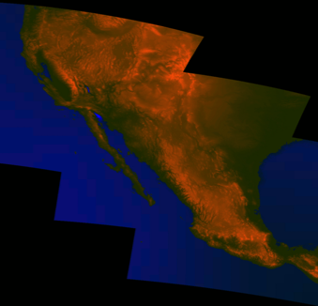


Common Big Data Architecture
- Data Velocity: SciDB for Dense Data -
Operators
Operators
Analysts
Commanders
Integrated SciDB; brings the power of databases to dense data
Users
SciDB
SAR
LIDAR
SONAR
HSI
EO
LAT
LON
TIME
HEIGHT
…
Web
Ingest & Enrichment
Databases
Ingest & Enrichment
Ingest
Analytics
- Dense data currently stored as raw, unindexed file
- SciDB dramatically reduces time to exploit dense data
Files
Scheduler
Computing
Data
<html>
OSINT
Weather
HUMINT
C2
Ground
Maritime
Air
Space
Cyber
Notes:
Data velocity requires high performance databases. SciDB is ideally suited storing dense sensor data.
Image Sources:
Operators: http://en.wikipedia.org/wiki/Air_and_Space_Operations_Center
Analysts: © Comstock http://www.gettyimages.com/detail/photo/businessman-at-computer-royalty-free-image/78479774.
Commanders: US Forces Korea General News http://www.usfk.mil/usfk/%28A%28dL8DLge1ywEkAAAAYzg4NWY4MzMtM2I0OS00YWI5LTljYjctMWQ0NDM4MGUwYzVmgU4GPacw1yQ4-d8XCgyTu_0lbjQ1%29S%28aw5nfc45hpuvapn5pihn0o45%29%29/news.annual.command.post.exercise.winds.down.in.korea.printview.648
OSINT: Acrobat logo is © Adobe Systems Inc., © Twitter and Office 2011 logos are © Microsoft
Weather: © Rebecca van Ommen : http://www.gettyimages.com/detail/photo/paper-craft-weather-royalty-free-image/180478515
HUMINT: U.S. Dept of State http://www.rewardsforjustice.net/index.cfm?page=zulkifli&language=english
C2: http://www.disa.mil/Services/Command-and-Control/GCCS-J
Ground: Staff Sgt. William Tremblay/U.S. Army via Wired : http://www.wired.com/dangerroom/2010/09/afghan-biometric-dragnet-could-snag-millions/
Maritime: This file is a work of a sailor or employee of the U.S. Navy, taken or made as part of that person's official duties. As a work of the U.S. federal government, the image is in the public domain. http://en.wikipedia.org/wiki/File:USS_Lake_Champlain_%28CG-57%29.JPG
Air: This image or file is a work of a U.S. Air Force Airman or employee, taken or made as part of that person's official duties. As a work of the U.S. federal government, the image or file is in the public domain. http://en.wikipedia.org/wiki/File:MQ-9_Reaper_in_flight_%282007%29.jpg
Space: This file is in the public domain because it was solely created by NASA. NASA copyright policy states that "NASA material is not protected by copyright unless noted". http://en.wikipedia.org/wiki/File:CloudSat_-_Artist_Concept.jpg
Cyber: © derrrek : http://www.gettyimages.com/detail/illustration/abstract-backgrounds-royalty-free-illustration/185548379
This graphic was previously approved for public release as MS-77705

Slide 8
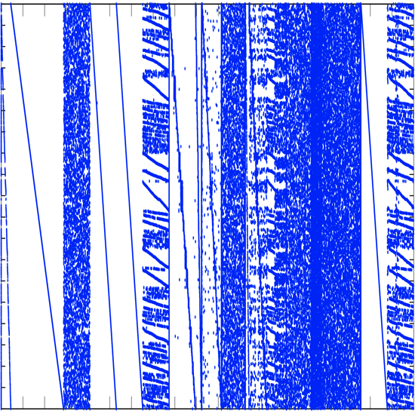
Common Big Data Architecture
- Data Variety: D4M Schema -
Operators
Analysts
Commanders
Users
D4M demonstrated a
universal approach to diverse data
columns
raw
Web
Ingest & Enrichment
Databases
Ingest & Enrichment
Ingest
Analytics
Files
rows
Scheduler
Computing
Σ
intel reports, DNA, health records, publication citations, web logs, social media, building alarms, cyber, … all handled by a common 4 table schema
Data
<html>
OSINT
Weather
HUMINT
C2
Ground
Maritime
Air
Space
Cyber
D4M 2.0 Schema: A General Purpose High Performance Schema for the Accumulo Database, Kepner et al, IEEE HPEC 2013
Notes:
Data variety require new schemas that allow data to be flexibly stored. D4M Schema provides a simple approach that has been validated on a wide range of data.
Image Sources:
Operators: http://en.wikipedia.org/wiki/Air_and_Space_Operations_Center
Analysts: © Comstock http://www.gettyimages.com/detail/photo/businessman-at-computer-royalty-free-image/78479774.
Commanders: US Forces Korea General News http://www.usfk.mil/usfk/%28A%28dL8DLge1ywEkAAAAYzg4NWY4MzMtM2I0OS00YWI5LTljYjctMWQ0NDM4MGUwYzVmgU4GPacw1yQ4-d8XCgyTu_0lbjQ1%29S%28aw5nfc45hpuvapn5pihn0o45%29%29/news.annual.command.post.exercise.winds.down.in.korea.printview.648
OSINT: Acrobat logo is © Adobe Systems Inc., © Twitter and Office 2011 logos are © Microsoft
Weather: © Rebecca van Ommen : http://www.gettyimages.com/detail/photo/paper-craft-weather-royalty-free-image/180478515
HUMINT: U.S. Dept of State http://www.rewardsforjustice.net/index.cfm?page=zulkifli&language=english
C2: http://www.disa.mil/Services/Command-and-Control/GCCS-J
Ground: Staff Sgt. William Tremblay/U.S. Army via Wired : http://www.wired.com/dangerroom/2010/09/afghan-biometric-dragnet-could-snag-millions/
Maritime: This file is a work of a sailor or employee of the U.S. Navy, taken or made as part of that person's official duties. As a work of the U.S. federal government, the image is in the public domain. http://en.wikipedia.org/wiki/File:USS_Lake_Champlain_%28CG-57%29.JPG
Air: This image or file is a work of a U.S. Air Force Airman or employee, taken or made as part of that person's official duties. As a work of the U.S. federal government, the image or file is in the public domain. http://en.wikipedia.org/wiki/File:MQ-9_Reaper_in_flight_%282007%29.jpg
Space: This file is in the public domain because it was solely created by NASA. NASA copyright policy states that "NASA material is not protected by copyright unless noted". http://en.wikipedia.org/wiki/File:CloudSat_-_Artist_Concept.jpg
Cyber: © derrrek : http://www.gettyimages.com/detail/illustration/abstract-backgrounds-royalty-free-illustration/185548379
This graphic was previously approved for public release as MS-77705

Slide 9
Graphulo.MIT.edu
- Data Variety: Graph Analytics -
Operators
Analysts
Commanders
Users
Open source library highlights
Accumulo’s inherent graph capabilities
columns
raw
Web
Ingest & Enrichment
Databases
Ingest & Enrichment
Ingest
Analytics
Files
rows
Scheduler
Computing
Σ
Data
<html>
OSINT
Weather
HUMINT
C2
Ground
Maritime
Air
Space
Cyber
Notes:
Data variety require new graph algorithms. Graphulo allows these algorithms to be built directly in Accumulo.
Image Sources:
Operators: http://en.wikipedia.org/wiki/Air_and_Space_Operations_Center
Analysts: © Comstock http://www.gettyimages.com/detail/photo/businessman-at-computer-royalty-free-image/78479774.
Commanders: US Forces Korea General News http://www.usfk.mil/usfk/%28A%28dL8DLge1ywEkAAAAYzg4NWY4MzMtM2I0OS00YWI5LTljYjctMWQ0NDM4MGUwYzVmgU4GPacw1yQ4-d8XCgyTu_0lbjQ1%29S%28aw5nfc45hpuvapn5pihn0o45%29%29/news.annual.command.post.exercise.winds.down.in.korea.printview.648
OSINT: Acrobat logo is © Adobe Systems Inc., © Twitter and Office 2011 logos are © Microsoft
Weather: © Rebecca van Ommen : http://www.gettyimages.com/detail/photo/paper-craft-weather-royalty-free-image/180478515
HUMINT: U.S. Dept of State http://www.rewardsforjustice.net/index.cfm?page=zulkifli&language=english
C2: http://www.disa.mil/Services/Command-and-Control/GCCS-J
Ground: Staff Sgt. William Tremblay/U.S. Army via Wired : http://www.wired.com/dangerroom/2010/09/afghan-biometric-dragnet-could-snag-millions/
Maritime: This file is a work of a sailor or employee of the U.S. Navy, taken or made as part of that person's official duties. As a work of the U.S. federal government, the image is in the public domain. http://en.wikipedia.org/wiki/File:USS_Lake_Champlain_%28CG-57%29.JPG
Air: This image or file is a work of a U.S. Air Force Airman or employee, taken or made as part of that person's official duties. As a work of the U.S. federal government, the image or file is in the public domain. http://en.wikipedia.org/wiki/File:MQ-9_Reaper_in_flight_%282007%29.jpg
Space: This file is in the public domain because it was solely created by NASA. NASA copyright policy states that "NASA material is not protected by copyright unless noted". http://en.wikipedia.org/wiki/File:CloudSat_-_Artist_Concept.jpg
Cyber: © derrrek : http://www.gettyimages.com/detail/illustration/abstract-backgrounds-royalty-free-illustration/185548379
This graphic was previously approved for public release as MS-77705

Slide 10


Common Big Data Architecture
- Data Veracity: Computing on Masked Data -
Operators
Analysts
Commanders
Users
Compute on Encrypted Data
Web
Compute on Encrypted Data
Ingest & Enrichment
Ingest & Enrichment
Databases
Ingest
Analytics
Compute on Encrypted Data
Files
Scheduler
Computing
Data
<html>
OSINT
Weather
HUMINT
C2
Ground
Maritime
Air
Space
Cyber
Data Encrypted
Computing on Masked Data: a High Performance Method for Improving Big Data Veracity, IEEE HPEC 2014
Data Unencrypted
Notes:
Maintain data veracity require new security techniques. Ideally, all data could be encrypted before it was stored and processed.
Image Sources:
Operators: http://en.wikipedia.org/wiki/Air_and_Space_Operations_Center
Analysts: © Comstock http://www.gettyimages.com/detail/photo/businessman-at-computer-royalty-free-image/78479774.
Commanders: US Forces Korea General News http://www.usfk.mil/usfk/%28A%28dL8DLge1ywEkAAAAYzg4NWY4MzMtM2I0OS00YWI5LTljYjctMWQ0NDM4MGUwYzVmgU4GPacw1yQ4-d8XCgyTu_0lbjQ1%29S%28aw5nfc45hpuvapn5pihn0o45%29%29/news.annual.command.post.exercise.winds.down.in.korea.printview.648
OSINT: Acrobat logo is © Adobe Systems Inc., © Twitter and Office 2011 logos are © Microsoft
Weather: © Rebecca van Ommen : http://www.gettyimages.com/detail/photo/paper-craft-weather-royalty-free-image/180478515
HUMINT: U.S. Dept of State http://www.rewardsforjustice.net/index.cfm?page=zulkifli&language=english
C2: http://www.disa.mil/Services/Command-and-Control/GCCS-J
Ground: Staff Sgt. William Tremblay/U.S. Army via Wired : http://www.wired.com/dangerroom/2010/09/afghan-biometric-dragnet-could-snag-millions/
Maritime: This file is a work of a sailor or employee of the U.S. Navy, taken or made as part of that person's official duties. As a work of the U.S. federal government, the image is in the public domain. http://en.wikipedia.org/wiki/File:USS_Lake_Champlain_%28CG-57%29.JPG
Air: This image or file is a work of a U.S. Air Force Airman or employee, taken or made as part of that person's official duties. As a work of the U.S. federal government, the image or file is in the public domain. http://en.wikipedia.org/wiki/File:MQ-9_Reaper_in_flight_%282007%29.jpg
Space: This file is in the public domain because it was solely created by NASA. NASA copyright policy states that "NASA material is not protected by copyright unless noted". http://en.wikipedia.org/wiki/File:CloudSat_-_Artist_Concept.jpg
Cyber: © derrrek : http://www.gettyimages.com/detail/illustration/abstract-backgrounds-royalty-free-illustration/185548379
This graphic was previously approved for public release as MS-77705

Slide 11
Outline
Introduction
  Volume, Velocity, Variety, Veracity
Big Data Storage APIs
  Lustre, Hadoop, Accumulo
Modeling Storage Performance
  Mix n’ Match Solutions
Summary
Notes:
Outline

Slide 12
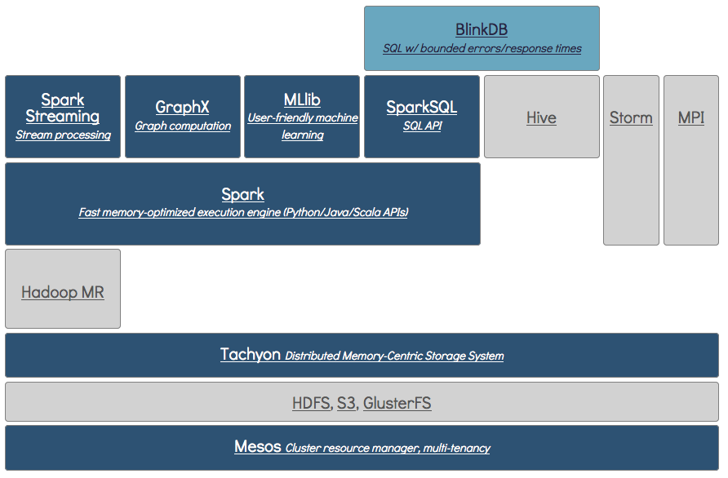
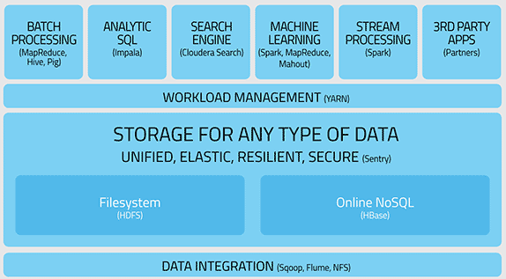

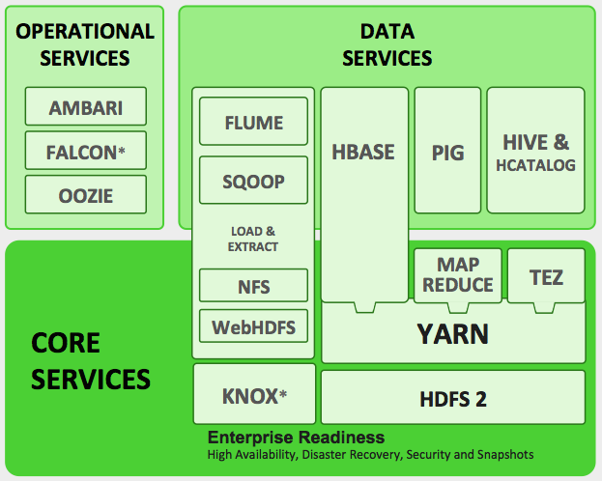


Example Big Data APIs and Megastacks
Operators
Berkeley
Analysts
Commanders
Users
Cloudera
Web
Ingest & Enrichment
Databases
Ingest & Enrichment
Ingest
Analytics
HortonWorks
Files
Scheduler
Computing
Data
<html>
OSINT
Weather
HUMINT
C2
Ground
Maritime
Air
Space
Cyber
Notes:
There are many large software stacks that are currently widely used in the Big Data community.
Image Sources:
Operators: http://en.wikipedia.org/wiki/Air_and_Space_Operations_Center
Analysts: © Comstock http://www.gettyimages.com/detail/photo/businessman-at-computer-royalty-free-image/78479774.
Commanders: US Forces Korea General News http://www.usfk.mil/usfk/%28A%28dL8DLge1ywEkAAAAYzg4NWY4MzMtM2I0OS00YWI5LTljYjctMWQ0NDM4MGUwYzVmgU4GPacw1yQ4-d8XCgyTu_0lbjQ1%29S%28aw5nfc45hpuvapn5pihn0o45%29%29/news.annual.command.post.exercise.winds.down.in.korea.printview.648
OSINT: Acrobat logo is © Adobe Systems Inc., © Twitter and Office 2011 logos are © Microsoft
Weather: © Rebecca van Ommen : http://www.gettyimages.com/detail/photo/paper-craft-weather-royalty-free-image/180478515
HUMINT: U.S. Dept of State http://www.rewardsforjustice.net/index.cfm?page=zulkifli&language=english
C2: http://www.disa.mil/Services/Command-and-Control/GCCS-J
Ground: Staff Sgt. William Tremblay/U.S. Army via Wired : http://www.wired.com/dangerroom/2010/09/afghan-biometric-dragnet-could-snag-millions/
Maritime: This file is a work of a sailor or employee of the U.S. Navy, taken or made as part of that person's official duties. As a work of the U.S. federal government, the image is in the public domain. http://en.wikipedia.org/wiki/File:USS_Lake_Champlain_%28CG-57%29.JPG
Air: This image or file is a work of a U.S. Air Force Airman or employee, taken or made as part of that person's official duties. As a work of the U.S. federal government, the image or file is in the public domain. http://en.wikipedia.org/wiki/File:MQ-9_Reaper_in_flight_%282007%29.jpg
Space: This file is in the public domain because it was solely created by NASA. NASA copyright policy states that "NASA material is not protected by copyright unless noted". http://en.wikipedia.org/wiki/File:CloudSat_-_Artist_Concept.jpg
Cyber: © derrrek : http://www.gettyimages.com/detail/illustration/abstract-backgrounds-royalty-free-illustration/185548379
This graphic was previously approved for public release as MS-77705

Slide 13


Example Big Data Database APIs
Operators
Analysts
Commanders
Users
Web
Ingest & Enrichment
Databases
Ingest & Enrichment
Ingest
Analytics
Files
Scheduler
Computing
Data
<html>
OSINT
Weather
HUMINT
C2
Ground
Maritime
Air
Space
Cyber
Notes:
Some of the more important Big Data Database APIs include Accumulo, SciDB, Graphulo, and D4M.
Image Sources:
Operators: http://en.wikipedia.org/wiki/Air_and_Space_Operations_Center
Analysts: © Comstock http://www.gettyimages.com/detail/photo/businessman-at-computer-royalty-free-image/78479774.
Commanders: US Forces Korea General News http://www.usfk.mil/usfk/%28A%28dL8DLge1ywEkAAAAYzg4NWY4MzMtM2I0OS00YWI5LTljYjctMWQ0NDM4MGUwYzVmgU4GPacw1yQ4-d8XCgyTu_0lbjQ1%29S%28aw5nfc45hpuvapn5pihn0o45%29%29/news.annual.command.post.exercise.winds.down.in.korea.printview.648
OSINT: Acrobat logo is © Adobe Systems Inc., © Twitter and Office 2011 logos are © Microsoft
Weather: © Rebecca van Ommen : http://www.gettyimages.com/detail/photo/paper-craft-weather-royalty-free-image/180478515
HUMINT: U.S. Dept of State http://www.rewardsforjustice.net/index.cfm?page=zulkifli&language=english
C2: http://www.disa.mil/Services/Command-and-Control/GCCS-J
Ground: Staff Sgt. William Tremblay/U.S. Army via Wired : http://www.wired.com/dangerroom/2010/09/afghan-biometric-dragnet-could-snag-millions/
Maritime: This file is a work of a sailor or employee of the U.S. Navy, taken or made as part of that person's official duties. As a work of the U.S. federal government, the image is in the public domain. http://en.wikipedia.org/wiki/File:USS_Lake_Champlain_%28CG-57%29.JPG
Air: This image or file is a work of a U.S. Air Force Airman or employee, taken or made as part of that person's official duties. As a work of the U.S. federal government, the image or file is in the public domain. http://en.wikipedia.org/wiki/File:MQ-9_Reaper_in_flight_%282007%29.jpg
Space: This file is in the public domain because it was solely created by NASA. NASA copyright policy states that "NASA material is not protected by copyright unless noted". http://en.wikipedia.org/wiki/File:CloudSat_-_Artist_Concept.jpg
Cyber: © derrrek : http://www.gettyimages.com/detail/illustration/abstract-backgrounds-royalty-free-illustration/185548379
This graphic was previously approved for public release as MS-77705

Slide 14



Example Supercomputing APIs
Operators
Analysts
Commanders
Users
Web
Ingest & Enrichment
Databases
Ingest & Enrichment
Ingest
Analytics
Files
Scheduler
Computing
Data
<html>
OSINT
Weather
HUMINT
C2
Ground
Maritime
Air
Space
Cyber
Notes:
Supercomputing systems have a small number of highly scalable APIs.
Image Sources:
Operators: http://en.wikipedia.org/wiki/Air_and_Space_Operations_Center
Analysts: © Comstock http://www.gettyimages.com/detail/photo/businessman-at-computer-royalty-free-image/78479774.
Commanders: US Forces Korea General News http://www.usfk.mil/usfk/%28A%28dL8DLge1ywEkAAAAYzg4NWY4MzMtM2I0OS00YWI5LTljYjctMWQ0NDM4MGUwYzVmgU4GPacw1yQ4-d8XCgyTu_0lbjQ1%29S%28aw5nfc45hpuvapn5pihn0o45%29%29/news.annual.command.post.exercise.winds.down.in.korea.printview.648
OSINT: Acrobat logo is © Adobe Systems Inc., © Twitter and Office 2011 logos are © Microsoft
Weather: © Rebecca van Ommen : http://www.gettyimages.com/detail/photo/paper-craft-weather-royalty-free-image/180478515
HUMINT: U.S. Dept of State http://www.rewardsforjustice.net/index.cfm?page=zulkifli&language=english
C2: http://www.disa.mil/Services/Command-and-Control/GCCS-J
Ground: Staff Sgt. William Tremblay/U.S. Army via Wired : http://www.wired.com/dangerroom/2010/09/afghan-biometric-dragnet-could-snag-millions/
Maritime: This file is a work of a sailor or employee of the U.S. Navy, taken or made as part of that person's official duties. As a work of the U.S. federal government, the image is in the public domain. http://en.wikipedia.org/wiki/File:USS_Lake_Champlain_%28CG-57%29.JPG
Air: This image or file is a work of a U.S. Air Force Airman or employee, taken or made as part of that person's official duties. As a work of the U.S. federal government, the image or file is in the public domain. http://en.wikipedia.org/wiki/File:MQ-9_Reaper_in_flight_%282007%29.jpg
Space: This file is in the public domain because it was solely created by NASA. NASA copyright policy states that "NASA material is not protected by copyright unless noted". http://en.wikipedia.org/wiki/File:CloudSat_-_Artist_Concept.jpg
Cyber: © derrrek : http://www.gettyimages.com/detail/illustration/abstract-backgrounds-royalty-free-illustration/185548379
This graphic was previously approved for public release as MS-77705

Slide 15
Lustre Parallel File System
High performance general purpose file system
Uses standard RAID for redundancy
Supports any parallel programming model
Notes:
The Luster parallel file system consists of tow main components: a metadata server and an object storage server.

Slide 16
Hadoop Distribute File System (HDFS)
Special purpose file system
Uses replication for redundancy (typically 3x)
Java map/reduce programming model
Notes:
The Hadoop distributed file systems consists of two main components: a name node server and data nodes.

Slide 17

Accumulo Database
tablet server
Accumulo clients
Tablet
Tablet
Tablet
sub graph
Tablet
Base Graph
tablet
High performance parallel database
Uses Hadoop as its file system
Notes:
The Accumulo database uses Hadoop to store its data.

Slide 18
Outline
Introduction
  Volume, Velocity, Variety, Veracity
Big Data Storage APIs
  Lustre, Hadoop, Accumulo
Modeling Storage Performance
  Mix n’ Match Solutions
Summary
Notes:
Outline

Slide 19
How to Compare Storage
Full-scale head-to-head comparison of Big Data Storage systems is expensive and time-consuming
Much can be learned from simple systems analysis
Model System Parameters
n_{c} = 100 Number of compute nodes
B_{c} = 1 GB/sec Compute node network link
n_{s} = 10 Number of central servers
B_{s} = 4 GB/s Central server network link
n_{d} = 1000 Number of disks in systems
V_{d} = 6 TB Disk capacity
B_{d} = 0.1 GB/sec Disk I/O
Notes:
Simple systems analysis can be an effective way to compare different storage systems.

Slide 20
Storage Capacity
Lustre
  100 x 6 TB x (0.66 RAID) = 4 PB
Hadoop
  100 x 6 TB x (0.33 Redundancy) = 2 PB
Accumulo on Hadoop
  Same as Hadoop
Notes:
Storage capacity of Lustre, Hadoop, and Accumulo on the same technology.

Slide 21
3 Disk Failure Data Loss Probability
Lustre
  P₃ ≈ (n_{d} P₁)³ / 100
  where
  P₃ = probability that 3 drives fail in the same OSS
  P₁ = probability that a single drive fails
Hadoop
  P₃ ≈ (n_{d} P₁)³
  where
  P₃ = probability that 3 drives fail
  P₁ = probability that a single drive fails
Accumulo on Hadoop
  Same as Hadoop
Notes:
Probability of data loss for Lustre, Hadoop, and Accumulo on the same technology.

Slide 22
Peak Read/Write Performance
Lustre
  B⁻¹ = (n_{c} B_{c})⁻¹ + (B_{n})⁻¹ + (n_{s} B_{s})⁻¹ + (n_{d} B_{d})⁻¹
  B = 22 GB/sec
Hadoop
  B_{write} = min(n_{c},n_{d})B_{d}/R = 33 GB/sec
  B_{read} = min(n_{c},n_{d})B_{d}/(1 + r) = 100 GB/sec (perfect load balancing)
Accumulo on Hadoop
  B = 30 MB/s n_{c} = 3 GB/sec
Notes:
Peak I/O of Lustre, Hadoop, and Accumulo on the same technology.

Slide 23
Capability Estimate Summary
 | Lustre | Hadoop | Acummulo
Raw capacity | 6 PB | 6 PB | 6 PB
Usable capacity | 4 PB | 2 PB | 2 PB
3 Drive data loss probability | (n_{d} P_{1fail})³ / 100 | (n_{d} P_{1fail})³ | (n_{d} P_{1fail})³
Peak write | 22 GB/s | 33 GB/s | 3 GB/s
Peak read | 23 GB/s | 100 GB/s | 3 GB/s
Find any string | 1 day | 3 hours | 50 msec
Simple model allows estimates of Lustre, Hadoop, and Accumulo capabilites for a “common” system consisting of
  100 compute nodes, 1 GB/s links, and 1000 6TB disks
Notes:
Summary of different capability estimates for Lustre, Hadoop, and Accumulo.

Slide 24
Mix n’ Match 1:
Hadoop/Accumulo on Lustre
Hadoop Map/Reduce is popular
  Many applications
  Strong commercial interest in Lustre community¹⁻⁶
Principal benefits
  Better $/byte
  Better reliability
  Support Map/Reduce and other applications
Principal challenge
  Accumulo tolerance to MDS load (actively being worked⁷)
file
metadata: filename, permissions, …
metadata server (MDS)
object: 01011010110 …
object
storage
server
(OSS)
file
metadata: filename, replicas, …
name node
object: 01011010110 …
data node
data node
data node
tablet server
Accumulo clients
¹Map/Reduce on Lustre: Hadoop Hadoop Performance in HPC Environments, Rutman, Xyratex, 2011
²Hadoop MapReduce over Lustre, Kulkarni, Lustre User’s Group, 2013
³Modernizing Hadoop Architecture for Superior Scalability, Efficiency & Productive Throughput, DDN, 2013
⁴System Fabric Works Lustre Solutions for Hadoop Storage, 2014
⁵Inside the Hadoop Workflow Accelerator, Seagate, 2014
⁶Lustre Hadoop Plugin, Seagate, 2015
⁷A Guide to Running Accumulo in a VM Environment, Fuchs, 2015
Tablet
Tablet
Tablet
sub graph
Tablet
Base Graph
tablet
Notes:
Many technologies attempt to Hadoop/Accumulo on the Lustre file system.

Slide 25
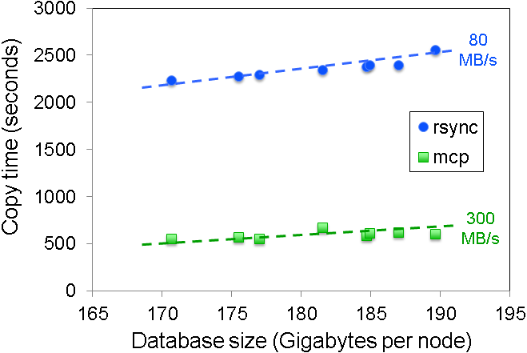
Mix n’ Match 2:
Accumulo Checkpoint on Lustre
Use Lustre to backup Accumulo
  Launch on Hadoop as needed
Principal benefits
  Start, stop, checkpoint, clone, migrate, restart an arbitrary number of Accumulo instances
  Can develop at scale
  Dynamic migration
file
metadata: filename, permissions, …
metadata server (MDS)
object: 01011010110 …
object
storage
server
(OSS)
file
metadata: filename, replicas, …
name node
object: 01011010110 …
data node
⇒ 100 node 100 TB Accumulo migration in ~1 hour
data node
node
data node
tablet server
Accumulo clients
node
Tablet
Tablet
Tablet
sub graph
Tablet
Base Graph
tablet
Prout et al, “Enabling On-Demand Database Computing with MIT SuperCloud Database Management System,” IEEE HPEC 2015.
Notes:
Accumulo can be checkpointed onto Lustre.

Slide 26
Mix n’ Match 3:
Lustre Metadata in Accumulo
Lustre systems can easily have 100M+ files
  Metadata is difficult to analyze
Accumulo can easily ingest this this metadata
  Ingested metadata on 50M files in ~3 hours on a single Accumulo node
  Complex metadata queries in minutes instead of days (“show all users who created over 100 50MB files in March”)
file
metadata: filename, permissions, …
metadata server (MDS)
object: 01011010110 …
object
storage
server
(OSS)
file
metadata: filename, replicas, …
name node
object: 01011010110 …
data node
data node
data node
tablet server
Accumulo clients
Tablet
Tablet
Tablet
sub graph
Tablet
Base Graph
tablet
Notes:
Inserting Lustre metadata into Accumulo could be an effective way to query Lustre metadata.

Slide 27
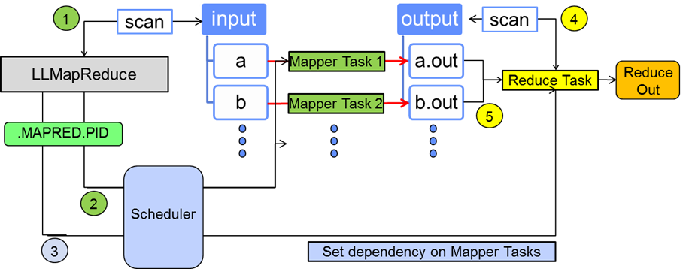
Mix n’ Match 4:
Map/Reduce on Lustre
LLMapReduce wraps schedulers (SGE, SLURM, …) in familiar Map/Reduce syntax
Supports all languages
No changes to user program
Scales to 1000s of cores
  In production use for 3 years
Readily accepted by Java & Python Map/Reduce users
3 Files, 300 lines of Python, can run/install user space
file
metadata: filename, permissions, …
metadata server (MDS)
object: 01011010110 …
object
storage
server
(OSS)
Parallel computing in 1 line of code; no change to user program
  LLMapReduce --input input --output output --mapper Mapper
Byun et al, “Portable Map-Reduce Utility for MIT SuperCloud Enviornment,” IEEE HPEC 2015.
Notes:
The Hadoop map/reduce programming model can be easily implemented on Lustre.

Slide 28
Summary
Storage systems are a critical part of Big Data systems
Lustre, Hadoop, and Accumulo are three important storage technologies
Full-scale head-to-head comparison of Big Data Storage systems is expensive and time-consuming
Much can be learned from simple systems analysis
Notes:
Summary

