Slide 1

GPU Implementation of Reverse Coordinate Conversion for Proteins
Authors:
Mahsa Bayati
Northeastern University, ECE Dep.
Miriam Leeser
Northeastern University, ECE Dep.
Jaydeep P. Bardhan
Northeastern University, MIE Dep.

Slide 2
Outline
Why Protein Coordinate Conversion?
Background and Internal Coordinates
Internal to Cartesian Implementations
Reverse Conversion Results
Conclusions & Future Work

Slide 3
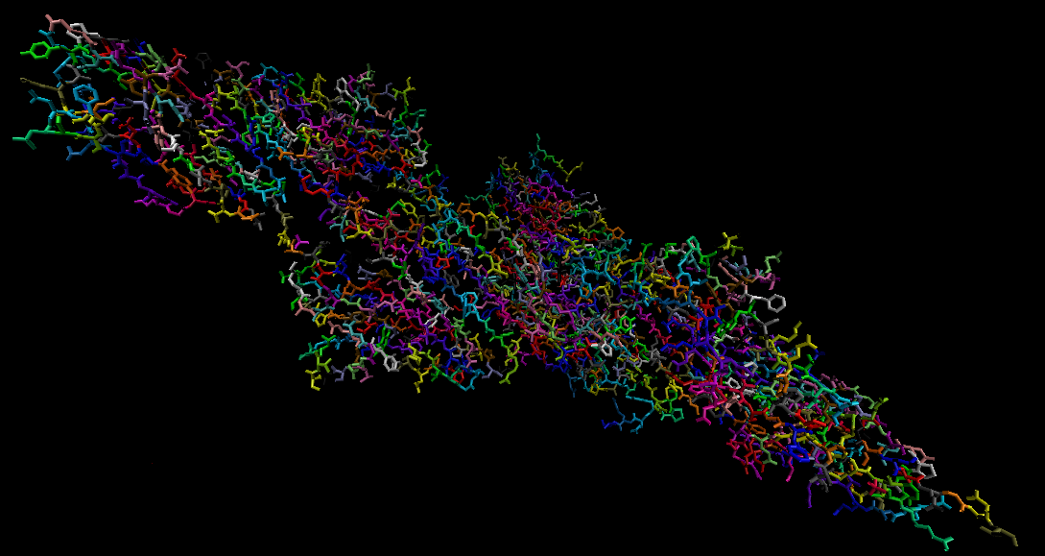
Why Protein Coordinate Conversion?
Large protein complexes millions of atoms, thousands of amino acids
Titin muscle protein : 539022 atoms, 27000 amino acids
Only part of Titin

Slide 4
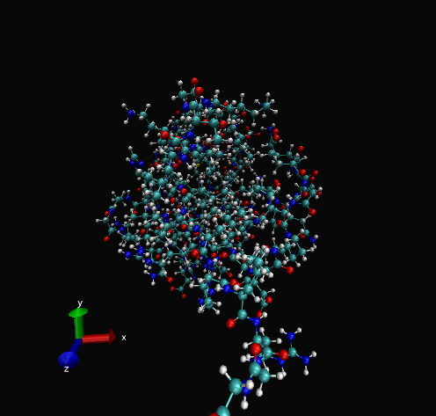
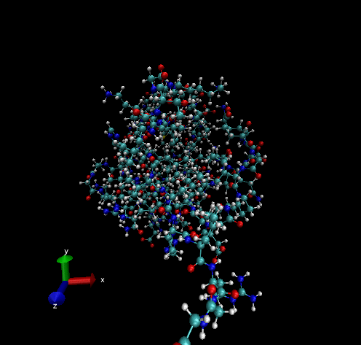
Why Protein Coordinate Conversion?
Proteins move in time
Thermal motion
Atomic charges
Influence of water and surrounding ions
Large amount of structural data
Notes:
Movement in time and changing in places in time frames

Slide 5
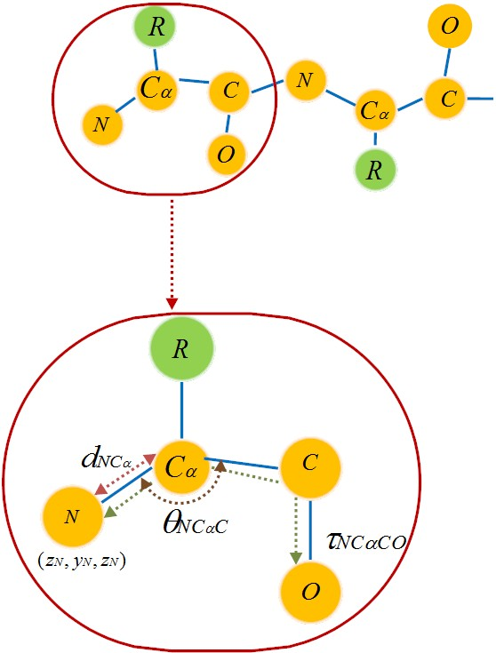
Why Protein Coordinate Conversion?
Methods of atom position representation
    Cartesian Internal
Reverse application
  Protein engineering
  Fitting atomic structure to
experimental data
Reverse
R denotes the side chain
Forward

Slide 6
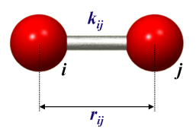
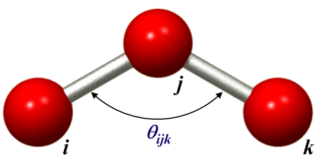
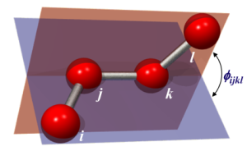
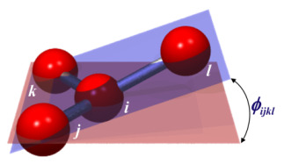

Internal Coordinates
Bond distance
  $${BondDistance}_{i,j}=\sqrt{{(X_{j}^{}−X_{i}^{})}^{2}+{(y_{j}^{}−y_{i}^{})}^{2}+{(Z_{j}^{}−Z_{i}^{})}^{2}}$$
Angle
  ${cosθ}_{ijk}=\frac{r_{ij}{∙r}_{jk}}{\left|r_{ji}\right|∙\left|r_{jk}\right|}$
Dihedral
Proper Dihedral
Improper Dihedral

Slide 7
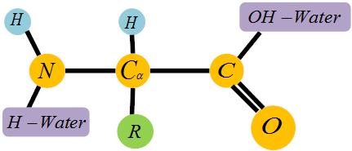
































Internal to Cartesian Implementation
Amino acid
$$O$$
$$O$$
$$O$$
(0,0,0)
$$O$$
Serial
$$N$$
$$C$$
$$N$$
$$C$$
...
$$N$$
$$C$$
$$N$$
$$C$$
$${ C}_{α}$$
$${ C}_{α}$$
$${ C}_{α}$$
$${ C}_{α}$$
(0,0,0)
$$O$$
$$O$$
$$O$$
(0,0,0)
(0,0,0)
(0,0,0)
$$O$$
Parallel
$$N$$
$$C$$
$$N$$
$$C$$
...
$$N$$
$$C$$
$$N$$
$$C$$
$${ C}_{α}$$
$${ C}_{α}$$
$${ C}_{α}$$
$${ C}_{α}$$
7

Slide 8





















Local Cartesian Coordinates
$$R_{0}$$
$$R_{1}$$
$$R_{2}$$
$$R_{3}$$
$$O$$
$$O$$
$$O$$
$$O$$
(0,0,0)
(0,0,0)
(0,0,0)
(0,0,0)
...
$$N$$
$$C$$
$$N$$
$$C$$
$$N$$
$$C$$
$$N$$
$$C$$
$${ C}_{α}$$
$${ C}_{α}$$
$${ C}_{α}$$
$${ C}_{α}$$
Assume “N” the origin of each residue : (0, 0, 0)
Based on ${NC}_{α}$bond calculate $C_{α}:$(bond ${NC}_{α}$ , 0, 0)
Using ${NC}_{α}C$ angle and ${NC}_{α}$, $C_{α}C$ bond
C: (${NC}_{α}×\cos{(π}{−{NC}_{α}C), C}_{α}C×\sin{(π−{NC}_{α}C)}$, 0)
Compute the position of “O” using dihedral angle:
O(x, y, z)= FindxyzUsingDihedral (${NC}_{α}CO$)
8

Slide 9


























































Merge and Reduce
$$O$$
$$O$$
$$O$$
$$O$$
(0,0,0)
(0,0,0)
(0,0,0)
(0,0,0)
$$N$$
$$C$$
$$N$$
$$C$$
$$N$$
$$C$$
$$N$$
$$C$$
$$R_{0}$$
$$R_{1}$$
$$R_{2}$$
$$R_{3}$$
$${ C}_{α}$$
$${ C}_{α}$$
$${ C}_{α}$$
$$h=0$$
$${ C}_{α}$$
$$O$$
$$O$$
$$O$$
$$O$$
(0,0,0)
(0,0,0)
$$N$$
$$C$$
$$N$$
$$C$$
$$C$$
$$N$$
$$C$$
$$h=1$$
$$R_{0}−R_{1}$$
$$R_{2}−R_{3}$$
$$N$$
$${ C}_{α}$$
$${ C}_{α}$$
$${ C}_{α}$$
$${ C}_{α}$$
$$O$$
$$O$$
$$O$$
$$O$$
(0,0,0)
$$h=2$$
$$R_{0}−R_{1}−R_{2}{−R}_{3}$$
$$N$$
$$C$$
$$N$$
$$C$$
$$N$$
$$C$$
$$N$$
$$C$$
$${ C}_{α}$$
$${ C}_{α}$$
$${ C}_{α}$$
$${ C}_{α}$$
9

Slide 10

















Merge and Reduce
$$h=0$$
$$S_{0}^{0}$$
$$S_{1}^{0}$$
$$S_{2}^{0}$$
$$S_{3}^{0}$$
$$S_{4}^{0}$$
$$S_{5}^{0}$$
$$S_{6}^{0}$$
$$S_{7}^{0}$$
$$h=1$$
$$S_{0}^{0 to 1}$$
$$S_{1}^{0 to 1}$$
$$S_{2}^{0 to 1}$$
$$S_{3}^{0 to 1}$$
$$h=2$$
$$S_{0}^{0 to 3}$$
$$S_{1}^{0 to 3}$$
$$S_{0}^{0 to 7}$$
$$h=3$$
10

Slide 11
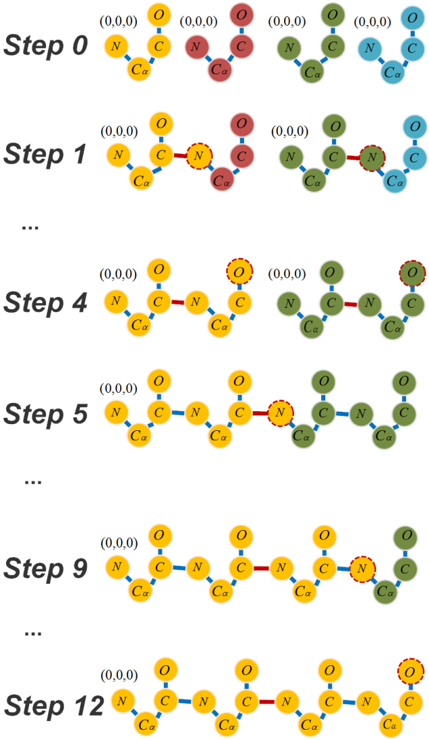
Naïve Algorithm
Merge and reduce
local coordinate spaces
Time complexity: O(n)
n : number of residues

Slide 12
Our solution solves this dependency
using transformation matrixes

Slide 13
















































Merge and Transformation Matrix
$$O$$
$$O$$
$$O$$
$$O$$
...
(0,0,0)
...
$$N$$
$$C$$
$$N$$
$$C$$
$$C$$
$$N$$
$$C$$
$$N$$
$${ C}_{α}$$
$${ C}_{α}$$
$${ C}_{α}$$
$${ C}_{α}$$
$$O$$
$$O$$
$$O$$
$$O$$
...
(0,0,0)
$$N$$
$$C$$
...
$$N$$
$$C$$
$$N$$
$$C$$
$$N$$
$$C$$
$${ C}_{α}$$
$${ C}_{α}$$
$${ C}_{α}$$
$${ C}_{α}$$
$$O$$
$$O$$
$$O$$
$$O$$
...
...
$$N$$
$$C$$
$$N$$
$$C$$
$$C$$
$$C$$
$$N$$
$$N$$
$${ C}_{α}$$
$${ C}_{α}$$
$${ C}_{α}$$
$${ C}_{α}$$
Find transformation matrix
13

Slide 14

























Merge and Transformation Matrix
$$h$$
$$S_{0}^{0−3}$$
$$S_{1}^{0−3}$$
$$S_{0}^{0}−S_{0}^{3}$$
$${… S}_{0}^{3}$$
$$S_{0}^{0}−S_{0}^{7}$$
$$h+1$$
$$S_{0}^{0}−S_{0}^{15}$$
$$h+2$$
$$O$$
$$O$$
$$O$$
$$O$$
...
...
$$N$$
$$C$$
$$N$$
$$C$$
$$C$$
$$C$$
$$N$$
$$N$$
$${ C}_{α}$$
$${ C}_{α}$$
$${ C}_{α}$$
$${ C}_{α}$$
Apply transformation matrix
14

Slide 15

























Transformation Matrix
$$h=0$$
$$T_{0}$$
$$T_{1}$$
$$T_{2}$$
$$T_{3}$$
$$T_{4}$$
$$T_{5}$$
$$T_{6}$$
$$T_{7}$$
$$S_{0}^{0}−S_{0}^{3}$$
$$S_{1}^{0}−S_{1}^{3}$$
$$h=2$$
$$h=1$$
$$T_{01}$$
$$T_{23}$$
$$T_{45}$$
$$T_{67}$$
$$h=2$$
$$T_{02}$$
$$T_{46}$$
$$T_{04}$$
$$h=3$$
$$S_{0}^{0}−S_{0}^{3}$$
$S_{0}^{4}$ …
$$h=3$$
Data structure to save transformation matrix with one entry for each residue
In each merge save and modify the matrix of the first merging residue

Slide 16





























Global Cartesian Coordinate
$$h=0$$
$$T_{0}$$
$$T_{1}$$
$$T_{2}$$
$$T_{3}$$
$$T_{4}$$
$$T_{5}$$
$$T_{6}$$
$$T_{7}$$
$$S_{0}^{0}$$
$$S_{1}^{0}$$
$$S_{2}^{0}$$
$$S_{3}^{0}$$
$$S_{4}^{0}$$
$$S_{5}^{0}$$
$$S_{6}^{0}$$
$$S_{7}^{0}$$
$$S_{0}^{0 to 1}$$
$$S_{1}^{0 to 1}$$
$$S_{2}^{0 to 1}$$
$$S_{3}^{0 to 1}$$
$$h=1$$
$$T_{01}$$
$$T_{23}$$
$$T_{45}$$
$$T_{67}$$
$$h=2$$
$$T_{02}$$
$$T_{46}$$
$$S_{0}^{0 to 3}$$
$$S_{1}^{0 to 3}$$
$$h=3$$
$$T_{04}$$
$$S_{0}^{0 to 7}$$
In each level of the tree, find the segment the residue belongs to
If on the second half of the segment apply the transformation matrix
16

Slide 17
Implementation Overview
Naïve Algorithm
Merge and reduce
local coordinate spaces
Time complexity: O(n)
n : number of residues

Slide 18
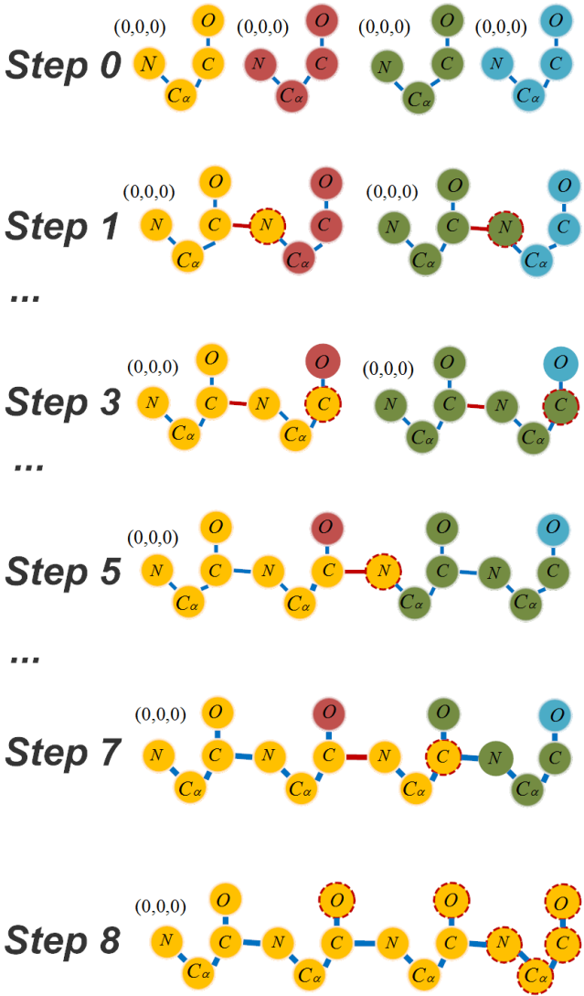
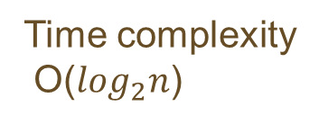
Implementation Overview
Local coordinates
Time complexity
O($\log_{2}n$)
Find transformation matrices
Apply transformation matrices
Calculate global cartesian

Slide 19
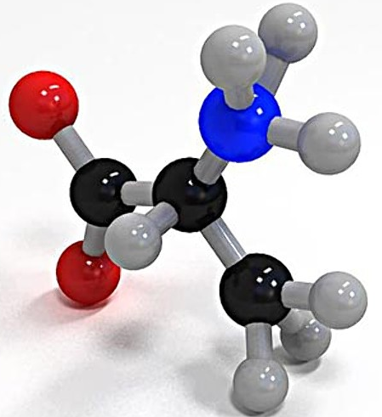
Reverse Conversion Results
Architecture:
  CPU-Intel Xeon Sandy Bridge processor with 6 cores
  GPU-NVIDIA Tesla K-20m (Kepler): 448 cores and 14 streaming processors
Test Cases:
  LDH (Lactic DeHydrogenase)
  Use VMD¹ to calculate internal coordinates
  Chain of Alanine residues
H
H
O
N
H
C
C
H
O
C
No. of Atoms LDH | 28589
No. of Atoms LDH (one chain) | 2568
No. Atoms alanine-100 | 1003
No. Atoms alanine-500 | 5003
No. Atoms alanine-1000 | 10003
H
H
H
Alanine
19

Slide 20
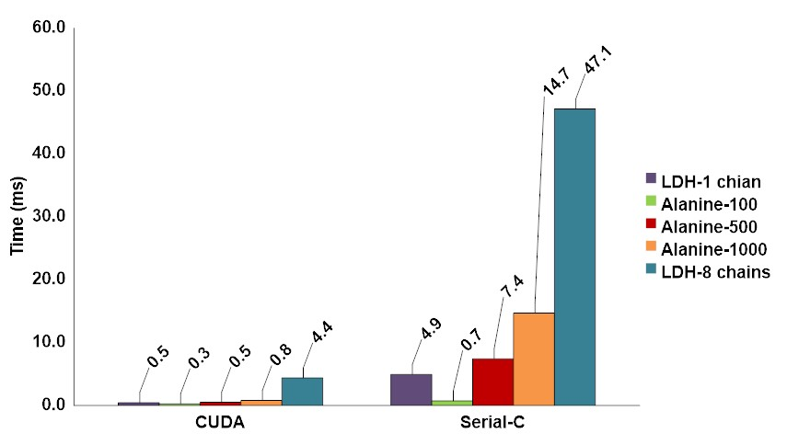
Reverse Conversion Results
Reverse Conversion Timing results (ms)
10-18x

Slide 21
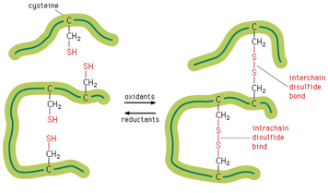
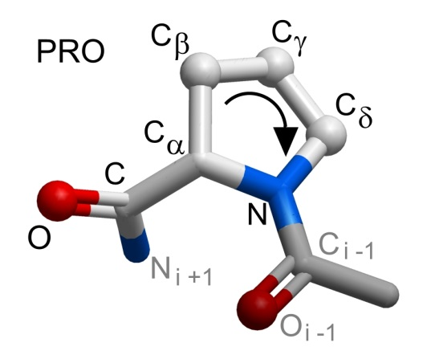
Future Work
  Side chains
  Backbone with loops
    Proline
    Disulfide bonds
  Larger proteins

Slide 22
Conclusions
Reverse protein coordinate conversion is useful computation
Current implementations walk over the protein chain serially
Ours is the first parallel method for reverse conversion
Reversed conversion using CUDA achieved 10-18x speedup compared to sequential-C implementation

Slide 23


Thank You!
Mahsa Bayati:
bayati.m@husky.neu.edu
http://www.coe.neu.edu/Research/rcl/index.php
Acknowledgments
National Institute of General Medical Sciences (R21GM102642).
National Science Foundation, under award number CCF-1218075.

Slide 24
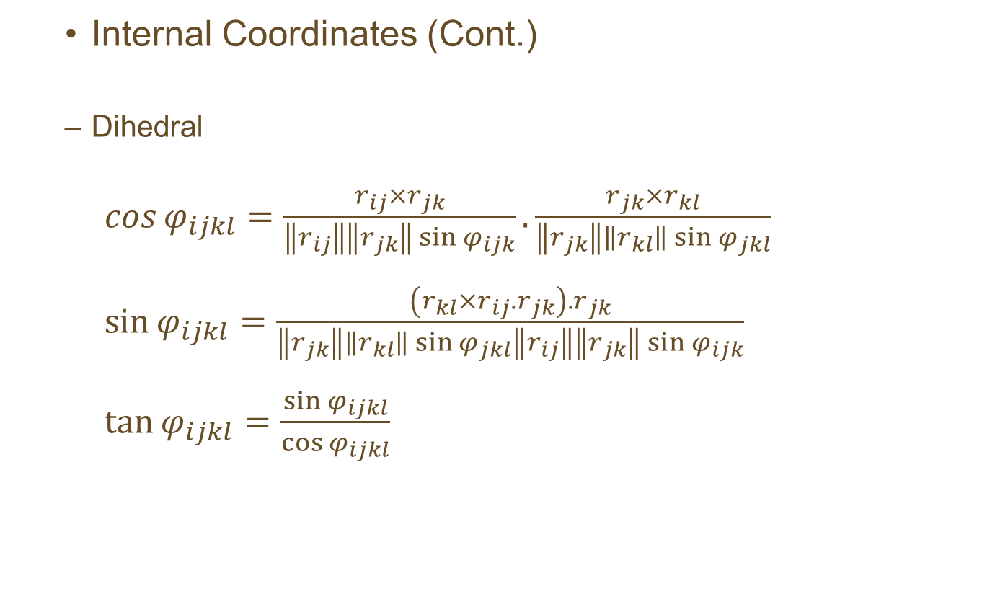
Background and Computation
  Internal Coordinates (Cont.)
  Dihedral
  $\cos{φ_{ijkl}=\frac{r_{ij}×r_{jk}}{\left\|r_{ij}\right\|\left\|r_{jk}\right\|\sin{φ_{ijk}}}.\frac{r_{jk}×r_{kl}}{\left\|r_{jk}\right\|\left\|r_{kl}\right\|\sin{φ_{jkl}}} }$
  $\sin{φ_{ijkl}=\frac{\left(r_{kl}×r_{ij}.r_{jk}\right).r_{jk}}{\left\|r_{jk}\right\|\left\|r_{kl}\right\|\sin{φ_{jkl}}\left\|r_{ij}\right\|\left\|r_{jk}\right\|\sin{φ_{ijk}}}}$
  $\tan{φ_{ijkl}}=\frac{\sin{φ_{ijkl}}}{\cos{φ_{ijkl}}}$

Slide 25
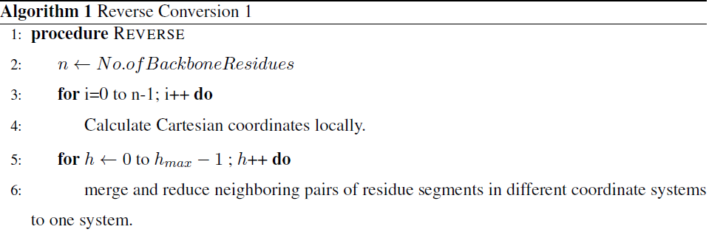

$$h_{max}=\left\lceil \log_{2}{n}\right\rceil$$

Slide 26
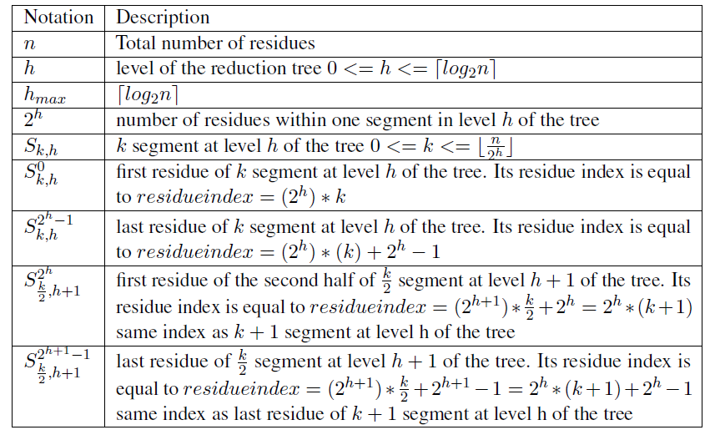

Slide 27
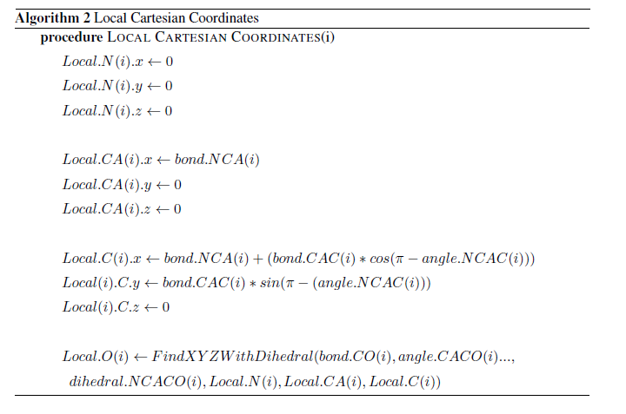

Slide 28
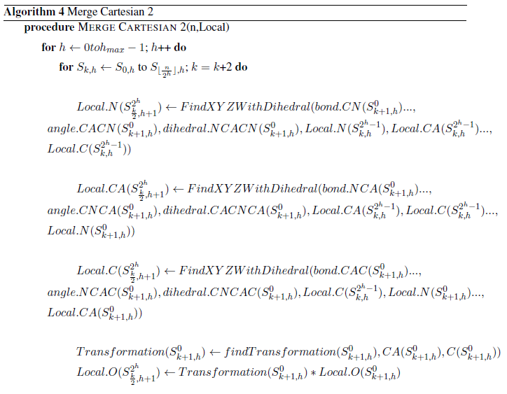

Slide 29
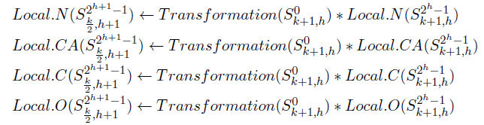
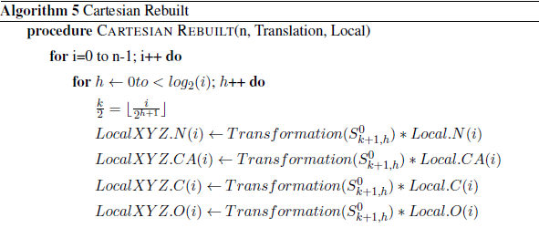

Slide 30
